Slide 1




ZAPF 49TH ANNUAL CONGRESS
Presented by C.T Munjoma
17 May 2024

Slide 2


Presentation Outline
1
IPEC Organisation Capacity and Image
2
Improving Pension Benefits
3
Improved industry compliance
4
Improved Industry Resilience and Soundness
5
Improved Industry Growth

Slide 3




Improved Organisational Capacity and Image
IPEC’s performance Assessment by CGU
Active participation in regional & international bodies
Delays in submissions of return resulting in delays in production of industry reports
Procurement of Electronic Supervisory System—interconnectedness with industry systems

Slide 4


Improved Pension and Insurance Benefits
Benefits tracking as part of member outcome assessment
Continued use of the bread index
Funds urged to have benefits tracking as a boardroom agenda
Benefits not meeting reasonable expectations
Call for objective assessment of the value chain

Slide 5

Low Benefits – Value Chain Assessment
Legacy factors and obtaining macroeconomic fundamentals
Pension Fund Design - adequacy of contributions
Investment performance – performance benchmarks for asset managers
Product Relevance – Nominal guarantees, level annuities
Relevance of administration models
Partial withdrawals on job switching
weak corporate governance – capacity of BOFs

Slide 6

Reforms to Improve Benefits
Legal reforms to close gaps
Review of existing products – exposure limits to Deposit Administration Schemes
Ring-fencing of assets – asset separation
Consolidation of smaller funds for economies of scale
Expense Framework

Slide 7

Reforms to Improve Benefits….
Engagement with labour and employers on adequacy of contributions
Review of investment guidelines – alternative and offshore investments
Investment performance – new asset creation & performance benchmarks for asset managers

Slide 8
Improved Industry Compliance
31 Mar deadline for 2023 Annual reports missed
Call for timeous filing of returns
Non-remission of unclaimed benefits to the Guardian Fund.
Attainment of COPs and proper constitution of BOFs.
Board meetings and AGMs.
Compliance with the Expenses Framework critical.
Timeous remission of contributions.

Slide 9
Prescribed Asset Compliance
Sector | Total Amount Conferred (Millions US$) | Total uptake (Millions US$) | Uptake by the Insurance and Pensions (Millions US$)
Other | 197.87 | 33.18 | 20.89
Agriculture | 897.36 | 178.77 | 103.17
Road and sewer | 8.20 | 4.70 | 4.70
Student Accommodation | 101.80 | - | -
Stands Servicing | 2.72 | 1.05 | 1.05
Shopping malls | 507.98 | 32.22 | 4.97
Mining | 72.80 | 11.10 | 11.10
Energy Infrastructure | 677.95 | 491.13 | 299.13
Housing Construction | 2,279.01 | 692.82 | 689.16
Hotel Construction | 250.00 | 388.33 | 1.25
Hospitals | 143.34 | 33.30 | 19.36
Total | 5,139.02 | 1,866.59 | 1,154.78
Call for profiling industry investments in PAs
Too many projects chasing few contributions & investible income
Call for coinvesting for greater impact
Industry to invest in bankable PAs to ensure compliance
BOFs to develop Project monitoring capacity

Slide 10
Improved Industry Soundness and Resilience
Consolidation of smaller funds to manage costs.
Liquidation of Contribution arrears.
Amortisation of Actuarial deficits in DB funds.
Some funds facing liquidity challenges – staggering of benefits.
Unpaid contributions to reflect in Sponsoring Employer fin stats.
Adoption of locally developed mortality tables

Slide 11

Guideline on 2024 Currency Reforms
Guideline issued to industry to convert assets and liabilities from ZWL to ZIG
Basis
  S.I. 60 of 2024 “Presidential Powers (Temporary Measures) (Zimbabwe Gold Notes and Coins) Regulation, 2024
  Section 48 of Pensions and Provident Funds Act
  Section 3 of S.I. 169 of 2020
  Justice Smith Commission of Inquiry Report
Objective
Standardise the conversion process and avoid repeat of 2009

Slide 12
Guideline on 2024 Currency Reforms…
Requirements
Conversion of assets and liabilities on the 5th of April 2024
Submission of conversion report as at 5 April 2024
  30 June 2024 – Internal Assessments
  31 August 2024 – reviewed by statutory actuaries
Submission of auditable financial statements (Internal) – 30 June
Submission of audited financials by 31 August – Jan to 5 April and 5 April to 30 June
Requirements on sub-accounts – A & B
Reserving for different classes of business
Reporting

Slide 13



Improved Industry Growth

Slide 14
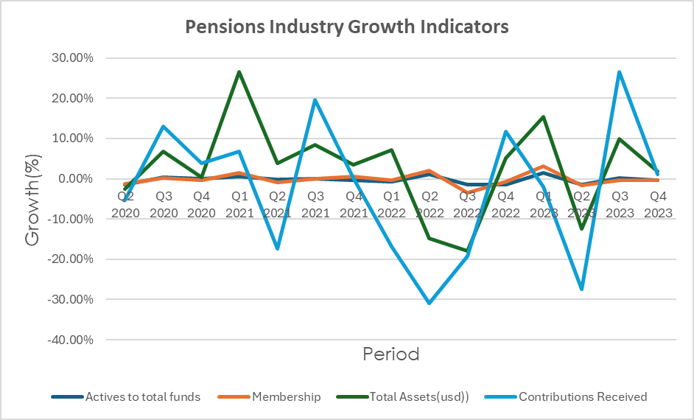
Key Highlights on Growth Trend
Presiding over a shrinking industry
Pensions industry Assets are declining.
Declining number of active pension schemes now above 50% of all schemes.
Fall in contributions from a peak of US$220m to US$125
Partial withdrawals due to increased job switching affecting accumulation.
Low consumer confidence
Industry growth constrained if legacy issues are not resolved

Slide 15

Envisaged Reforms for Growth
Macroeconomic stability and growth
Holistic review of the national pension system – private and public sector
National dialogue on pension reforms involving all stakeholders
Benchmarking with countries that have experience hyperinflation
Regulatory and supervisory reforms

Slide 16






Pre-2009 Compensation
Agreement of the compensation framework with industry WG
Informed by COI industry recommendations
4
111
Gazetting of Pension Compensation Regulations
IPEC mandated by Government to ensure compensation for loss of value
5
222
Submission of compensation schemes by industry—31 Dec 2023 deadline
Constitution of industry working Group—ZAFA, LOA, ZAPF, ASZ
161
13311

Slide 17
Assessment of Compensation Schemes
Actuarial reports lacking adequate disclosures
  Methodologies inconsistent with Regulations or inadequate disclosures on methods applied
  Lack of disclosure of significant assumptions where data was not available
  Total liabilities in schedules different from those in the actuarial report
  No disclosure of cohorts as required in regulations
Member schedules
  Duplicates
  Lack of disclosure of key information e.g 2014 salaries for DB schemes
  Invalid dates
  High value compensation benefits for one individual with no explanation at all

Slide 18

Assessment of Compensation Schemes…
No independent built up of assets in asset separation reports
Significant funding gaps—unreasonable time to extinguish liabilities for some of funds
Delays in data transfers between administrators—resulting in inconclusive compensation schemes
No evidence that Board of Trustees for insured schemes were involved in the process

Slide 19

Interventions to Expedite Approvals
Engagements with individual entities
  Technical Meetings to close any observed engagements with entities mainly to discuss technical gaps
  Strategic meetings to discuss funding modalities
Prosecution of funds especially those with non-submission & partial submissions

Slide 20
Q & A
????

