Slide 1
Value Creation for Pension Funds (Ghana Case Study)
Zimbabwe Association of Pension Funds
16 May 2024 – Tavona Biza

Slide 2
s
Assumption
Ghana Overview
Potential Vale Creation
The Packaging

Slide 3


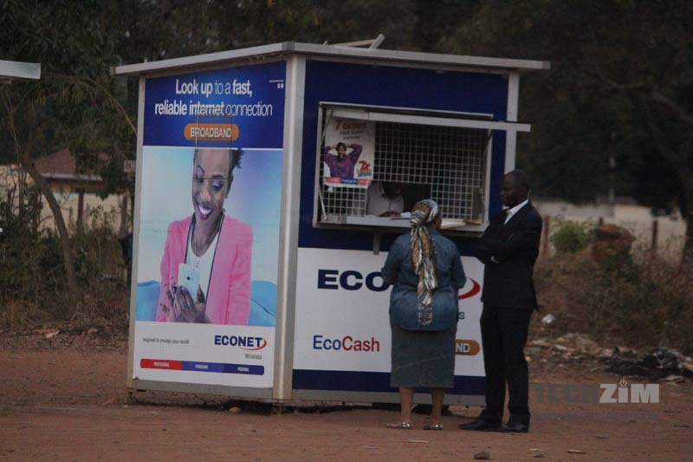
Assumption – Why are People Unbanked
Bank Charges

Slide 4

Assumption – You need to be working to get a loan
Salary

Slide 5
Ghana Pensions Industry Overview (1957 & 2012 – 2022)

Slide 6
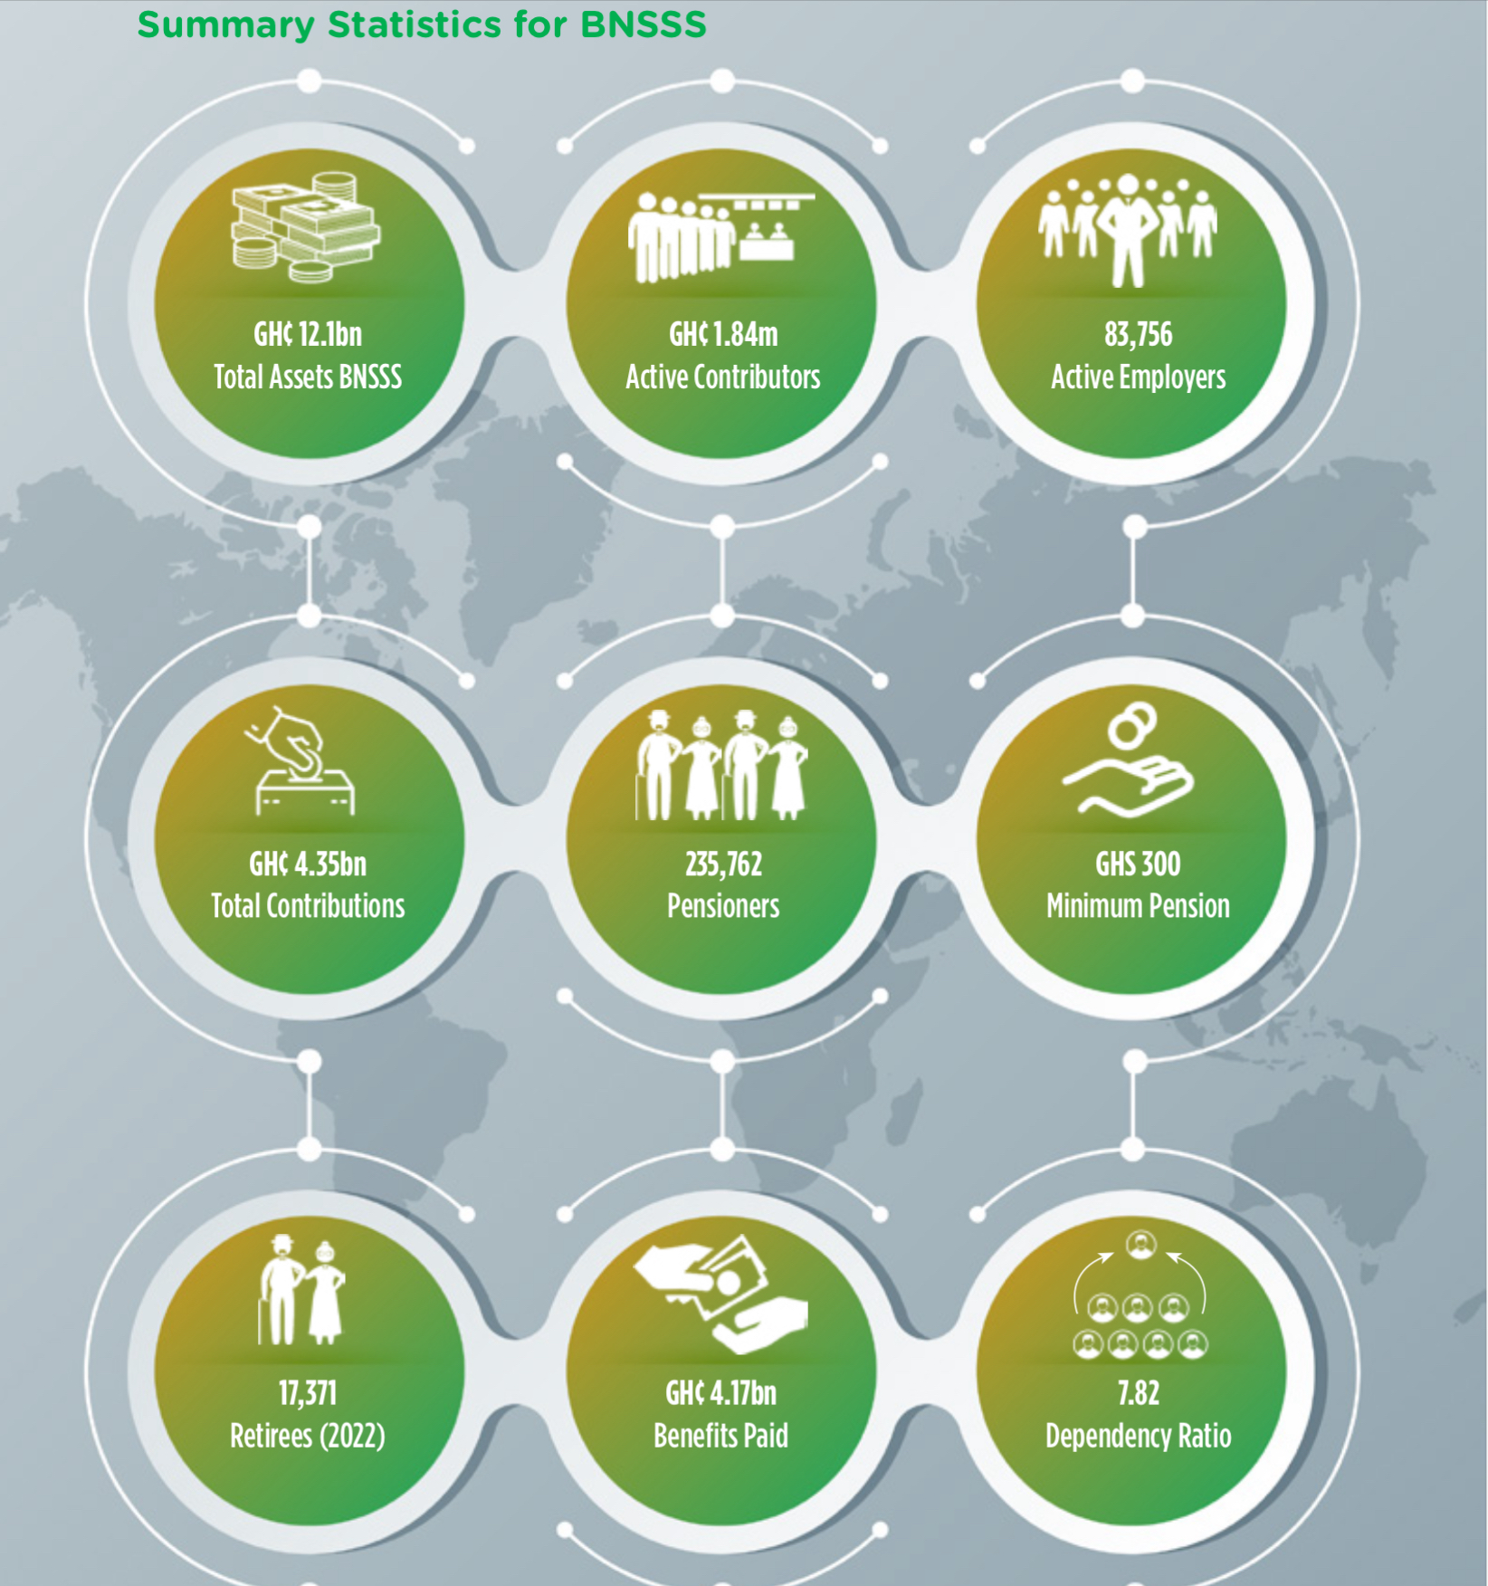
Ghanaian Pensions Industry – Social Security

Slide 7
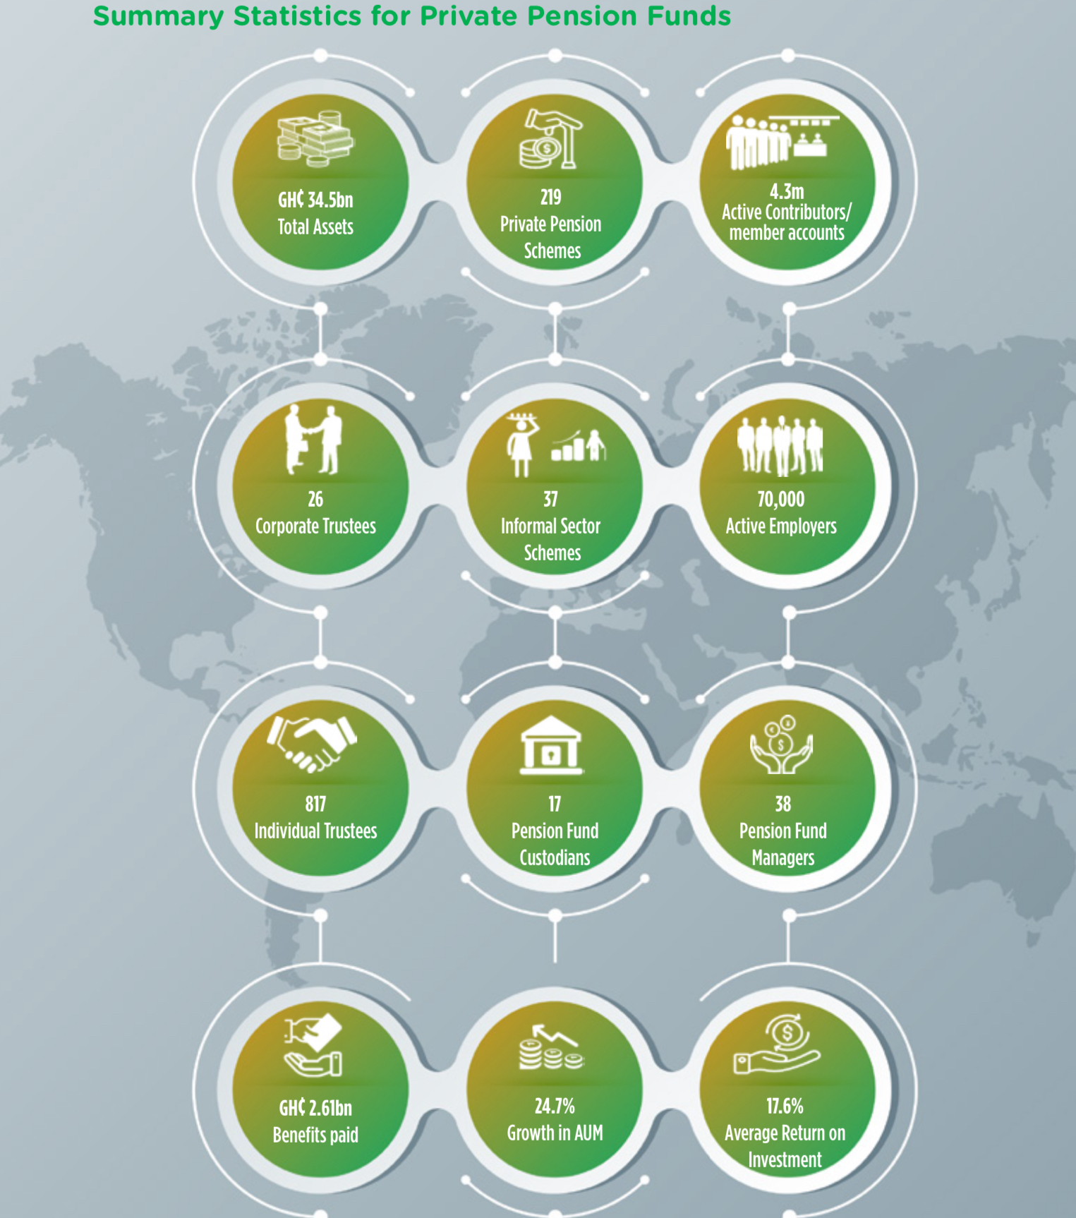
Ghanaian Pensions Industry – Private Pensions

Slide 8
The Retirement Equation

Slide 9
The Retirement Equation
Contribution + Interest = Retirement Pot

Slide 10
Contributions

Slide 11
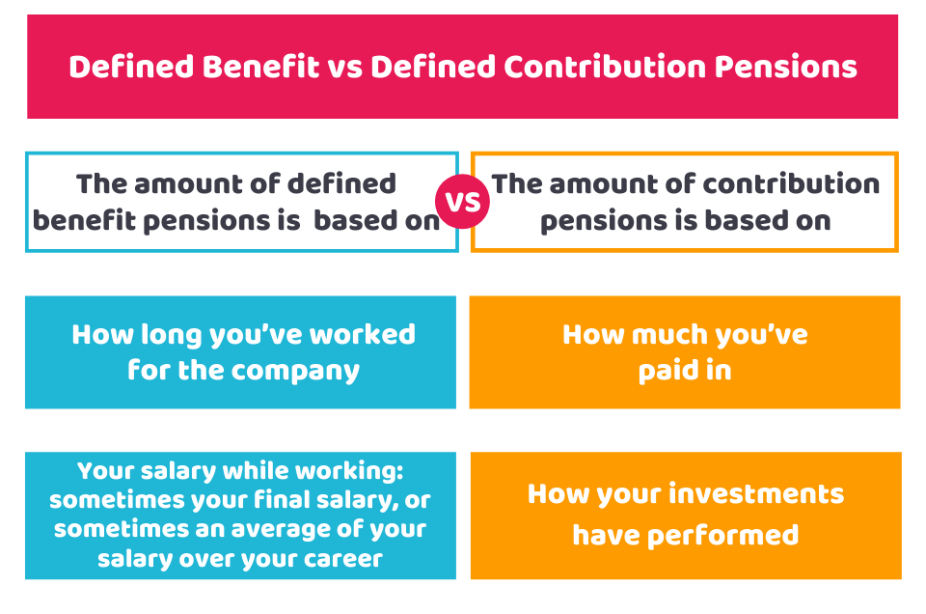

What are our assumptions as an industry
Are we contributing Enough ?
Benefits in Kind?

Slide 12
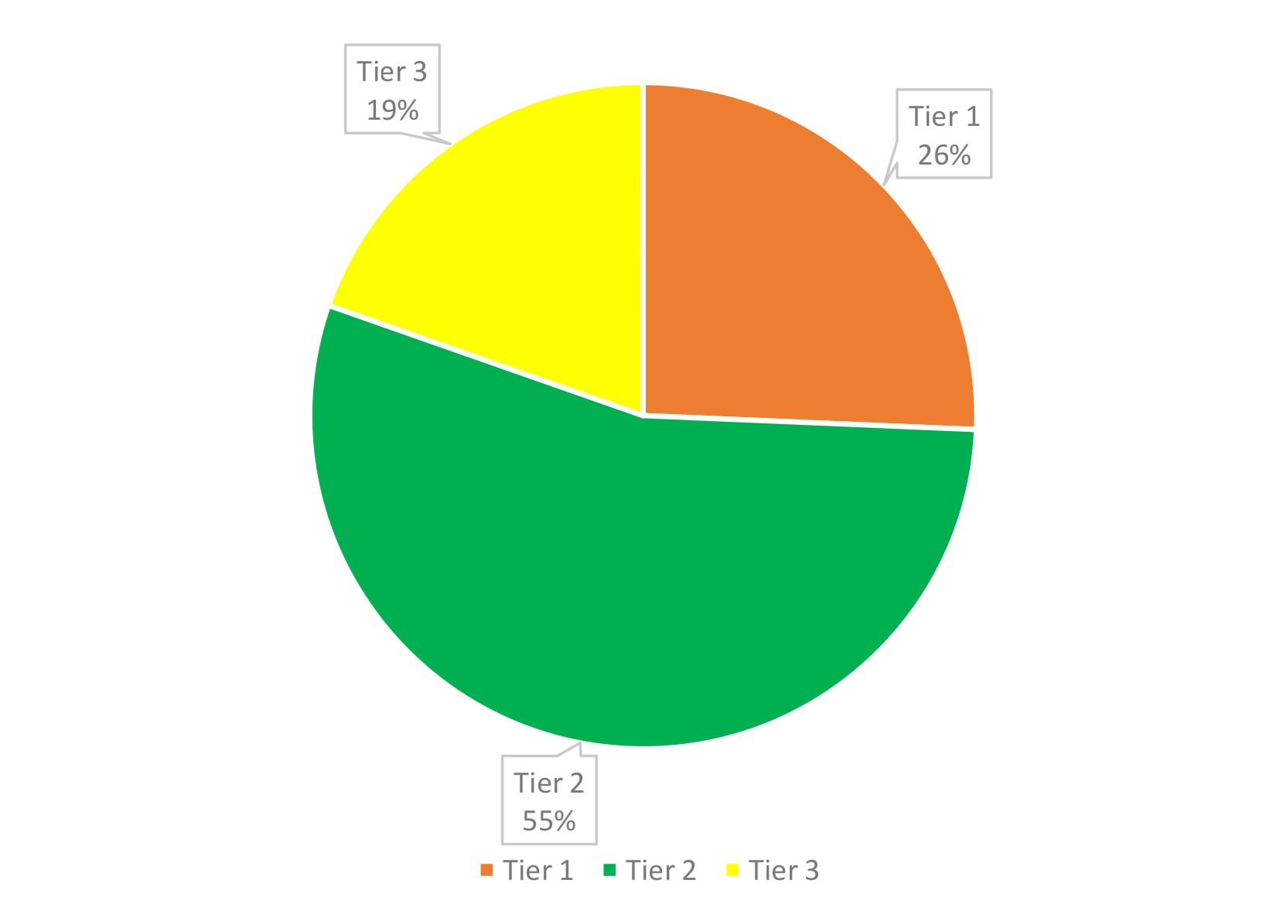
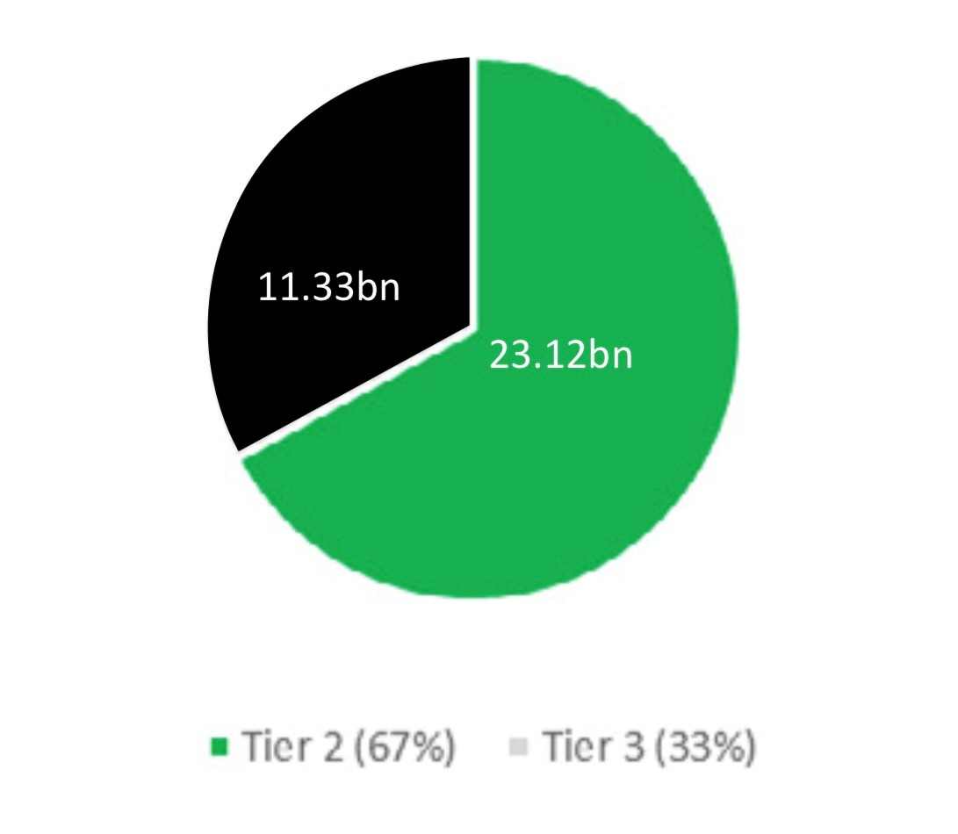
Voluntary Contributions in Ghana

Slide 13

Who is Contributing ?
Then
Formal Employment
Till Retirement
Stable income
Now
Informal Employment – 70 to 80 percent
Job hopping or Poly Jobbing
Unstable Income

Slide 14

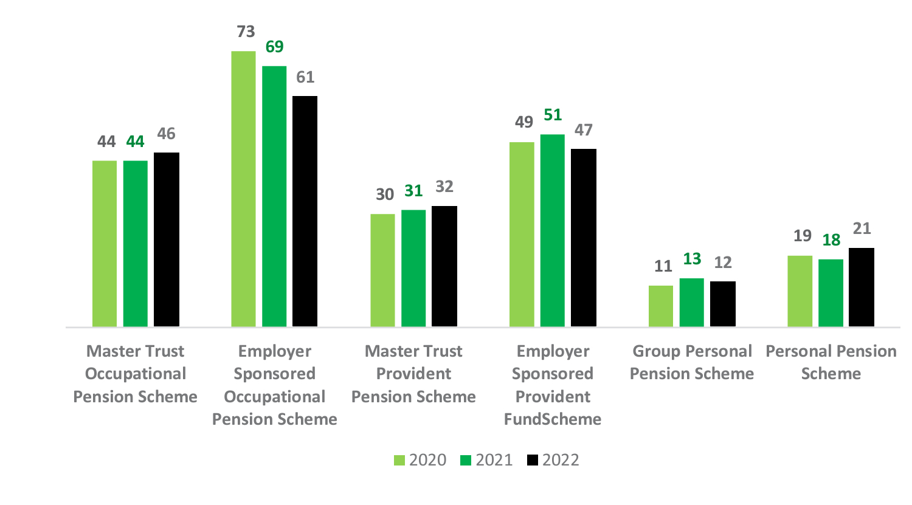
Informal Sector Pensions?
Ghana Stats

Slide 15


Investment Return

Slide 16
Investment Trends into the future
Alternative Investments
Focus on Risk Management (all types of risks)
Greater collaboration – trustees, employers, employees

Slide 17
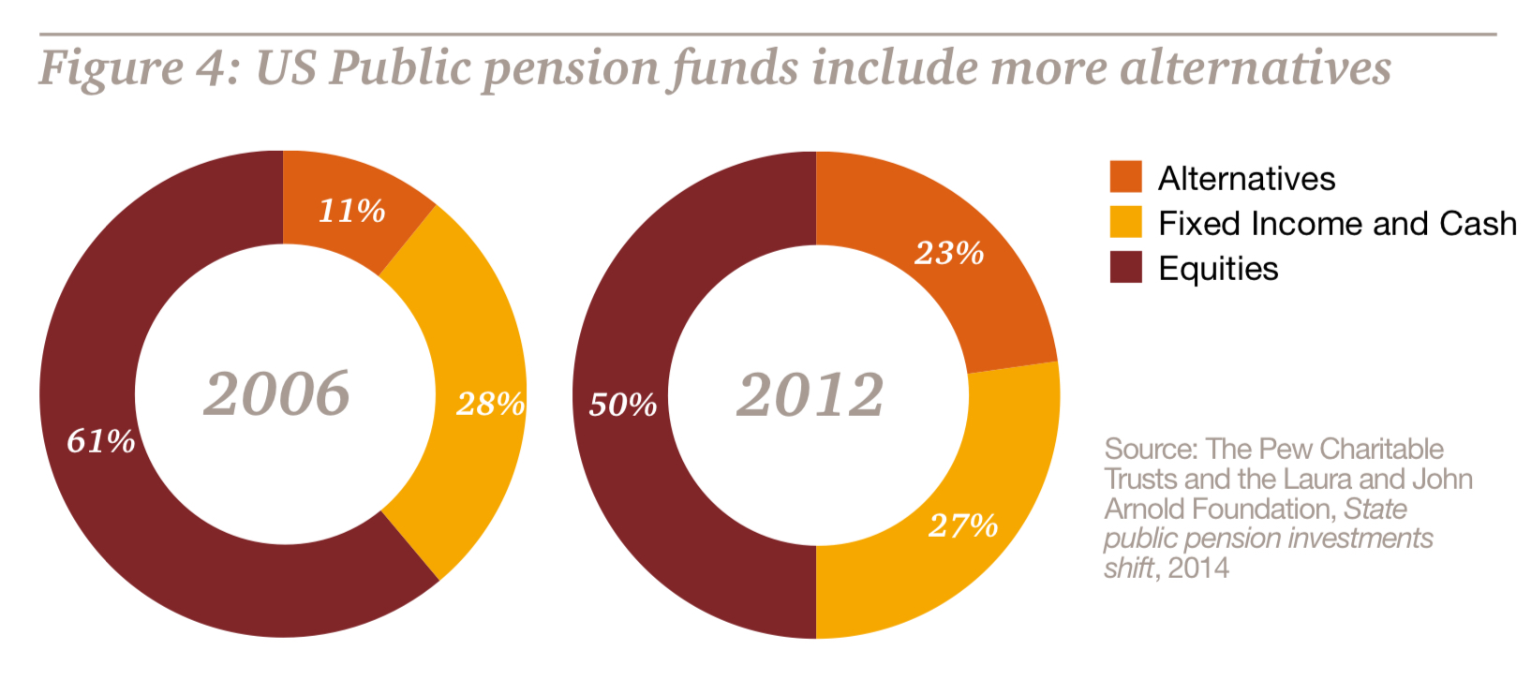
Trends
Ghana Tier 2 Members Can Choose
Moderately Aggressive Portfolio (Default 15 to 44 years),
Moderately Conservative Portfolio (Default 45 to 54 years),
Conservative Portfolio (Default 55 to 60 years),
Aggressive Portfolio (By formal request).

Slide 18

Retirement Pot

Slide 19

Retirement or no Retirement and Post Retirement
Access
Access frequency
Access Penalties?
What next after Retirement ?

Slide 20
Pre Retirement Tier 3
An optional contributory scheme
Monthly contributions of up to 16.5% ofthe basic salary of all employees and informal sector workers.
The contributions for Tier 3 are exempt
.
If an individual has been in the scheme for 10 years or more, he or she will receive all contributions made under the scheme in addition to all returns earned tax free
In the event of an exit prior to the contributor’s tenth anniversary, a marginal tax rate of 15% will be applied to the contributor’s total redemption amount.

Slide 21
The Gift Wrapper and Ribbons

Slide 22
Things we can think about
Flexible contribution
Digital Access and Engagement
Personalization
Flexible Access – Pre and Post Retirement
Relevant Investment Options

Slide 23
Thank You

