Slide 1
ZIMBABWE ASSOCIATION OF PENSION FUNDS Z.A.P.F
WEBINAR
THURSDAY 25 JANUARY 2024

Slide 2
TOPIC: HABITS AND WORK ETHICS THAT WILL HELP PROFESSIONALS LAST THE YEAR
Presentation by Dr Abel Mubango

Slide 3
OUTLINE OF PRESENTATION
INTRODUCTION
Definition of habits
Definition- work ethics
Importance of work ethics.
Habits and work ethics
Continuous scanning of the environment
Understand your organisation
Job results
Attitude

Slide 4
OUTLINE OF PRESENTATION
Communication Skills
People Skills
Networking
Continuous improvement
Discipline
Take 100% responsibility
Determination
Put first things first
Being proactive
Sharpen the saw
c. Conclusion

Slide 5
DEFINITION-HABITS
Habits are the small decisions you make and actions you perform everyday.

Slide 6
DEFINITION – WORK ETHICS
Values guiding professional behaviour, encompassing integrity, responsibility, quality, discipline and teamwork.

Slide 7
IMPORTANCE OF WORK ETHICS
Work ethics are essential for success in the work place
They influence productivity, satisfaction and reputation

Slide 8
(1) CONTINUOUS SCANNING OF THE ENVIRONMENT
A PESTEL Analysis is a strategic framework used to evaluate the business environment in which the firm operates.
Political
Economic
Social
Technological
Environment
Legal

Slide 9
(2)Understand your Organisation, the Industry and the Environment
What are your organisation’s targets/strategies?
What are the organisation’s priorities?
What are the organisation’s pain points?
What is happening in the industry and how does this affect us?
What is happening in the environment and how does this affect us?
Be innovative – offer solutions?

Slide 10
(3) JOB RESULTS
The attainment, surpassing the results that are expected of you in your job.
This is the reason why you were hired/retained in your job.
The quality of your work should be exemplary.
If you are meeting/exceeding the targets in your job you will be making a meaningful contribution to your organisation.
Be the best, it is the only market that is not crowded (Tom Peters- The Excellence Dividend).

Slide 11
(4) ATTITUDE
You must always have the right/positive attitude towards
yourself
your work
your colleagues
your workmates
Attitude is more important than skills and knowledge
Have a positive attitude
Look for lemonade in the lemons
Many talented people have not been able to go very far due to their bad attitude.

Slide 12
(5)COMMUNICATION SKILLS
You must be able to communicate well with your bosses, colleagues, customers and all stakeholders
Communication is the process of collating, transmitting and interpreting ideas ,facts, opinions and feelings. It is a process that is essentially a sharing one – a mutual interchange between two or more persons ( G. A. Cole: 1996)
You need to keep your managers “informed” on all critical issues
Do not wait to be asked

Slide 13
(6)PEOPLE SKILLS
We all work and live among people
People skills are important for your success and even your survival
Develop skills that can help you to relate to people better
Be a useful member of all teams you belong to – family, department at work, organisation, church

Slide 14
(7) NETWORKING
Rabbi. D. Lapin says
“ find opportunities to become friendly with many people”
People do business with people, whom they like
Extend the network of your connections to many people
Relationships can lead to transactions and transactions can lead to business
Find opportunities to make contacts with as many people as is possible
The solutions to the challenges you are facing could be two or three people away

Slide 15
(8) Continuous Improvement
It is only those who continue to improve who will survive
You are either green and growing or ripe and rotting
You determine your own “BEST BEFORE DATE”
Continue to improve, to cope with changes in technology, environment, systems, processes, regulations
Learn from your mistakes and those of others
Be adaptable
You must be innovative

Slide 16
(9) DISCIPLINE
Be a disciplined person
Discipline will guide you in terms of ethics, what to do, by when and what not to do
If you are disciplined you will not be caught up in scandals off and on the work or things like corruption
A disciplined person does what they say they will do ( you earn trust and reliability) from others
A disciplined person has integrity
The discipline must come from within
A disciplined person manages time

Slide 17
(10) Take 100% responsibility for your life
There is only one person responsible for the quality of the life you live – that person is you (Jack Canfield)
You must assume 100% responsibility for your life (you are the cause of all your experiences)
You have to give up blaming others and complaining
You have to give up all excuses
If you want something different you are going to have do something different
Learn to take ACTION-QUICKLY

Slide 18
(11) DETERMINATION
Og Mandino in his book “ Success Unlimited” says that one of the qualities of successful men was determination
The men knew what they wanted and they were determined to do it regardless of sickness, impediments and general conditions
These men were optimists who felt they could do what they had set their hearts on doing
Do not look for excuses
Life is not about waiting for the storm to pass, it is about learning to dance in the rain (Ted Rubin)

Slide 19
(12) PUT FIRST THINGS FIRST
You have the power to significantly change your life in the present
Identify your priorities
Manage your time effectively

Slide 20
(13)Being Proactive
Take the responsibility for your life
Do not blame your behaviour on external factors but own it as part of a conscious choice based on your values
Stick to the commitments you make to yourself and to others
(S. Covey - the 7 Habits of Highly Effective People)

Slide 21
(14)SHARPEN THE SAW
Enhance yourself through the four dimensions of renewal mentioned by Steve Covey
Physical: exercise, nutrition and stress management
Social/Emotional: service, empathy, synergy and intrinsic security
Spiritual: value clarification and commitment
Mental: reading, visualising, planning and writing
Express and exercise all four of these motivations regularly and consistently

Slide 22
CONCLUSION
You should not only last the year, you must EXCEL

Slide 23
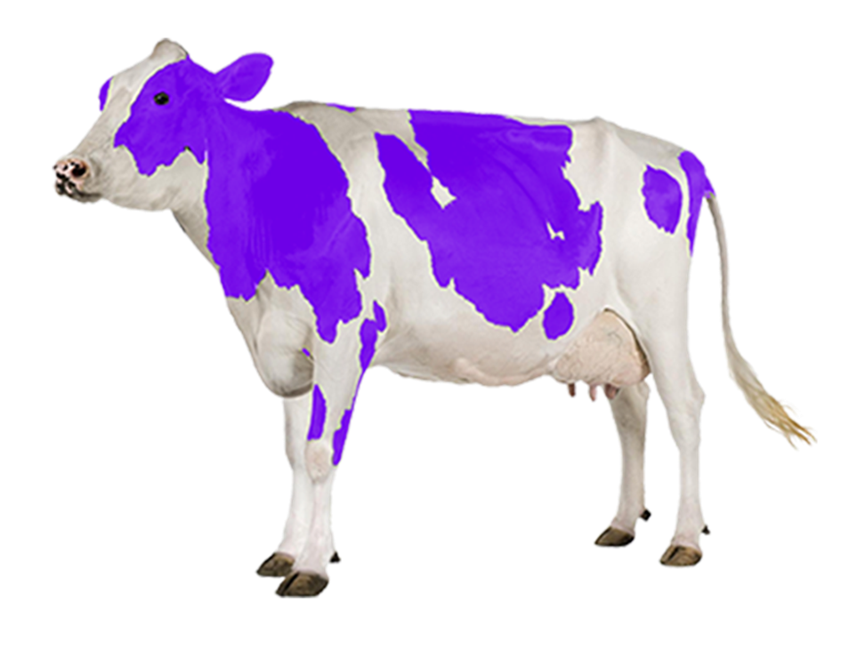
BE A PURPLE COW
You must be remarkable
You must be a purple a cow
( Seth Godwin – Purple Cow)
A less available item is more desired and valued
(R. B. Ciadini)

Slide 24
THE END
SIYABONGA
THANK YOU
ZIKOMO
TINOTENDA
ASANTE SANA
KEA LEBOGA
DANKIE
MERCI BEACOUP
XIE-XIE

