Slide 1
ZAPF ZEEPAY Solution Presenter: Sharon Marira Date: 26 June 2024

Slide 2
ZEEPAY – The Solution
A secure, efficient and cost-effective Electronic Funds Transfer (EFT) solution that facilitates the sending of single and bulk payments.
ZiG - EFT Credits (Batch) – live
USD - EFT Credits (Batch) – live for ON-US transactions, targeting OFF-US by end of June

Slide 3
ZEEPAY Solution - Benefits
Efficiency as it supports straight through processing of same day value transactions.
Low cost bulk electronic transfer solution.
Inbuilt dispute management system.
Detailed audit trail & reports, (can account for every transaction being processed).
Security and Compliance conforms to AML, CFT, FATF and Tax Compliance.
Value Added Services; MIS Reports, Analytics and Big Data.
Scalable and interoperable system.

Slide 4
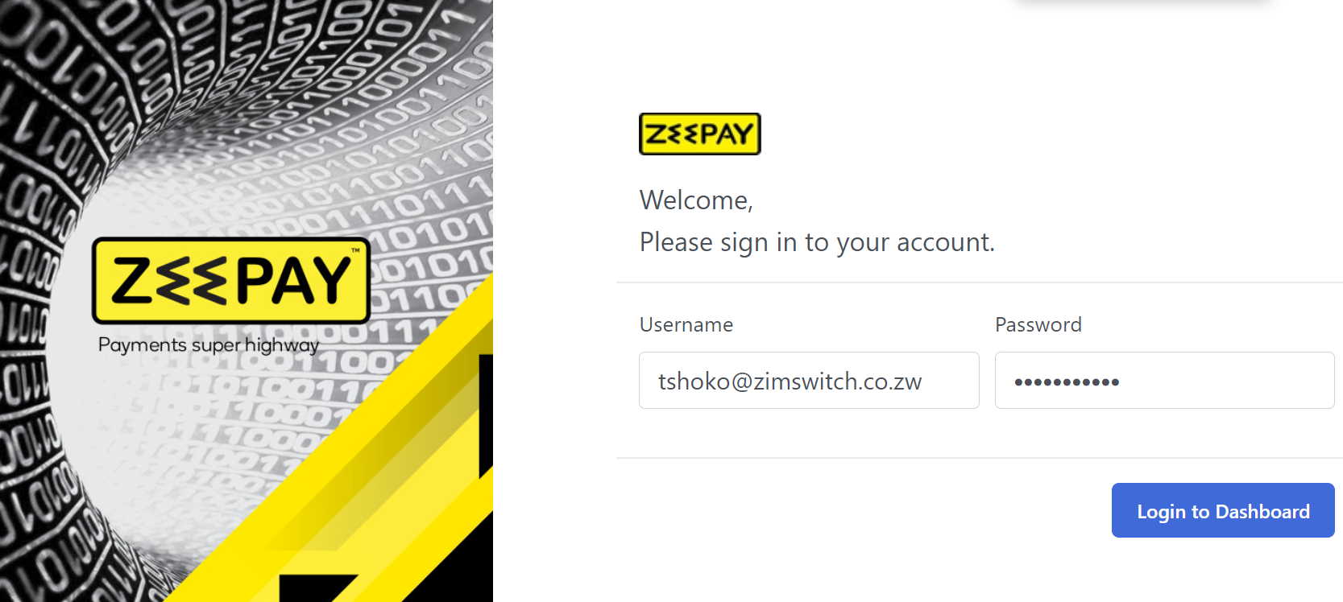
ZEEPAY Solution - Overview
Login Interface

Slide 5
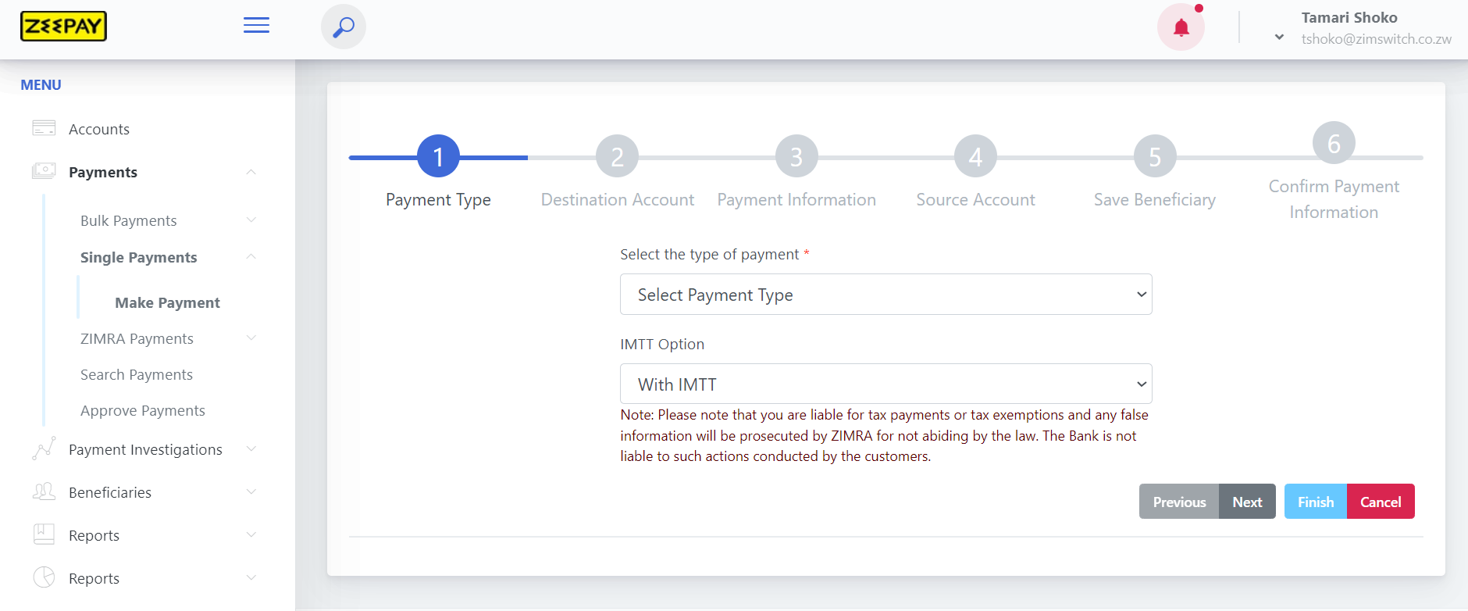
ZEEPAY Solution - Making a single payment
Steps in making a single payment

Slide 6
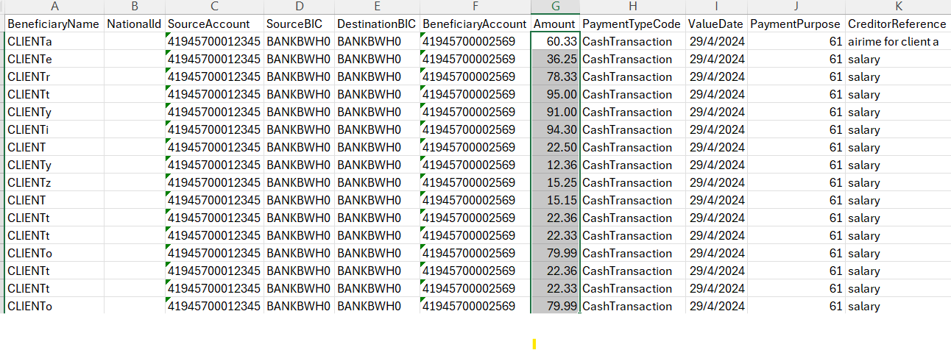
ZEEPAY Solution - Uploading a Bulk File
The bulk template (csv):

Slide 7
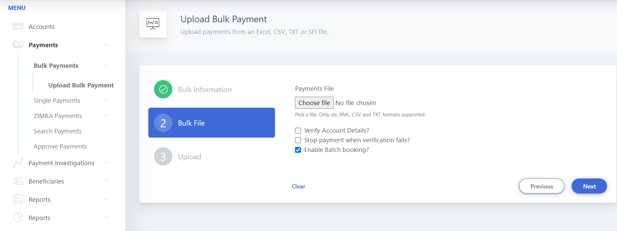
ZEEPAY Solution - Uploading a Bulk File
How to upload a bulk file:

Slide 8
ZEEPAY Solution - Limits

Slide 9
Sign up with your bank and enjoy the convenience. THANK YOU
www.zimswitch.co.zw

