Slide 1
Impact of AI on Pensions
Charles Makoni (MBA, ICSA, MCom, CIMA Adv Dip)

Slide 2
Opening Remarks
Background Information on Pensions.
Pain points in the Pensions industry.
Impact of AI in Pension Processes.
Impact of AI on Active Members - Benefits Statements.
Impact of AI on Pensioners - Proof of Life for Pensioners.
Impact of AI on Data Quality and Accessibility.
Benefits of AI.
Drawbacks of AI.
IPEC and AI Governance.
Conclusion.

Slide 3
Introduction
Artificial intelligence (AI) is transforming the world, presenting both opportunities and challenges.
As Zimbabwe strives to become an upper-middle-income economy by 2030, embracing AI can be a game-changer.
However, it’s crucial to address the ethical, social, and economic implications of AI for full maximisation of AI potential
To safeguard the work of the innovators and creating a sustainable market for AI.
This drives us to the key issue of responsible AI governance in Zimbabwe, with a focus on the need for an AI-focused patent office.

Slide 5
Improve pensions performance by cutting costs.
Highlighting upcoming risks
Building customized portfolios
Identifying market anomalies
However, AI unlikely to predict market movements

Slide 6
Improve efficiency for pensions funds
Sifting through the data troves to find promising investment opportunities
To build custom investment portfolios for clients
Analysts track trading patterns & uncover market sentiments in real time
Credit risk estimations
Funds using AI in market analysis will earn higher returns and improve portfolio diversification.

Slide 7
Background

Slide 8
Cont'n

Slide 9
Statistics of UK Error & Fraud in Benefit System

Slide 10
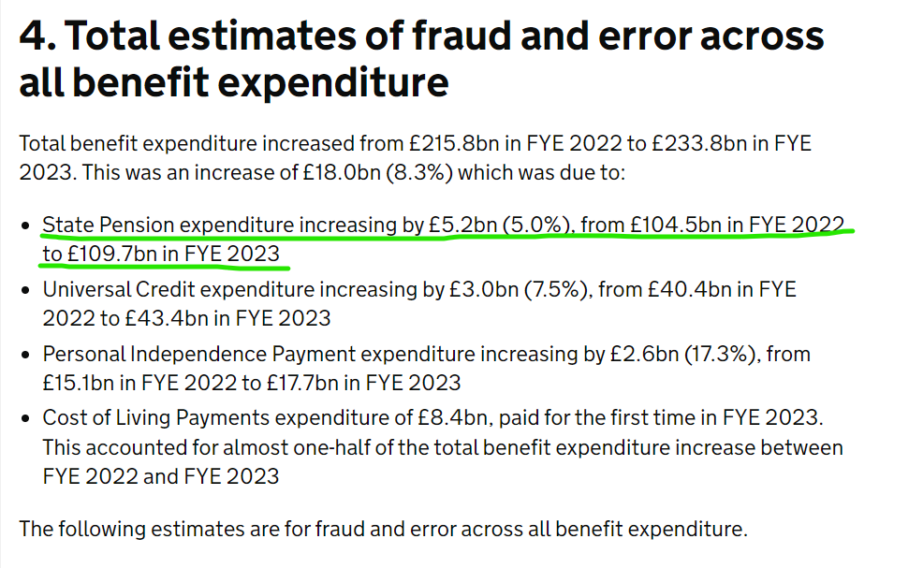
Cont.n

Slide 11
Key Challenges in the Pensions Industry
1. Knowledge Gap on AI: AI has been a topical issue in various industries.
AI will not replace but rather enhance & complement.
2. Viability Challenges: Sponsoring Employers facing viability challenges - Funding Gaps.

Slide 12
3. Lack of Good & Quality Data
Inquiry Observed that
Lack of Data became a hindrance, and most issues could not be concluded.
Industry is data intensive
Requires to be kept over a long period of time
Recommended to keep data for at least 100 years

Slide 13
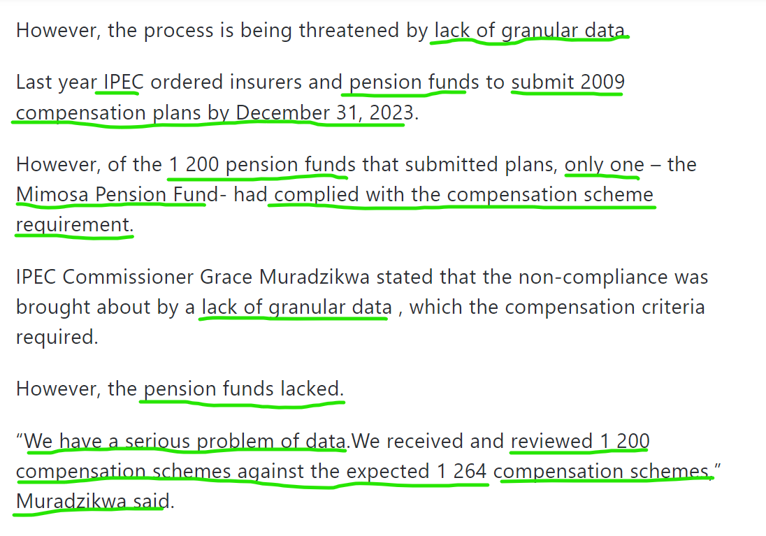

Slide 14
4. Keeping up Currency Changeovers
To Active members – This causes delays in benefit statement delivery.

Slide 15
Cont’n
It takes time to
Carry out the conversions etc.
Issues with claim processing accuracy.
Including overpayments
Underpayments, and
Payments to incorrect beneficiaries.
I believe AI can offer solutions to many of these problems.

Slide 16
Definition of Terms
1. Artificial intelligence:-
<Goldman Sachs>- “Simulation of intelligent behavior in computers, to exhibit human-like behavioral traits eg reasoning, common sense, learning & decision making.
<IBM> - “ AI is a tool to support a human workforce, optimising workflows, making business operations more efficient, extracting meaningful insights, quickly processing vast amounts of data
2. Machine Learning:- “It is a subset of AI used to make predictions based on input data. Pensions we work with a lot of data, machine learning algorithms can thrice in these environments for us to realise the full benefits of AI”
ML Algorithms: identify patterns, discover anomalies, make projections eg future benefits payments.
3. Deep Learning:- A subset of ML that allows automation of tasks without human intervention. Examples include Chatbots, Facial Recognition, and Fraud prevention technology all of which rely on deep learning models.
- Deep learning models can more accurately extract information from unstructured data such as text and images and do not require as much human interventions
4. Natural Language Processing:- Branch of AI that enables computer & digital devices to recognize, understand & generate text and speech, customer support chatbots, digital assistants & voice-operated technologies, and GPS systems are all powered by NLP. Extracts insights from unstructured data i.e., text or voice driven.

Slide 18
Mc Kinsey and Company

Slide 19
Cont’n
Computer Vision:- <IBM> Computer vision is a field of artificial intelligence (AI) that uses machine learning and neural networks to teach computers and systems to derive meaningful information from digital images, videos, and other visual inputs—and to make recommendations or take actions when they see defects or issues.

Slide 21
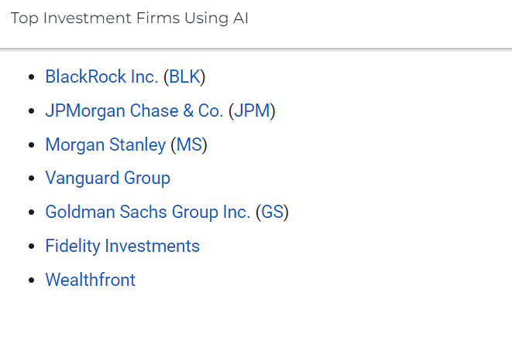

Slide 22
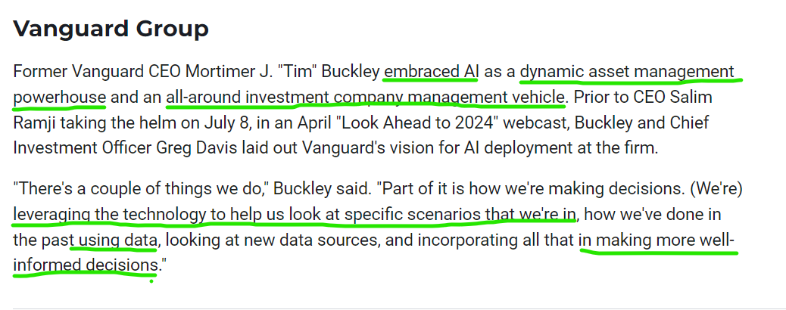

Slide 23
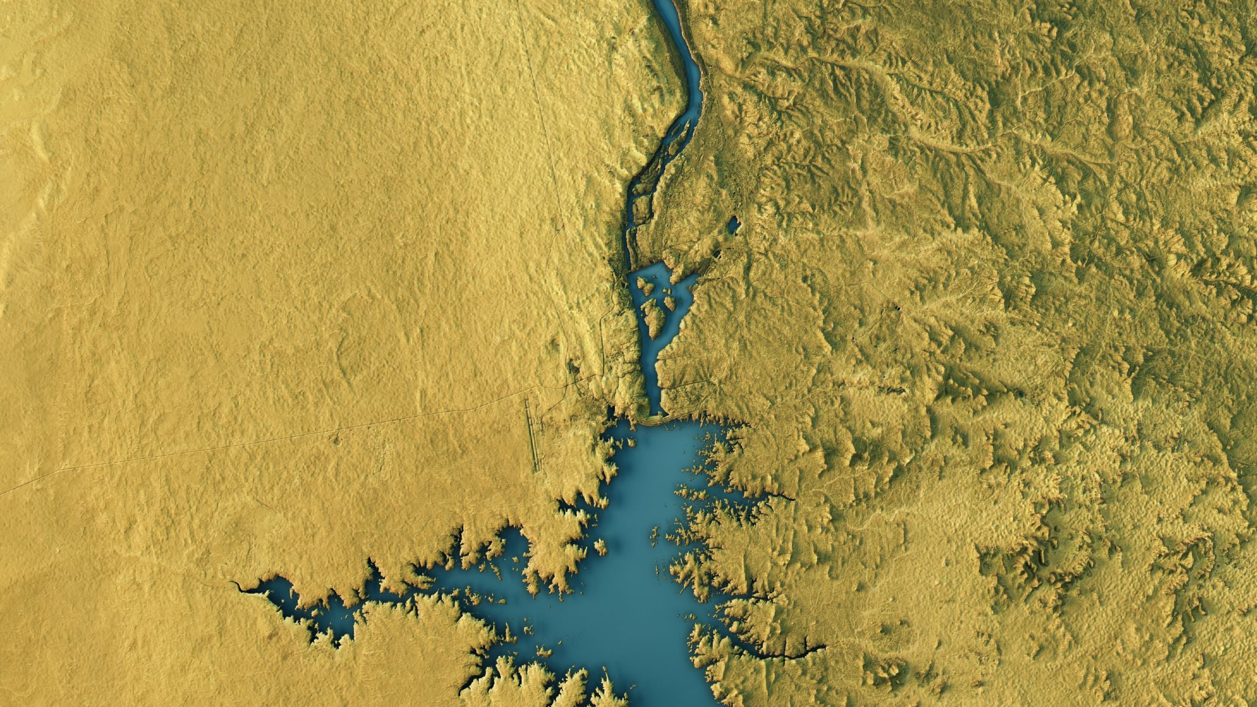
AI in Africa A recent report projects that AI could expand Africa’s economy by a staggering US$1.5 trillion—half of its current gross domestic product (GDP)—if the continent could only capture 10% of the fast-growing AI market

Slide 24
Egypt
In 2021, Egypt launched its national AI strategy to deepen the use of AI technologies and transform the economy

Slide 25
Mauritius
Mauritius was the first country in Africa to publish a national AI strategy

Slide 26
Kenya
Kenya, on the other hand, has an AI task force that is creating guidance on how AI technologies can be used to further the country’s development

Slide 27
Rwanda
In 2021, Rwanda established a technology center of excellence focused on digitalization and AI, and is working
on an AI strategy

Slide 28
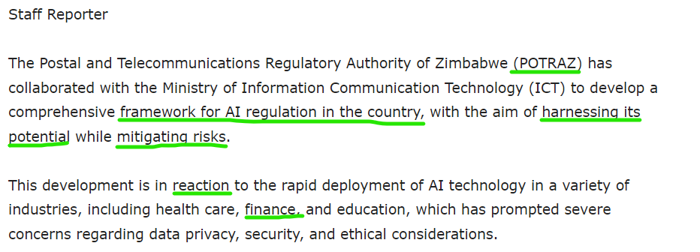
AI In Zimbabwe

Slide 30
Impact of AI in Pension Processes
Active members: Those currently contributing to the fund.
Pensioners: Those receiving benefits.
-Those who have exited
-DEFICIENCY PART
-% Increase/decrease
Manual processes: Inefficient and error-prone, leading to underpayments and overpayments.
AI enhancement: Automation can streamline processes, reducing errors and improving efficiency
% on the errors.

Slide 31
AI will improve Efficiency & Effectiveness
When Actuarial Valuations are done.
Actuarial report has to be signed.
Someone must be accountable
A professional that you can hold responsible.
The Actuary has access to clean data
and if AI in place To perform Data checks
If you have AI doing Data Checks.
Clean data is feeding in the Actuarial model
To do the numbers and estimated forecast.
So AI doesn't necessarily remove the need to have an Actuary
AI is there to enhance and not to replace but Complement the Actuary
AI knows Python, and VBA -You can tell it what to do.
All these things are there to make it better
Over time we should see Admin costs go down
Actuarial costs going down . Actual Core Mandate, without spending time cleaning data , sending queries
AI will ensure
-Data is accessible
- data is user friendly
- Clean
-Fit for purpose

Slide 32
Where are the pain points?
When making Benefit Claims
On claims
When a Pensioner comes through and they want to claim their pension benefits.
They have to go and see the Administrator with Physical Papers.
There is a back-and-forth collecting physical documents
The process starts and then maybe the process is concluded after 6 Weeks
With AI we don't have to go to those steps.
We already have an environment that is live which shows particular details of an individual.
They just come in electronically online or with physical documents.
If you are spending weeks.
Once we plug in their details everything else will be automated.
And we should have a process which should be completed within a week.
If you are spending 6 weeks, you are paying salaries over something that can be done in one week using AI.
This is what AI can do, and it can help lower your costs.

Slide 33
AI and Defined Contribution
In developed country
If I want to see my pension pot
If I'm an active member
And I am contributing
and I want to see my Accumulated Value.
This is more applicable to a DC fund
I can do it on a daily basis
My numbers will change on a daily basis. Why because?
The Investment managers
Are able to calculate the return attributable to me.
On a daily basis
They feed it into the system
That system automatically calculates and says ok,
This is the balance you had yesterday.
This is the return that the market has earned today.
This is what we are passing on to you, net of our fees. - So the amount that you have is so much
And you do that everyday-

Slide 34
AI will allow you to Integrate Investment Management – and Pension Systems – Applicable to DC
These systems are talking to each other on a daily basis and
Able to give your pension members daily updates
if they so wish.
In terms of the involvement of their portfolio and
That will reduce the prices when it comes to retirement because someone can track the growth of their Pensions.
When it comes to tracking your investment
You don't wait for the Actuary to tell you of the financial savviness of your investment portfolio

Slide 35
Impact of AI & Proof of Life requirements – for Pensioners
Current process:
Requirement of Pensioners to provide proof of life
Manual process is done every year.
How it’s done
You have to go to a branch with an ID.
They say you are alive, and we continue to pay you
Suggestion: In the 21st century, there should be a way to automate processes.
It can also be through linking systems to the Registry Department Office.
If someone dies and the burial Orders are Uploaded & recorded in the Government registry.
it should be flagged in the system through AI
- AI solution: Automated verification through system linkages, reducing fraud and administrative burden.

Slide 36
AI & Actuarial Valuations during Hyper inflationary periods – DB Schemes
Use AI as an internal tool.
Helps track your funding level as Pensions Funds.
Helps to inform the Board of Trustees on their contribution rates.
Helps to inform the Board of Trustees whether they need to do a lump sum.
It can give the Board of Trustees some insights.
Outside of what the Actuary gives them.
The Board may not get 100 % of the results of what the Actuary gives the Board but at least they will be close.
The Board will have an idea of where they will be standing in terms of funding levels.

Slide 37
AI in Investment Strategies – Investment Managers
Critical leverage on AI to inform our investment strategies.
AI will assist us with research on appropriate investment opportunities.
Within and outside of Zimbabwe.
Closely monitor the performance of the funds that we are investing and also the appropriateness of asset allocation and.
Trigger if there is a need for the rebalancing of the investment portfolio.
The markets are moving significantly.
There is a lot of volatility that is happening in the market.
You might start a year with a balanced portfolio.
Looking at your liability profile- overtime- over the course of the year.
If you don't continue tracking these things.
In the context of a liability profile.
There is a possibility that you might miss it.

Slide 38
Figure below summarizes some of the applications of AI in investment management and their potential benefits to pension plans and other investors

Slide 39
AI Complementing the Work of An Actuary
The Actuary is responsible for determining the contribution rate.
Or the lump sum that is required to restore the fund to 100%.
You can “Internally” use AI to track and say ok if we implement what the actuary is saying, and we are chasing the market dynamics.
The Actuary would have used assumptions and if something happens.
We may see that these assumptions are not applicable anymore and we track what is happening in the market and we use our liability on how the liability of a DB is calculated, how are we calculating on a monthly basis.
We can use AI as an Internal tool to track your funding levels.
To inform your contribution rates.
Whether you need to do a lumpsum.
It can give you insights outside of what the Actuary will give you.
With AI you may not have to wait for the Actuary to tell you of the Financial Savviness of your Fund you may not get 100% but at least you will have an idea of where you are standing.

Slide 40
Work of Actuary and investment Manager
We have seen is, investment managers and pension funds- sometimes they work in silo.
And what that means is it’s not every time that
The investment managers have full visibility on the distribution of the age of fund members
All they will be doing will be to maximize the return within the confinement of the regulatory requirements, in terms of the regulatory environments
What is then needed is to have an investment policy at the pension fund level that translates to a strategic asset allocation
Later translating that to a target asset portfolio
Monitor that portfolio
Research other opportunities on a continuous basis
Make sure there is diversification
Make sure there is sufficient liquidity
All these can be done by AI

Slide 41
Cont’n
They are inputs from all different functions of risk management input.
The compliance team is coming in from a regulatory standpoint.
The accounting team, the actuaries.
The investment guys.
AI can help coordinate and ensure the investment strategies that are being pursued are in the best interests of the fund members and pensioners.
And that if there is an anticipation of loss of value.
And there are interventions that can be done to reduce the impact thereof, we can always leverage AI as a tool to trigger all those things.
There is some leverage we can use and maximize on AI to deliver the best outcomes for pension fund members.

Slide 42
Global Companies using Artificial Intelligence
EY is using AI to automate tasks such as data entry and reconciliation.
KPMG is using ML to develop new models for fraud detection and financial forecasting.
PwC is using ChatGPT to provide customer service and answer questions about accounting services.

Slide 43
AI – on Benefit Statements: Active Portfolios –Market Dynamics
If AI can calculate benefit statements on its own
This was your opening balance
These are the contributions that you have made
This is the closing balance
If that can be done by AI on a daily, monthly basis, quarterly
This will help calculate results that are closer to the truth
Enhance communication with pension members and fund itself
Reduce costs
Thus AI is cost effective
Some of the things to think about
AI calculation: Can provide more accurate and timely benefit statements, enhancing member satisfaction.

Slide 44
AI on Data Quality and Accessibility
Challenges: Inconsistent and unstructured data, hindering AI applications.
Opportunities: Improved data management can enable more effective AI-driven solutions.
Mainly the issue oi data
That corporate don’t have good data
When that happens , spend more time trying to go manual documents clean up data through
data manual process
If you are using AI
Instead of gaining data gained through manual processes
Takes away much away being done internally and cleaning processes

Slide 45
Benefits of AI
It helps detect fraud.
People who are dead, and being credited
Funds being credited to the bogus accounts
There are a lot of gaps that we can think about

Slide 46
Role of Regulator

Slide 47
AI Governance
AI governance refers to the policies, regulations and institutions that shape the development, deployment and use of AI. Effective AI governance ensures AI adoption is ethical, inclusive and responsible, maximising benefits while minimising risks.
Like the government mantra of leaving no one and no place behind, inclusive AI that is tailor-made to suit and address our local challenges becomes key.
Zimbabwe must prioritise AI governance to harness the potential of AI and address its challenges. The greatest danger is that of implementing and utilising AI before establishing regulatory frameworks and guidelines.

Slide 48
Benefits of Artificial Intelligence
One of the standout benefits of AI is
Its ability to reduce operational costs.
By automating various aspects of pension management from data analysis to investment decision-making,
AI minimizes the need for extensive human intervention. These savings can then be passed on to pension holders,
enhancing their overall returns.
"The ongoing expansion of AI within the operations and decisions of investment managers
could lead to more efficient and better-informed decision-making processes," Mercer senior partner David Knox said. “AI also has the potential to improve member engagement and
help individuals make long-term decisions about their financial decisions. Both advances should improve retirement outcomes.”

Slide 49
Cont’n
Risk mitigation is another area where AI is making a marked difference. The technology is adept at identifying and highlighting potential risks, enabling pension managers to take proactive measures to safeguard investments. This ensures that pension holders’ investments are not only optimized for returns but are also shielded from avoidable risks.

Slide 50
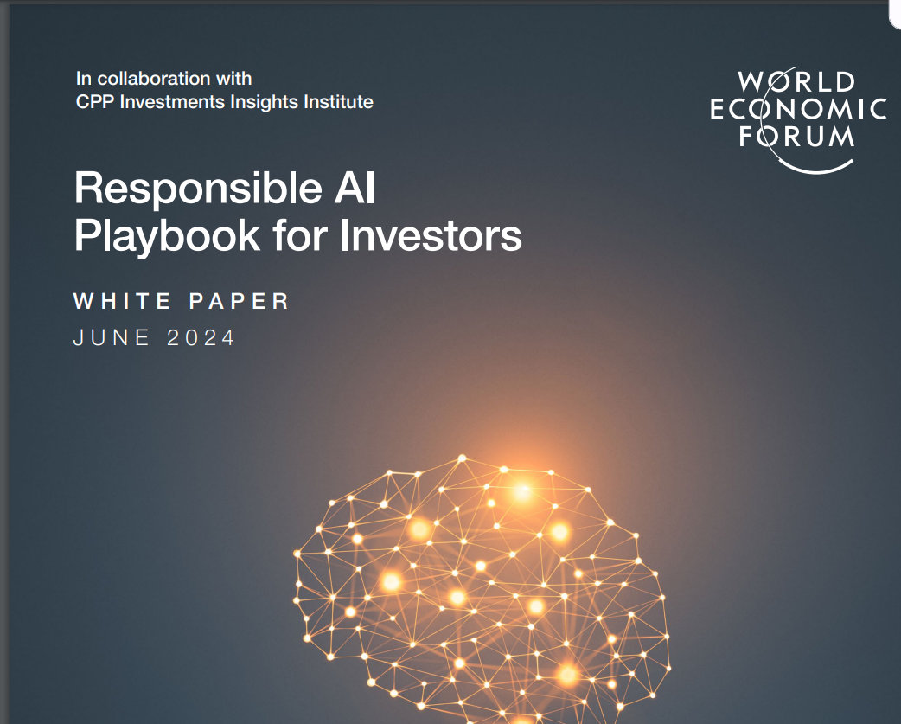

Slide 51
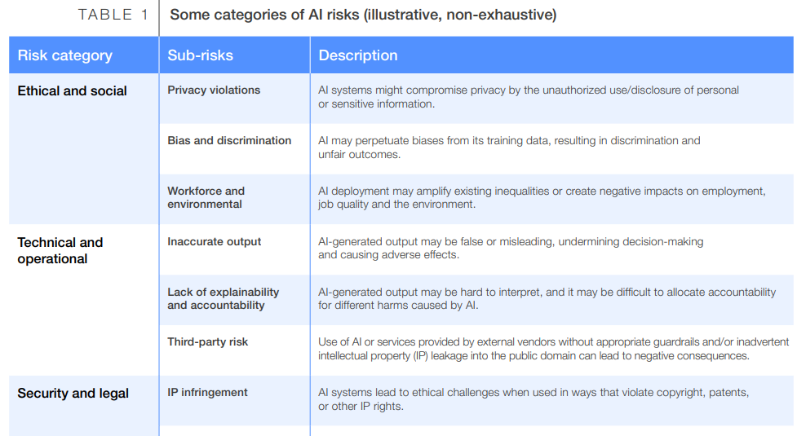

Slide 52
Challenges of Artificial Intelligence
Data: Any AI is only as good as the data it uses. Schemes hoping for AI to improve data accuracy will need to input sufficient (and high-quality) data for the AI tools to review.
Cyber risk: With new technology comes new risks. Trustees will be aware of the risk of cyber security attacks. AI will result in a higher perceived level of threat to schemes.
Change: Will our industry grab the bull by the horns or does the very nature of a long-term saving product mean we are slow to embrace innovation and change? We believe we can be bold to improve outcomes for pension savers, but more powerful AI will not drastically speed up widescale dashboard implementation, for example.
Perception: One concern is the danger of robo-advice. Is it appropriate for a pensioner to have their queries answered by an AI system? Perhaps liaising with a human builds confidence in the industry and this human touch should remain.
Duties: We cannot see AI replacing pension trustees and managers. Trustees have fiduciary duties that involve a human response, and we would suggest that decisions based solely on data may not necessarily always be the best ones. Of course, there is also a more general point that an AI system is not a separate legal entity that can have duties placed upon it.

Slide 53
Barriers to rolling out AI in the pensions space.
One barrier would be the availability of high-quality, accurate digitalised data.
This could be a challenge for many schemes and administrators, as often pension schemes rely on legacy systems and data.
There will likely need to be huge investments in systems and processes in order to ensure data is used effectively to deliver results for participants.
A further risk of using AI in the pensions sector is data protection and cyber security.
Pension schemes hold a great deal of personal and sensitive data about members.
Research indicates that UK pension schemes have seen the biggest increase in cyber security breaches, reporting a 4,000% rise in data breach reports to the Information Commissioner’s Office, going up from six in 2021/22 to 246 in 2022/23

Slide 54
Ethical Consideration of AI in Pensions
A lack of transparency relating to a model’s working is also likely to lead to confusion and lack of trust. It may also lead to adverse media stories. Yet pension plans rely on long-term trust from their members as the plans invest funds for decades. An inappropriate use of AI can quickly lead to a destruction of trust, which may be very hard to recover.
It is therefore critical that predictions or recommendations be easily explainable and justifiable to plan members, even when the personal data is incomplete. This will require careful planning and explanation by pension plans that choose to adopt these models.
Active governance and clear accountability are essential in the development of all AI models and algorithms. This will require experienced pension professionals to be involved, for, without that experience, judgment and oversight, there is the real risk that some outcomes will be unhelpful or misleading, and possibly even wrong, in the complex world of pensions and social security

Slide 55
Conclusion
The Statistics were speaking to us this morning.
AI & Pension Processes.
AI & Calculating Active Portfolio Benefit Statements.
AI & Meeting Proof of Life requirements.
AI & IPEC in AI Governance and Ethics.
The call for those at the strategic level to consider investing
Investment in AI
The Benefits outweighs the Limitations

Slide 56
Cont’n
AI by itself is not the complete answer. There will always be a need for human oversight. Despite these risks, AI has the opportunity to deliver a higher standard of living in retirement—a worthwhile objective for all pension systems,” Knox said.

Slide 57
Thank You
Merci Beaucoup
Siyabonga
Asante Sana

