Slide 1
WWW.MUSHORIWAMOYO.CO.ZW

Slide 2
Navigating Zimbabwe’s Pension Fund Landscape - Adherence to Global Governance Standards and Local Realities
Presented by Beatrice Moyo
7 October 2024
WWW.MUSHORIWAMOYO.CO.ZW

Slide 3
Overview
Today we will look at:
1. Governance- why?
2. the pension governance regulatory framework in Zimbabwe and best practice globally;
The global trends in pension fund governance;
3. Challenges and opportunities in Zimbabwe's pension fund governance;
4. Adapting to global governance standards.

Slide 4
What is Governance
Good Governance:
Minimizes conflict of interest
Is linked to good performance
Reduces regulatory costs
Enhances public confidence in the oversight process

Slide 5
Governance Framework
The Pension and Provident Funds Act [Chapter 24:32]
Other
Zimbabwe national code on corporate governance (ZIMCODE)
IPEC Circular 11 of 2020 Risk management and corporate governance guidelines
Companies and other business entities Act [Chapter 24:31]
Board Composition (sec. 22)
Board Duties (sec. 23)
Board Qualifications (sec.25)
Terms of office (sec. 25)
Training & Assessment (sec. 26)
Principal Officer (sec. 27)
Auditor, valuator, custodian, fund admin (sec.28)
Liabilities (sec 56 &57)

Slide 6
Global Standards of Governance
IOPS/OECD/World Bank - | Independence, accountability, transparency, and integrity
Overall fiduciary duty | Best interest of Fund members
Governing Body | Should be accountable, suitable and utilize to delegation and expert advice.
Risk based internal controls | Comprehensive internal documents e.g. code of conduct and a conflicts-of-interest policy.
Reporting & Disclosure | Transparent reporting structures & disclosure of relevant information to all stakeholders, timeously

Slide 7
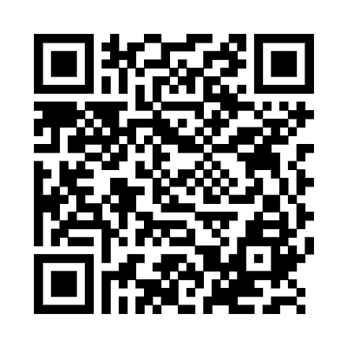
In your opinion
What is the most important governance issue facing pension fund boards in Zimbabwe?
Agency issues - Balancing stakeholder interests/Understanding the legal & regulatory environment;
Oversight effectiveness issues- Appropriate skill / knowledge on the Board & adequate use of delegation to management/experts;
Investment issues / risk management issues -Understanding context-based risk and its management, Informed ‘investment decisions’;
Strategic planning / effective management issues - Resource planning, organization design, and, effective implementation systems & policies

Slide 8
Key Governance Trends
Focus areas globally include:
ESG & Sustainability
Technological Advancements
Evolving regulatory landscapes
Risk Management.

Slide 9
Key Governance Challenges - Zimbabwe
Market volatility and Economic turbulence | The increasing time-sensitive nature of investment has effectively sidelined many trustees from engagement with the investment process, given the limited time set aside for deliberation
Changing risk environment | Public funds face new challenges from market volatility related to computer trading, new types of market, operational and liquidity risks from alternative investments, cybersecurity risks, as well as environmental, social, and governance risks that require a new and expanded framework for managing risk
Regulatory uncertainty | The regulatory environment can be complex, and funds may struggle to keep up with changing regulations and compliance requirements.
Governance and succession planning | Lack of Board Diversity and Expertise. The COP is a great starting point, but frequent reviews and updates are necessary to ensure relevance.

Slide 10
Key Governance Opportunities - Zimbabwe
Improving Governance | Reviewing internal strategies, codes of conduct and policies - emphasize high degree of expertise, training and development, and member-focused governance, with rigorous investment appraisal, transparency, and auditing.
ESG | Actively seek to identify “financially material ESG factors relevant to the fund, integrate into decision making, report on ESG factors considered and require ESG compliance from service providers and investments.
Technology | To improve the efficiency of pension systems – reducing costs and fragmentation, improving investment strategy and governance. Administrative processes, risk management,
Lobbying | The governance challenges the region is facing – partly attributable to legal and regulatory frameworks - considered barriers to proper corporate governance. More lobbying may assist reforms in the direction desired and in line with good practice.

Slide 11
Adapting to global standards
Focus on transparency, accountability and effective risk management
Robust governance framework
Risk Management tailored to local conditions
Whistleblower policy
Strong Internal Controls
Continuous Development and Training
Regular Audits and Performance reviews

Slide 12
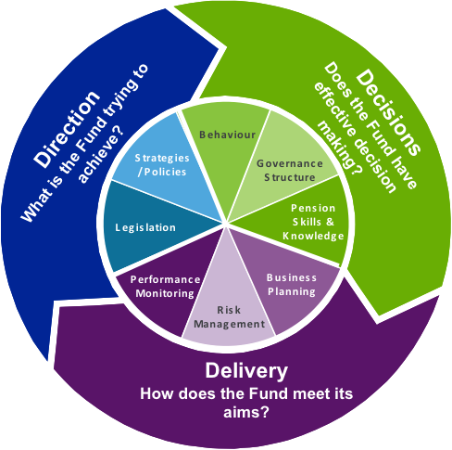
Take aways
Innovate for survival
Intensification –step up in board attention to deal with exceptional circumstances;
Priority setting – using ‘dashboards’ to signal the importance of issues and hence the time that should be devoted to those issues inside and outside of board meetings;
Risk management - using new tools e.g. market risk stress testing, technology risk assessments and internal control audits to position plans to achieve their objectives in key areas;
Expansion of the composition structure of the board and its experts –more complex market conditions can only be coped with more complex (deeper) expertise.

Slide 13
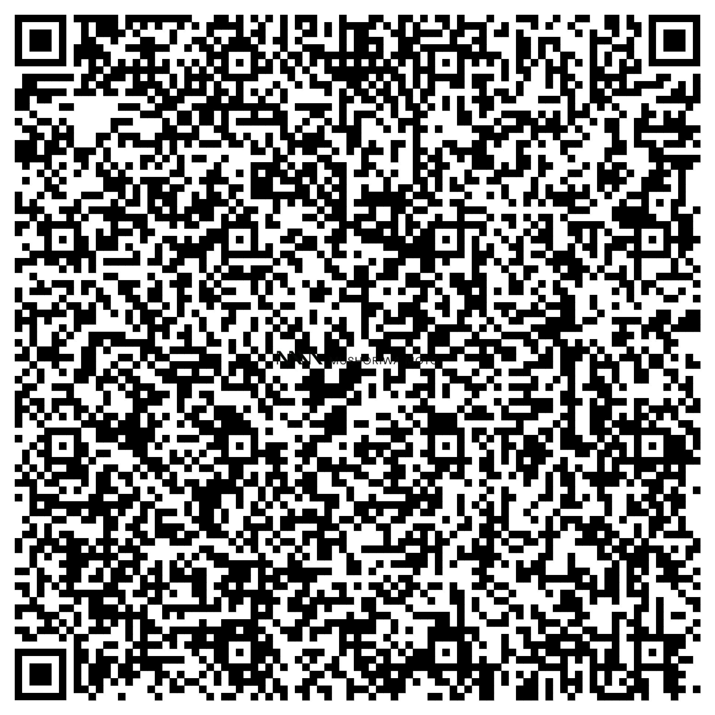
Thank you
Tel +263 4 793322/3
Mobile +263 737482529
www.mushoriwamoyo.co.zw
beatrice@mushoriwamoyo.co.zw
37 Lawson Avenue, Milton Park, Harare, Zimbabwe

