Slide 1
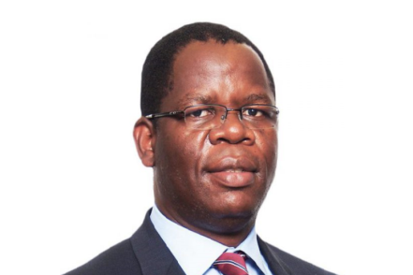
RESTORATION OF CONFIDENCE – GETTING THE FUNDAMENTALS RIGHT!
Presenter:
Gandy T. Gandidzanwa
director (Rimca)
8 October 2024
Presenter: Gandy T. Gandidzanwa
10 NOVEMBER 2020

Slide 2
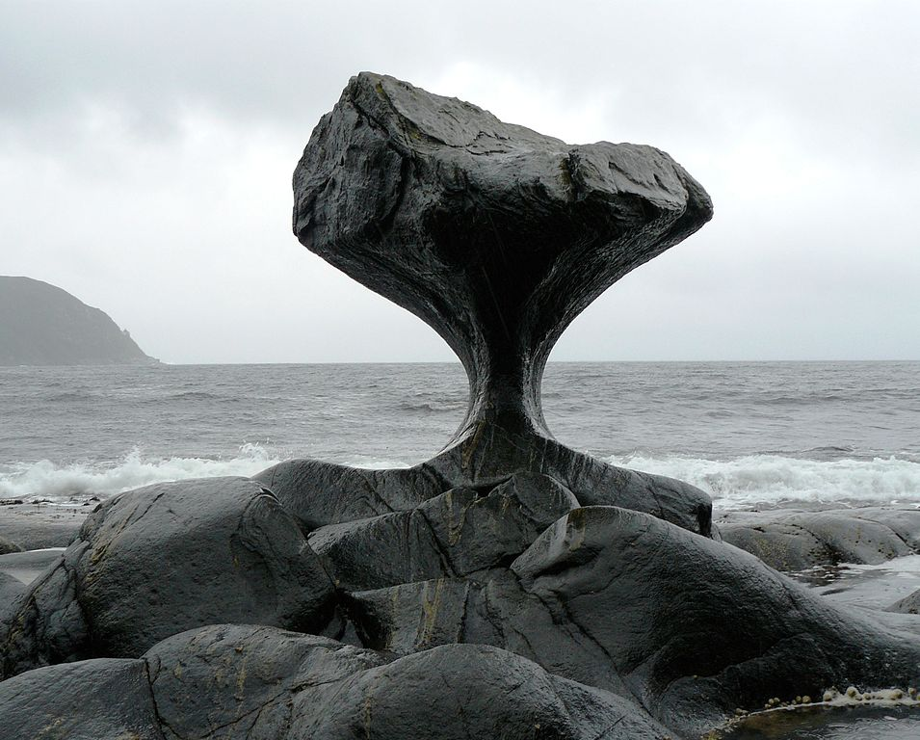
WHERE WE ARE?

Slide 3
WHERE WE ARE?
We are at a cross-road;
Our options are few,
Need to make some very unpopular decisions,
With potentially painful immediate consequences.
There is a bigger problem though;
It’s not a cross-road, it’s a round-about,
……………. and we have been stuck in the circle,
Time is running out,
Our key stakeholders are slowly and steadfastly losing patience with us.

Slide 4
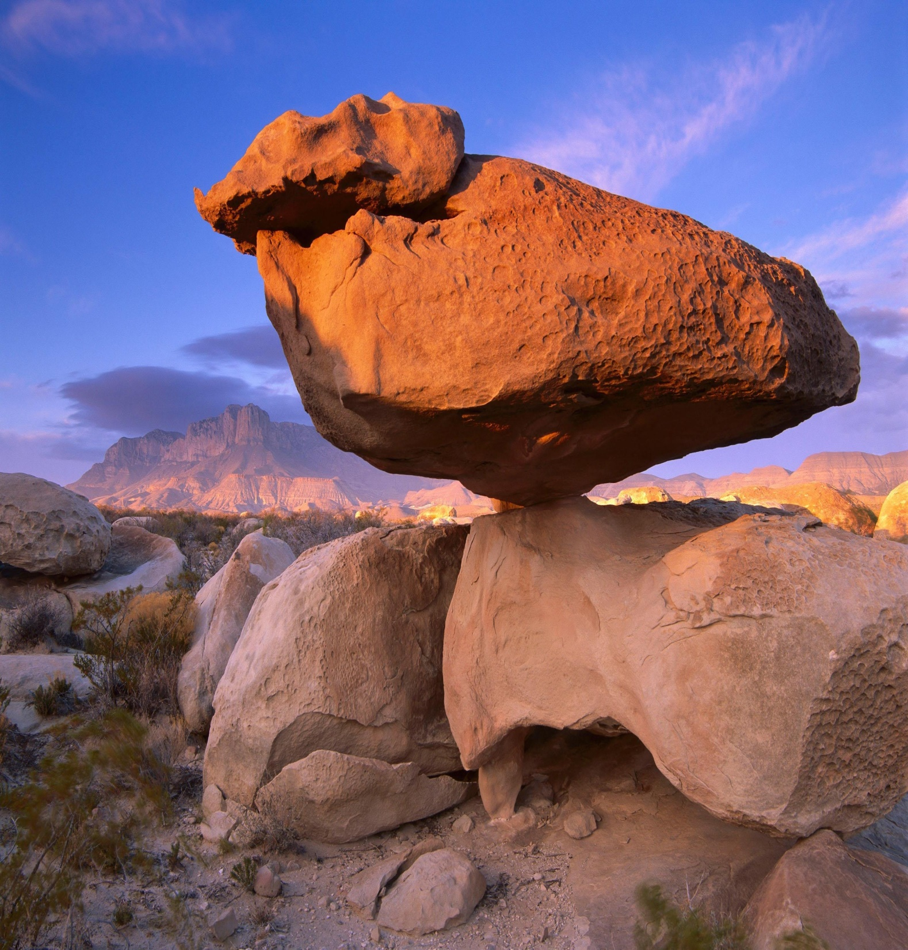
The 7 key levers for a turn-around

Slide 5
7 key levers for THE PENSION FUND industry turn-around
Structural Reconfiguration;
Fundamentals Resetting;
Strategic Positioning;
Regulatory Reforms;
Product Re-designing and Innovation;
Technological Adoption and Digitilisation;
Economic Environment Normalisation.

Slide 6
STRUCTURAL RECONFIGURATION

Slide 7
STRUCTURAL RECONFIGURATION
Legacy DB legal structure super-imposed on DCs;
Risk passed on to Members – but with no accompanying authority;
Trust structure – a company structure could deliver better results;
More innovative, more cost-effective, more member-centric, competition will drive weaklings out, and likely less regulation;
Mistrust between employer and employee irrelevant.
Contributions: Whose money is it?
Beneficial owner Vs legal owner, and the overly-adopted employer partenalism mindset?
Give power to members – and let them vote with their feet.

Slide 8
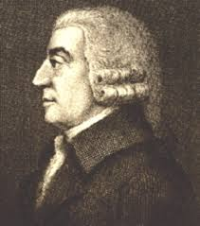
STRUCTURAL RECONFIGURATION (CONTD)
Industry way too fragmented;
Both in terms of number of pension funds and service providers;
Industry consolidation is very long overdue.
Umbrella funds seem our best option;
Economies of scale,
Have both trust and company structure features,
Expert-matter boards of funds,
Fewer entities for the regulator to deal with,
Fierce competition would be for the benefit of members
Profit motive will drive product innovation and cost-effectiveness.
“It is not from the benevolence of the butcher, the brewer, or the baker that we expect our dinner, but from their regard to their own self-interest.”
Adam Smith

Slide 9
Fundamentals resetting

Slide 10
FUNDAMENTALS RESETTING
DBs conts were +/- 22% - 25%, DCs are mostly 10% - 15%;
With the same intended objective, the results cannot be the same.
Consider including allowances in pension salary definitions;
Under a DC regime, pension salary definition for ret benefits does not matter,
There is very little reason, if any, it should matter for the DC risk benefits.
Need clear basis for comparing pension funds;
Fees, investment performance, strategic performance, operational performance, service quality, compliance and governance oversight,
With set benchmarks and performance measures,
That which get measured, gets managed.
Short-termism need to be eradicated;

Slide 11
FUNDAMENTALS RESETTING (contd)
Remunerate trustees adequately;
Pension funds are not-for profit entities, but fund trusteeship is no charity work,
Members can hold trustees to account more when they know they are on the Fund’s allowances-roll,
Effective decision-making process require more frequent meetings and commitment than only four times a year,
Wheels in this industry turn painfully slow.
But are trustees adequately equipped to run such enterprises?
Some pension funds balance sheets are bigger than their sponsoring employers’ own balance sheet;
How much reliance can be placed on service providers – who are self-interested and run profit-seeking businesses.

Slide 12
FUNDAMENTALS RESETTING (contd)
Re-think fee payments;
Why are administration and other fees deducted prior to investing the contributions?
Why not at the end of the month – or even quarterly?
Similarly with risk benefits premiums.

Slide 13
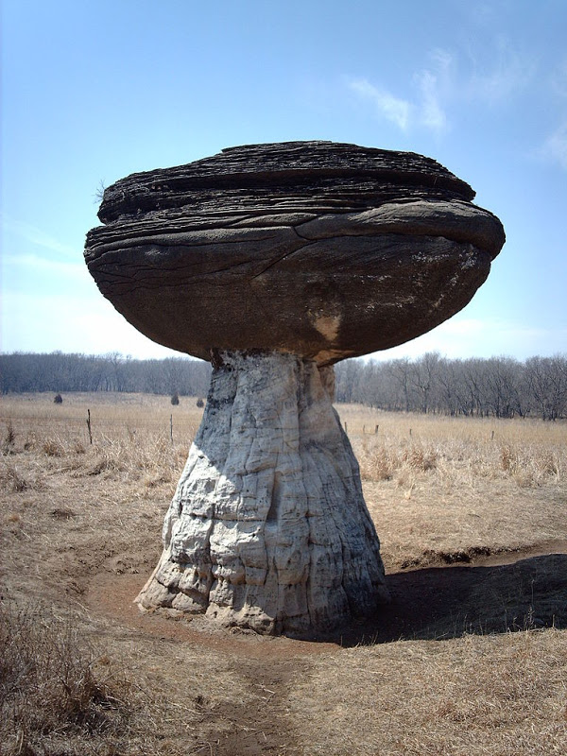
Strategic positioning

Slide 14
STRATEGIC POSITIONING
Industry controls a significant chunk of total national assets (invested);
Can be more than 100% in size of total GDP (currently way too little than that).
Could use that to claim its position as a bastion of economic resilience;
If well organized, structured, and consolidated, it could more easily inform and shape national policy;
Effective foreign investment magnets;
Significant foreign currency generators;
Can be effective promoters of financial inclusion;
Economic growth catalysts and job creators – by investing in the real economy.

Slide 15
Regulatory reforms

Slide 16
Regulatory reforms
Influence strategic direction;
Steer clear from prescriptive regulation though (admittedly, a delicate balancing act required);
Articulate the intended long-term path, and take the industry into your confidence.
Relook and redefine our regulatory regime – current mixed structure confusing;
Sponsoring pension funds by employers not compulsory,
However, once an employer has a pension fund it’s sponsoring then membership by all employees is compulsory;
Why place such a critical life-time decision into the hands of
a third party?

Slide 17
REGULATORY REFORMS (CONTD)
Explore mandatory participation;
But only for later implementation (current trust and confidence levels way too low for such an intervention),
Could widen the savings base though – providing the much-needed economies of scale and investment capital.
Consider auto-enrolment instead;
Auto-enrolment is considered a modern approach,
All companies to have a default pension fund for their employees,
With employee choices for their own preferred pension funds, and
Member opt-out options.
Think Collective Defined Contribution Schemes (CDC);
DC funds that share longevity and investment risks (DCs with DB features);
Gaining popularity in the Netherlands and the UK.

Slide 18
PRODUCT DESIGN AND INNOVATION

Slide 19
PRODUCT DESIGN AND INNOVATION
Focus on Income in Retirement and not Accumulation at Retirement;
They are called pension funds for a reason – to provide a pension in retirement, not to simply manage retirement savings;
Explore the entire spectrum of retirement products (conventional/varying/adjustable/living, annuities, hybrids, tontines, equity-release mortgages, etc).
Current system, one of a few solutions that take their clients only half-way there.
Strike right balance between short, medium, and long-term benefits;
Make pension fund benefits real and tangible for workers
Not a mere far distant concept that only starts to make sense when they are in their twilights,
Meet members’ current needs – e.g. pension-backed home loans,
Make pension fund membership classy and a status symbol through lifestyle and loyalty rewards.

Slide 20
TECHNOLOGICAL INNOVATION AND DIGITILISATION

Slide 21
TECHNOLOGICAL INNOVATION AND DIGITILISATION
Technological advances are a key enabler of both mass distribution and mass customisation;
These include, but are not limited to, artificial intelligence, blockchain technology, machine learning, data harvesting and processing, cloud computing, and robotic process automation.
Huge mindset shift required;
From pension fund administrators to pension fund fintechs or pentechs.
Data is the “new oil” – and it requires a tech-centric approach;
Distribution and client relationship management technology
No longer a “nice-to-have”, but a “must have” digital asset for effective stakeholder communication and engagement.

Slide 22
TECHNOLOGICAL INNOVATION AND DIGITILISATION (CONTD)
Risk management technology
Global Financial Crisis of 2008/2009 (GFC), COVID-19 pandemic of 2020/2021, accelerating Cyber-security Threats have heightened the need for more robust risk management.
Regulatory technology (Regtech)
Effective digital assets for managing regulatory compliance;
Optimal response to continuously increasing amount and depth of reporting required by the regulator.
Operations management technology
Automate and optimise daily processes;
Reduce time lapse from contribution payroll deduction to investment,
Minimise costs for benefit statement generation and distribution;
Eliminate human processing delays in benefit settlements on exit from the fund;

Slide 23
Economic environment normalization

Slide 24
Economic environment normalisation
Invest in the real economy;
Alternatives steadily becoming mainstream globally;
Pension funds need to help develop the skill required for alternatives investments (chicken-and-egg scenario);
Private capital assets expand the investment universe;
What we need is a robust eco-system that allows for the flow of capital from pension funds to private companies in a risk-controlled environment,
The opportunities are there, the need for capital is there, and pension funds have the capital, what’s lacking is a trusted system for capital deployment.

Slide 25
Economic environment normalization (CONTD)
Focus on infrastructure development;
Design, Build, Operate and Transfer (DBOT) models are attractive investments for private investors;
Forge Public-Private Partnerships.
Aggregate assets for offshore investments;
Few pension funds are big enough to be able to meaningfully deploy assets offshore;
Industry should partner with experienced offshore fund allocators to help ride through the learning curve.

Slide 26
Economic environment normalization (CONTD)
Our economic problems are a manifestation of our currency challenges and shortages;
Pension funds could mandate their assets to be invested in mostly targeted foreign currency generating sectors only.

Slide 27
Where we draw our inspiration?

Slide 28
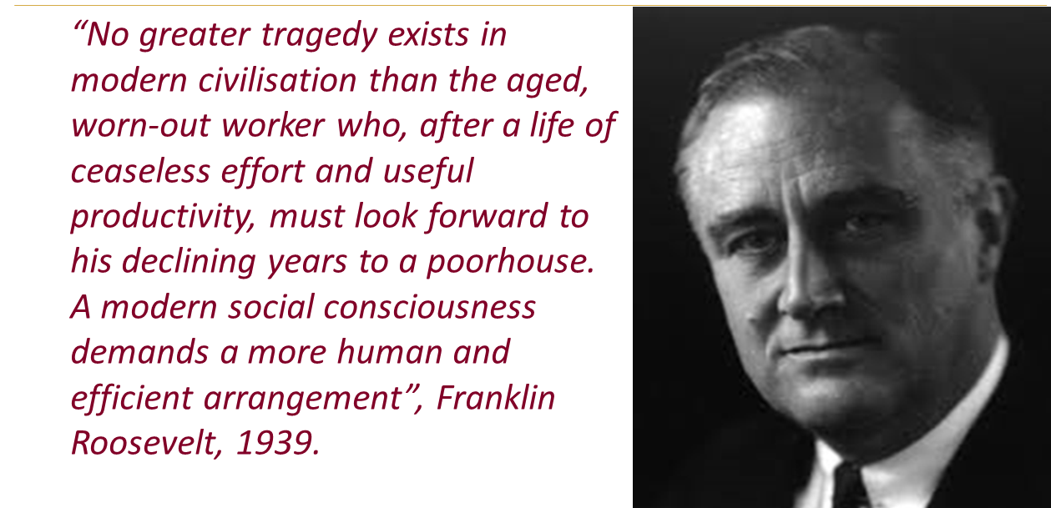
INSPIRATION

Slide 29
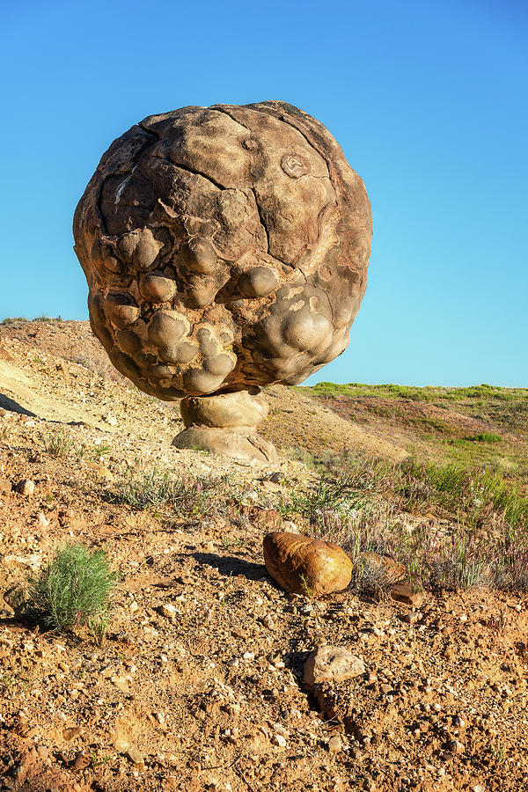
Thank you!
gandy@rimcasolutions.com

