Slide 1
Regulatory Update Regulatory Update At ZAPF Convention By Cuthbert Munjoma Director, Pensions and Life Insurance Supervision
07 October 2024

Slide 2
Presentation Outline
Compliance with Governance Requirements
Adoption of Global Standards
Emerging Issues in Global Pensions Industry
Updates on Other Compliance Matters
Concluding Remarks

Slide 3
Rationale for PAS
Pensions Compliance Dashboard

Slide 4
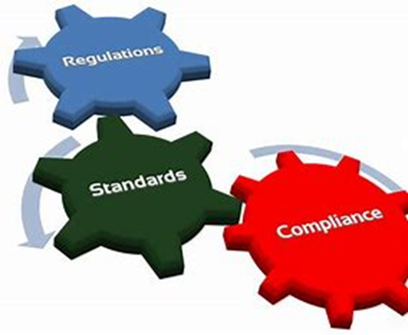
Rationale for PAS
Compliance with Statutory Reporting
Delays in filing Q2 returns by few entities
Perennial failure to submit audited finstats within prescribed timelines
Partial submissions and non-submission of required disclosures
Penalties for non-compliance
Boards of Funds to recover penalty amounts from administrators
Lack of capacity among administrators to prepare accounts
Figures not reconciling to the underlying reports i.e. Property valuations and Actuarial reports.
Some financial statements are arithmetically incorrect, which puts to question the quality of external audits being carried out.

Slide 5
Rationale for PAS
Boards of Funds
Compliance with Minimum Qualifications
18% of BOF members do not have COP
37% of BOF members have been in office for more than 10 years
Knowledge – collective skills mix and individual experience
Qualifications for managing the fund- section 24(3) of the Act.
honest and integrity
Term limits for BOF members capped at 10 years
Disqualifying them in terms of provisions of the Act
Call for continuous professional development

Slide 6
Rationale for PAS
Boards of Funds…
Independent Expert Board of Fund Member
Rationale when skills already available
Cost implications on small funds
Voting Rights of an independent Member
Requests for exemptions

Slide 7
Rationale for PAS
Data Integrity
Data integrity challenges persist despite investment in systems
Costs of imported systems still high
Use of Moral suasion to share IT infrastructure
IPEC’s acquisition of an Electronic Supervisory System
Proposal for one IT system for the pensions industry as not for profit national infrastructure

Slide 8
Rationale for PAS
Governance of Preservation Funds
Deferred pensioners constitute 46% total membership
Compromised Governance of preservation funds
Boards conflicted as they are appointed by administrators
No clear accountability mechanisms to members

Slide 9
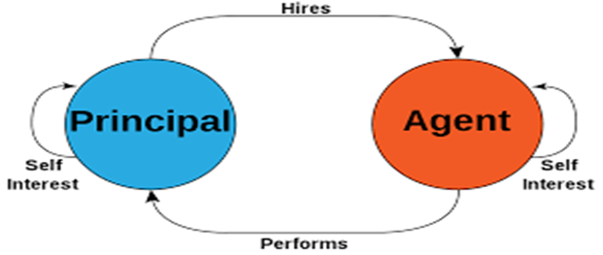
Rationale for PAS
Governance of Preservation Funds….
No audits and actuarial valuations of their own
Asset ownership opaque
Several complaints relate to preservation funds
Call for compliance with the Guideline on Governance Requirements for Umbrella and Preservation Funds

Slide 10
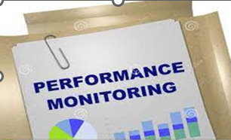
Pension Funds’ AGMs
Emerging Issues from AGMs held to date
Qualification of financials on account of currency change, with some members hesitant to approve the financials.
Members challenging the valuation of investment property as understated and prejudicial to pensioners.
Low participation by members for other funds due to lack of appreciation of financials.
No discussions on asset managers performance benchmark.
Pensioners for mature funds calling for representation in the Boards.
Non-issuance of benefit statements
Need to comply with Guideline on Conduct of AGMs

Slide 11
Pension Fund’s Investments
Board oversight on investments
Performance benchmarks of asset managers
Registration of fund’s assets in the fund’s name
Tracking of forex income and payment of benefits in forex
Board’s role to ensure remittance of contributions and engagements with employers on arrears
Need to manage concentration risk:-
ESATF preference shares - US$13.7 million
Exposure to ZETDC & Investment Property
Call for syndication on projects

Slide 12
Compliance with Expense Framework
Urged to ensure compliance with the Expense Framework
Mandate agreements /SLA to align with Expense Framework

Slide 13
Adoption of IOPS Principles
Domestication in legal and regulatory frameworks
Adoption of Risk-Based Supervision - proportionality
Conduct of Risk-Based offsite and onsite inspections.
Electronic Supervisory system to monitor risk and aid Risk-based supervision

Slide 14
Climate Risk - ESG
Gvt commitment at international and national level
Priority areas identified through National Determined Contributions
Need for a Green Financing Policy as informed by the Green Policy
Need for Guidance on International Standards to follow for the sector
Call for a Green Financing Policy Framework
Work underway to develop a taxonomy through support from AfDB
Integration of ESG considerations in decision making helps to create a sustainable future

Slide 15
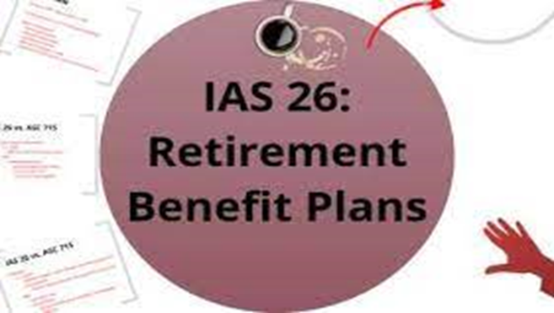
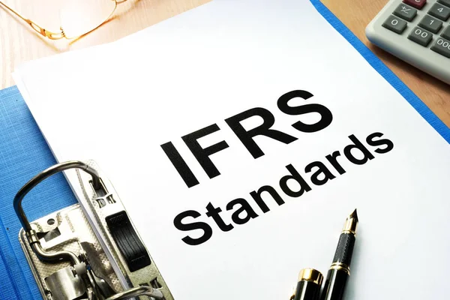
International Financial Reporting Standards
Engagements with PAAB
Functional currency
Adoption IAS 29
IASB changes to IAS 21 beginning on or after 1 January 2025.
Earlier application is permitted.
Expected to address the issue of fair value measurements going forward.
Urged to adopt IFRS standards

Slide 16
FATF Standards on AML/CFT PF
Domesticated through the MLPC Act
Call for a risk-based approach – section 12 B of MLPC Act on conduct of ML/TF institutional risk assessment
Risks of new products, delivery channels and assets such as crypto
Sectoral risk assessment – low risk for pensions
Relaxed AML/CFT measures
Demonstrate understanding of risks to support resource allocation
Policies and procedures must address the risks identified, including trainings

Slide 17
Value for Money Concept
Mooted by the UK Pension Regulator – Value for Money Framework
Being replicated in other jurisdictions
Call for introspection on value being created by key service providers of pension funds
Need for objective way of assessing their value addition
Boards of Funds and Principal Officers are challenged to reflect on value for money concept

Slide 18
Pre-2009 Compensation
Most pension funds submitted compensation schemes
Only 2 schemes has been approved
Reasons for not approving
Incorrect methodology applied
Data issues in the actuarial reports & member schedules
For insured schemes, life insurance companies have not yet fully demonstrated separation of assets for P/Hs and S/Hs
Call for closure of the long-outstanding matter

Slide 19
Other Compliance Matters

Slide 20
2024- Currency Reforms
Guidance on conversion of assets & liabilities from ZWL to ZiG issued by the Commission
Submission rate still low
Validating conversions & providing feedback to entities
Imposition of penalties on non-compliant pension funds

Slide 21
Concluding Remarks
Effective leadership on pension funds critical to improve member outcomes
Set to issue a revised Risk and Corporate Governance Directive for Pensions Industry
Pushing for Gazetting of Pension and Provident Funds Regulations before year end
All fund rules to be aligned with new Regulations and Revised Risk and Corporate Governance Directive
IPEC to share strategic focus areas for 2025 before year end

Slide 22
Comments & Questions??
WhatsApp: +263 772 154 281
Email: enquiry@ipec.co.zw
Facebook: Insurance and Pensions Commission
Twitter: @IPECZW
Website: www.ipec.co.zw

