Slide 1
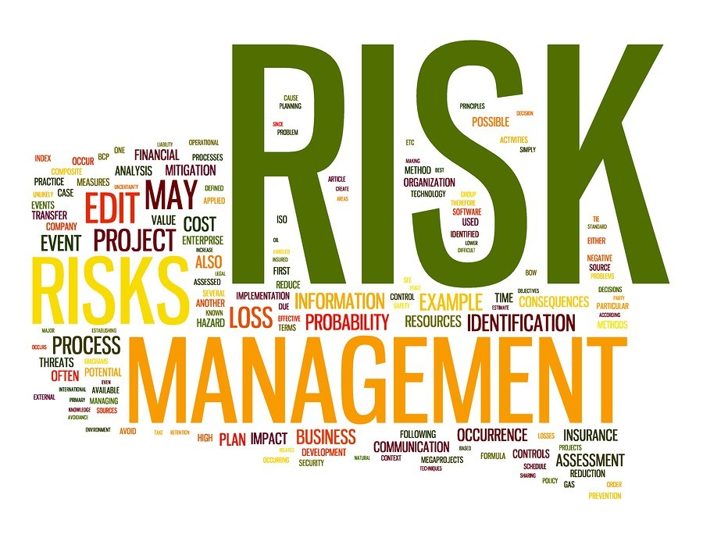
Navigating Uncertainty: Risk Management Strategies for Preservation and Growth
GLORIA ZVARAVANHU

Slide 2
Setting the Scene
Uncertainty is the new operating environment
Pension funds face rising pressure from global and local forces
We will cover;
Practical risk management strategies, leadership principles, and practices for preservation and growth
Reinforce trustees' vital role in governance and risk oversight

Slide 3
ARE PF TRUSTEES LOSING SLEEP OVER…
Member trust and equity?
Longevity risk?
Liquidity and solvency?
Investment risk and volatility?
Governance and fiduciary responsibility
Depleting role in economic security?
Increasing complexity and scrutiny?
Regulatory Compliance?

Slide 4
ROLES AND RESPONSIBILITIES OF TRUSTEES IN RISK MANAGEMENT
Act in beneficiaries’ best interest
Approve and monitor risk strategy
Ensure controls and structures
Manage conflicts of interest

Slide 5
Managing the Governance risk
Regulator trustees training and Development
Diverse perspectives and Expertise
Robust governance frameworks
Conflict of Interest Management
Long term planning

Slide 6
OVERSIGHT AND GOVERNANCE BEST PRACTICES
Annual board risk workshops
Risk and audit committees
Expert reviews
KPI-linked risk evaluation
Risk in strategic agendas

Slide 7
THE GLOBAL RISK LANDSCAPE – WHY IT MATTERS
Risk | Relevance to Pension Funds
Inflation & Interest Rate Volatility | Reduces the real value of retirement payouts; disrupts bond pricing and actuarial assumptions.
Geopolitical Instability | Impacts offshore investments and causes market volatility, affecting portfolio performance.
Tech Disruption (AI, Cyber) | Threatens member data, administration platforms, and investment management systems.
Climate Extremes | Damages physical assets; increases exposure to underinsured risks.
Regulatory Shifts | Alters compliance obligations; affects asset allocation and long-term strategy.
Demographic Trends | Longer life expectancy increases liabilities; necessitates adaptive actuarial and funding models.

Slide 8
Managing the Global/Emerging Risks
Diversification and flexibility
Scenario planning and stress testing
Investing in resilience
Global networks and partnerships
Continuous learning and Innovation

Slide 9
LOCAL RISK CONTEXT – ZIMBABWE
Currency volatility, inflation
Real estate over-concentration
Infrastructure and political risks
Regulatory Changes
Confidence erosion

Slide 10
Risk management Responses…
Currency diversification (offshore)
Manage real estate concentration through class diversification/regular rebalancing
Sectoral diversification
Transparent communication

Slide 11
Pension Fund Risk Management Strategy
⚖️ 1. Governance and Oversight
📊 2. Investment Risk Management
🏦 3. Operational Risk Controls
🛡️ 4. Regulatory and Compliance Risk
🔄 6. Liquidity and Cash Flow Risk
🔍 7. Transparency and Member Communication
📈 8. Performance and Risk Metrics

Slide 12
Insurance as a Risk Transfer Strategy
Insurance Type | Application in Pension Fund Governance
Fidelity Guarantee | Covers losses from fraud or theft by fund or admin personnel.
Directors & Officers (D&O) Liability | Protects trustees and directors against personal liability in governance decisions.
Cyber Insurance | Mitigates financial loss from cyberattacks, ransomware, or data breaches.
Professional Indemnity | Covers advice-related errors by asset managers or fund administrators.
Property Insurance | Protects real estate or infrastructure assets held in the investment portfolio.

Slide 13
Strategic Investment Risk Management – Preserving Value
Strategy | Pension Fund Application
Diversification | Spreads risk across geographies and asset classes, reducing exposure to local shocks.
Hedging | Shields against currency volatility and inflation risk.
ESG Integration | Builds resilience by aligning investments with long-term sustainability and regulatory trends.
Liquidity Planning | Ensures cash flow to meet benefit payments without fire-selling assets.

Slide 14
Risk Management Strategies for Growth
Strategy | How It Drives Growth
Dynamic Asset Allocation | Allows tactical shifts in portfolio weights to seize market opportunities and adapt to macro conditions.
Diversification (Global & Sectoral) | Enhances return potential by accessing high-growth sectors and geographies while reducing concentration risk.
Inflation-Linked Investments | Protects purchasing power while unlocking growth in sectors like infrastructure and commodities.
Alternative Assets | Adds yield and diversification through private equity, real estate, infrastructure, and hedge funds.
ESG-Driven Investment | Taps into long-term growth megatrends (climate tech, sustainable infrastructure); enhances resilience.
Robust Governance | Ensures agile yet accountable decision-making aligned to growth mandates.
Liquidity Optimization | Balances growth allocation with readiness to meet obligations; avoids forced selling in downturns.

Slide 15
Leadership Principles for Uncertain Times
Lead with clarity
Agile decision-making
Risk fluency
Long-term decision-making
Purpose-led culture

Slide 16
Opportunities in Adversity
Climate-resilient infrastructure
Digital transformation
Regional pension collaborations
REITs and alternative assets
Align with ESG

Slide 17
Action Plan for Trustees and Fund Managers
Refresh risk registers
Reassess insurance
Align investments to liabilities
Build ESG capacity
Member communication and self-assessments

Slide 18
Final Reflection
"Uncertainty isn’t something to avoid – it’s something to lead through."
Preserve value. Grow with purpose.
Thank You.

