Slide 1
Navigating Zimbabwe's Investment Maze
Presented By: Onismas Karakadzai CA(M),FCCA
ZAPF 50th Anniversary Conference-15 May 2025

Slide 2
Presentation Outline Pre-Independence Post Independence

Slide 3
Pre-Independence (1960-1979)
State-Driven
UDI
ZSE
Federation (Salisbury concentration)
Sanctions

Slide 4
Independence: (1980-1990) Era
Education
Healthcare
Social Services
International Investors
National Debt

Slide 5
Economic Structural Adjustment Program (ESAP) Era (1990-1995)
Year | GDP Growth (%) | Inflation Rate (%) | Interest Rate (%) | Fiscal Deficit (% of GDP) | Current Account Balance (US$ mn) | Exchange Rate (Z$ per USD) | External Debt (US$ bn)
1991 | 4.3 | 23.5 | 18.0 | -9.3 | -372 | 5.1 | 3.5
1992 | -5.0 | 42.1 | 27.5 | -10.6 | -431 | 6.5 | 3.7
1993 | 2.0 | 25.0 | 29.0 | -8.1 | -410 | 7.9 | 3.9
1994 | 5.0 | 22.6 | 26.5 | -7.5 | -398 | 8.7 | 4.1
1995 | 3.0 | 22.0 | 23.0 | -7.2 | -450 | 9.6 | 4.3
World Bank

Slide 6
Post ESAP (1996-1998)
SI 281 of 1997
Once-off gratuity of totalling Z$4.2 billion. Unbudgeted and equivalent to about 3% of the nation's GDP at the time.
November 14, 1997.
International Monetary Fund. (1998). Zimbabwe: Recent Economic Developments.
Indicator | 1996 | 1997 | 1998
GDP Growth (%) | 8.0 | 3.1 | -1.2
Inflation Rate (%) | 16.0 | 20.1 | 48.0
Budget Deficit (% of GDP) | -7.2 | -10.2 | -11.5
ZWD/USD Exchange Rate | 10.0 | 17.0 | 38.0
Agriculture Output (% of GDP) | 18.0 | 17.2 | 16.5

Slide 7
1996-1999-GDP

Slide 8
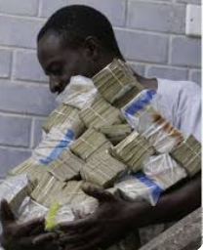
Economic Nightmare Era (2000-2009)
Curatorship
ZSE Overheat
Sanctions
Infrastructure Collapse
Hyperinflation
Global credit crunch
Property Mkt freeze
Investments Value loss

Slide 9
2000-2009 GDP-Result

Slide 10
Silver Lining…… (2009-2013)-GDP
Roads Infrastructure
Multi currency
Investor confidence
Construction boom
Savings Culture
Source: World Bank

Slide 11
2014-2024-GDP
Source: World Bank

Slide 12
Recent Economic Reform Attempts (2013-2023)
Period | Reform | Objective
2013–2018 | Zim Asset | Economic revival through value addition & growth
2016–2020 | Command Agriculture | Boost food production, especially maize
2019–2021 | Currency Reform (SI 142 of 2019) | Restore monetary sovereignty
2020–2023 | Auction Forex System | Exchange rate stability
2021–2025 | NDS1 | Economic modernisation and structural reform

Slide 13
Statutory Instruments
SI 133 of 2016- Bond Notes Regulations
S.I. 142 of 2019-RBZ Legal Tender Regulation (sole legal tender)
SI 218 of 2023 Presidential Powers (Temporary Measures) (Amendment of Exchange Control Act) Regulations, (Multicurrency up to 2030)

Slide 14
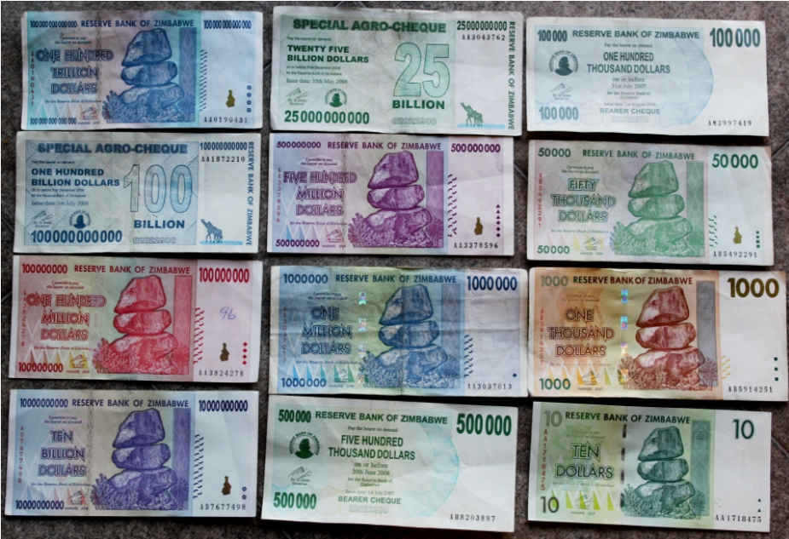
Currency Regime Changes (14 Episodes)
Period | Currency Episode
1980-1983 | ZWD series
1993-2003 | ZWD series
2003-2004 | The Cargill Cotton bearer cheques
2003-2006 | RBZ Bearer Cheques
August 2006 – August 2008 | The first re-denomination ZWN bearer cheque series
2007 | Abortive Sunrise 2 series
2008 | The 2008 bearer cheque series
2008 | The Special Agro. Cheques of 2008
2008-2009 | The Third Zimbabwe Dollar (ZWR):
February 2009 – April 2009 | The short-lived fourth dollar (ZWL):
2009-2019 | A decade of dollarisation
2016-2019 | The Bond Note and Coin
2019-2023 | Return of the Zimbabwe dollar (ZWL)
2024 | Zimbabwe Gold (ZiG)
International Monetary Fund (IMF), 2010. Zimbabwe: Staff Report for the 2010 Article IV Consultation. Washington, D.C.: IMF.

Slide 15
Corporates
Inflation and economic instability saw several counters delisting.
Kingdom Bank (2006)
Interfresh Holdings (2007)
CFX Bank (2008)Trust Holdings (2009)
Radar (2010)
Hwange Colliery (2018 its suspended till today)
Border Timbers (2021)
Zimre. Property Investments (ZPI) (2019)
Old Mutual and PPC (Suspended in 2020)
Border Timbers (2021, voluntary)
Dawn Properties (2022) Delisted and merged with African Sun Limited (hospitality sector consolidation).
Truworths (2020)
Bindura(2023)(Suspension pending corporate structure of Trojan Mine Lafarge(2023)(Voluntary suspension, now under corporate rescue)
Meikles (Suspended in 2024)
Corporate Rescues continues

Slide 16
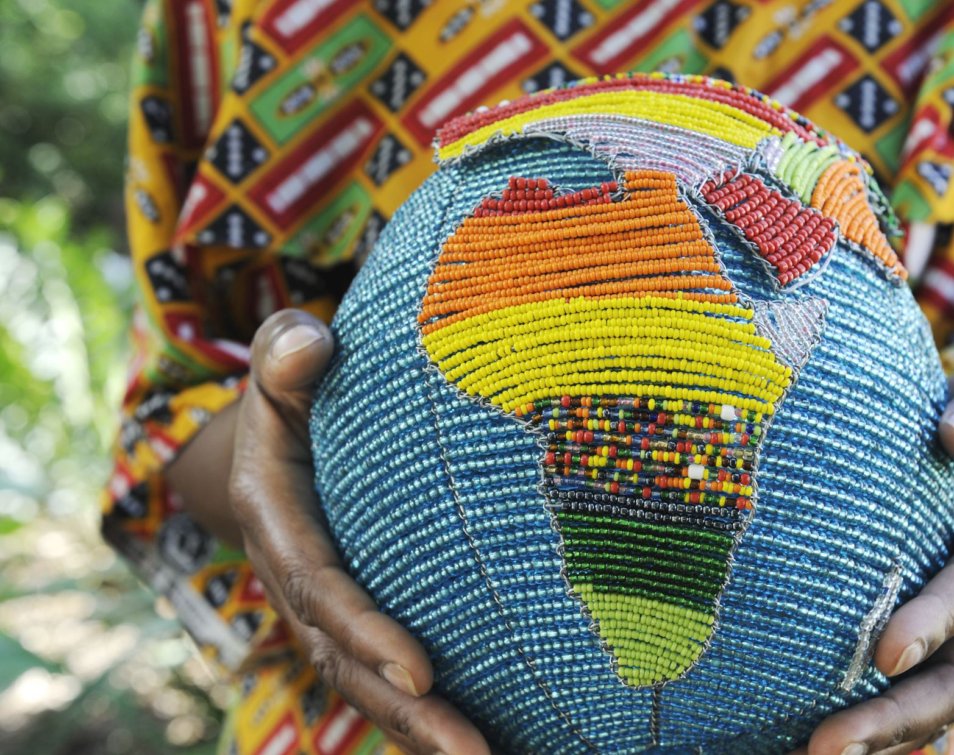
Overall Health Check!!!!

Slide 17
Economic Growth (1960-2024)
Source: World Bank

Slide 18
External Debt (% of GDP) - 25 Year Trend
Source: World Bank

Slide 19
Foreign Exchange Reserves (Months of Import Cover) - 25 Year Trend
Source: World Bank

Slide 20
Balance of Payments (BOP) Comparison
Country | Current Account Balance (% of GDP) | Foreign Reserves (months of imports) | External Debt (% of GDP)
Zimbabwe | -2.8% | 0.9 months | 78.6%
Global Average | -0.4% | 8.5 months | 61.3%
South Africa | 3.7% | 6.2 months | 51.2%
Nigeria | -2.4% | 7.5 months | 38.4%
SADC Average | -1.2% | 4.7 months | 58.2%
International Monetary Fund (IMF), 2024. IMF Country Report No. 24/126: Zimbabwe – Staff Consultation. Washington, DC: IMF.

Slide 21
Zimbabwe vs. African Nations
Country | GDP (Nominal, 2024) | GDP per capita (2024) | Inflation Rate (5-year Average) | Notes
Zimbabwe | $35.2 billion | $2,117.8 | ~255% | -
South Africa | $373.1 billion | $6,022.5 | 4.7% | Largest SADC economy
Angola | $95.2 billion | $2,308.2 | 25.2% | Oil-dependent economy
Tanzania | $77.5 billion | $1,207 | - | Emerging East African hub
Mozambique | $16.1 billion | $468 | 7.3% | Lower GDP but growing due to gas
Africa Average | $2.6 trillion | $2,000 | 8.5% | -
Global Average | $104.6 trillion | $12,263 | 2.3% | -
Source: World Bank

Slide 22
Infrastructure Development Index
Country | Africa Infrastructure Dev. Index | Energy Access | Road Density | Internet Penetration
Zimbabwe | 24.1/100 | 41% | 25 km/100km² | 33.4%
South Africa | 79.8/100 | 84% | 62 km/100km² | 68.2%
Kenya | 36.4/100 | 70% | 28 km/100km² | 40.5%
Nigeria | 23.5/100 | 55% | 21 km/100km² | 42.0%
SADC Average | 32.7/100 | 53% | 31 km/100km² | 38.3%
African Development Bank (AfDB), 2022. Africa Infrastructure Development Index (AIDI) 2022 Report.

Slide 23
Zimbabwe Capital Markets

Slide 24
Zim Capital Markets
Q4 2024 Trading Activity |  | ZSE | VFEX | FINSEC | Market
Market Turnover (USD' m) |  | 37.51 | 26.96 | 0.128 | 64.61
Foreign Participation (Buy Side %) |  | 8 | 2.5 | - | 5.74
Foreign Participation (Sell Side %) |  | 22.66 | 76.81 | - | 44.99
# of Trades |  | 6,370 | 3,321 | 65 | 9,756
Mkt Cap. As at 31 December 2024 (USD' m) |  | 2,568 | 1,280 | 20 | 3,868
Source: SECZ

Slide 25
Who is Investing on the ZSE?
Year | 2017 | 2018 | 2019 | 2020 | 2021 | 2022 | 2023
Local Investors | 70% | 69% | 66% | 77% | 88% | 81% | 93%
Foreign Investors | 30% | 31% | 34% | 23% | 12% | 19% | 7%
Source: SECZ

Slide 26
Pension Funds Assets (USD ‘bn) GDP 2010-24

Slide 27
Distribution of Pension Assets
Source: IPEC Annual reports

Slide 28
Number of Pension Funds and Contributions
Source: IPEC Annual reports

Slide 29
Funds Under Management-Dec 2024
Source: SECZ Annual reports

Slide 30
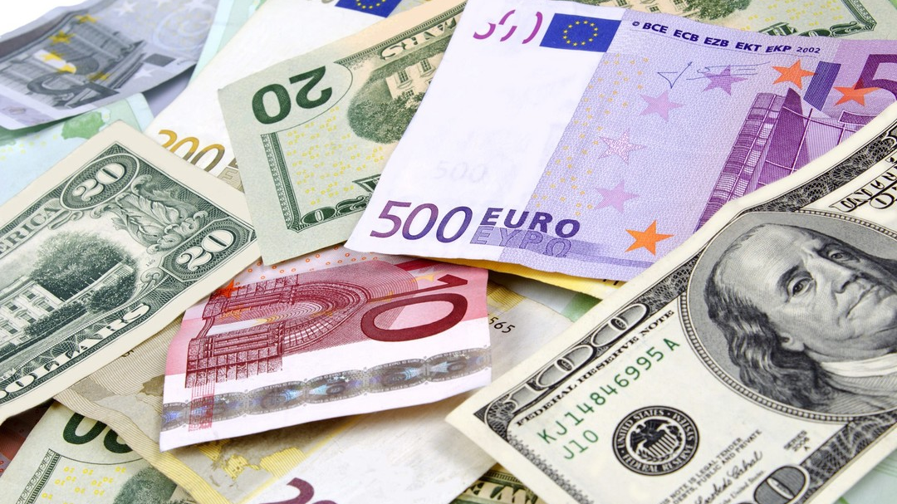
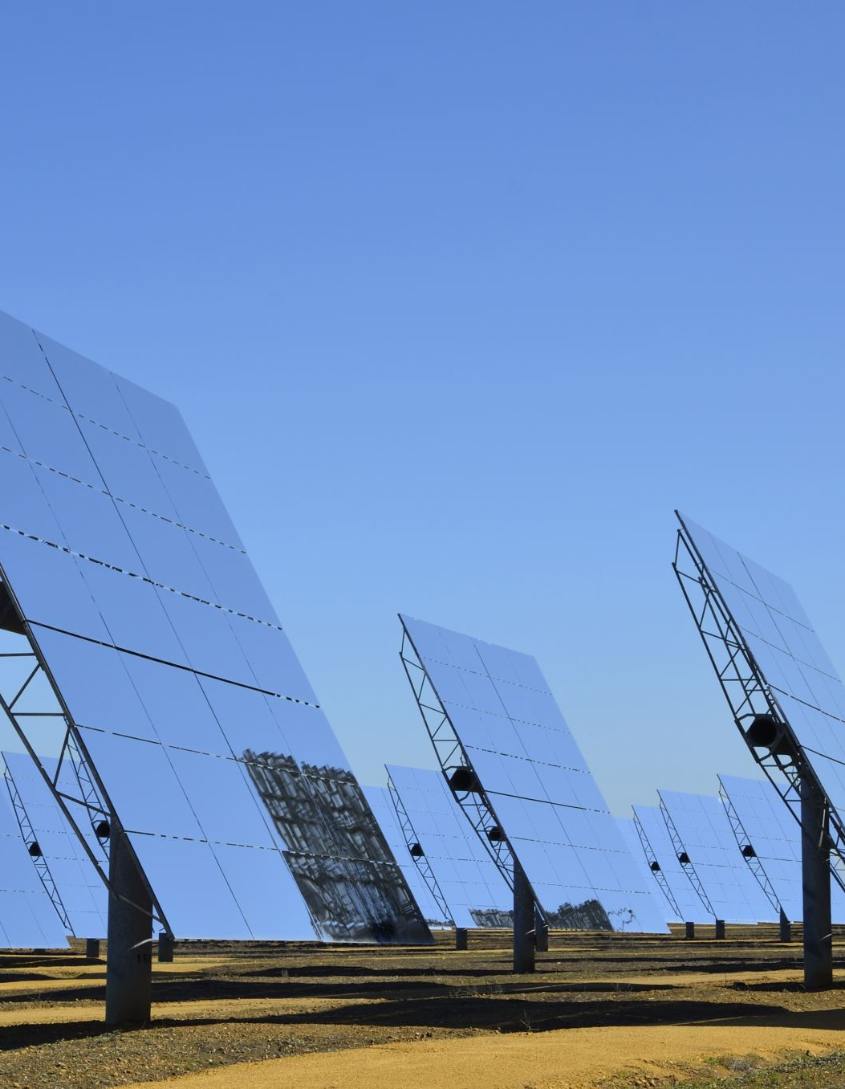
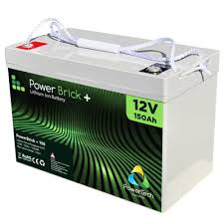
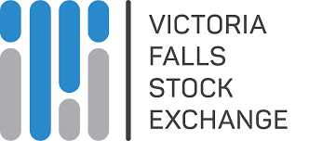
Finding the Green Path
Manufacturing
AI
Renewable Energy
Healthcare
Private Equity
REITs
Tourism
ZIDA investor programs
VFEX and ZSE
Offshore (15%)

Slide 31
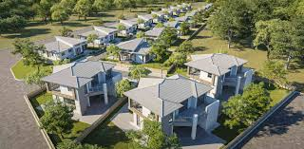
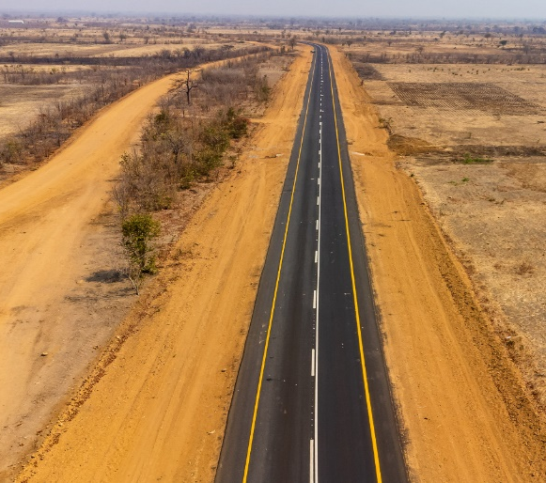
Prescribed Asset Projects
128 PA Projects
35% Uptake
2017-2025
USD4.2 Bn

Slide 32
Thank You!!

