Slide 1
State Service Pension Funds Modeling and Investment; Key pillars & attributes.
ZIMBABWE ASSOCIATION OF PENSION FUNDS (ZAPF)
15 MAY 2025, VICTORIA FALLS
PRESENTATION BY: DR. F. GABA
Ph.D. Economics (S.A)

Slide 2
Why state service pension funds are necessary
Provide retirement security,
Stabilisation Mechanism: (automatic stabilization during down turn); as catalyst,
Long-term Savings Vehicles,
Mobilize domestic capital,
Drives Gvt investment agenda and policy &NDS1.

Slide 3
Key Pillars of State Service Pension Fund Modeling
Governance
Funding and contribution design
Actuarial valuation
Fund oversight
Investment strategy
Benefit design

Slide 4
Fund Governance
✓ Delegation of Authority
Defines clear roles and limits for decision-making within the Fund.
Trustees retain ultimate fiduciary responsibility but delegate operational tasks to management
Enhances efficiency while maintaining strong oversight and accountability.
✓ Investment Policy Statement (IPS)
Guides investment objectives, asset allocation, risk management, and performance benchmarks.
Aligns the Fund’s investment activities with its long-term liabilities and return expectations.
Serves as a critical governance tool
✓ Compliance
Ensures all Fund activities conform to laws, regulations, internal policies, and ethical standards.
Covers regulatory reporting, anti-money laundering (AML), fiduciary duties, and investment rule adherence.
Protects the Fund’s reputation, legal standing, and beneficiary interests.
Quick Summary
Strong governance is the foundation of a sustainable pension fund — with clear delegation, a sound investment framework, and rigorous compliance systems ensuring accountability and long-term success.

Slide 5
Funding and Contribution Design
Core Objective:
Ensure that contributions from (employees, employers) are sufficient and sustainable to meet projected benefit payments.
Balance the Fund’s long-term solvency with affordability and fairness for all stakeholders.
Key Considerations:
Demographic assumptions (e.g., life expectancy, retirement age)
Economic assumptions (e.g., investment returns, inflation rates)
Regulatory funding requirements and fiduciary standards
Defined Benefit (DB) Scheme:
Promises a pre-determined pension benefit at retirement, typically based on salary history and years of service.
Employer bears investment risk and longevity risk.
Requires ongoing actuarial assessments to ensure liabilities are matched by assets.
Treasury settles balance inn payments

Slide 6
Periodic Actuarial Valuation
A periodic actuarial valuation assess the financial health of the Fund by comparing its assets to its projected liabilities.
Purpose:
Determine if the Fund is fully funded, underfunded, or overfunded.
Recommend adjustments to contribution rates or benefit structures if necessary.
Validate long-term sustainability assumptions (such as mortality, retirement patterns, salary growth).
Key Components:
Asset valuation (current value of investments)
Liability projection (present value of future pension obligations)
Funding ratio (assets ÷ liabilities)
Deficit/surplus analysis and funding recovery plans (if needed)
Regulatory Expectation:
Valuations are typically required every 3-5 years (or more frequently if major changes occur)
Longevity risk, inflation, discount rates
Funding ratio and solvency assessments

Slide 7
2. Fund Investment Oversight
Board & Sub-Committees
Fund Investment Advisor
(Strategic advice)
Fund Managers
(Execute investments under IPS mandates)
Custodial Institutions
(Safeguard assets, settle transactions)
Property Managers
(Manage real estate assets)
Actuarial Institution
(Evaluate liabilities, recommend funding levels)

Slide 8
3. Investment Strategy 🎯
The investment strategy must balance the dual objectives of growth and capital preservation to meet both current and future pension obligations.
A Strategic Asset Allocation (SAA) should be established, reflecting the Fund’s:
Risk tolerance,
Liability structure, and
Long-term return objectives.
Portfolio diversification across asset classes (equities, fixed income, real estate, private equity, infrastructure, alternatives) is essential to mitigate risks and optimize returns.
Periodic rebalancing should be conducted to ensure adherence to the strategic allocation and avoid style drift.
Developmental investments (e.g., student housing, healthcare, renewable energy) must be blended with traditional assets to support both portfolio performance and economic impact.
Return based (matrices and permutations)
National impact and support NDS1
Asset Fungibility

Slide 9
4. Benefit Design
The benefit structure must be financially sustainable, aligning with the Fund’s long-term actuarial valuations.
Key features include:
Defined Benefit (DB) or Defined Contribution (DC) structure clarity.
Regular actuarial reviews to assess contribution adequacy and benefit viability.
Incorporation of indexation mechanisms (inflation adjustment) where applicable, to protect retirees’ purchasing power without unduly burdening the Fund.
Provision for commutation, survivor benefits, disability pay-outs, and early retirement options, all factored into actuarial modeling.

Slide 10
5.0 Risk Management
A comprehensive Enterprise Risk Management (ERM) framework must underpin Fund operations.
Key risks to manage include:
Investment risk (market volatility, asset concentration),
Longevity risk (members living longer than expected),
Operational risk (process failures, fraud),
Liquidity risk (ability to meet short-term obligations),
Regulatory and compliance risk (changes in pension laws, tax treatment).
Projects/ investment bankability full scoping)
Risk appetite statements, risk registers, and key risk indicators (KRIs) should be maintained and updated regularly.
Regular stress testing and scenario analysis must be conducted to assess fund resilience under adverse market conditions.
Internal audit and external oversight (e.g., OAG audits) reinforce risk governance and transparency.

Slide 11
Core Attributes of a Well-Modeled SSPF
Sustainability
Adequacy
Affordability
Efficiency
Transparency
Resilience
Developmental Impact

Slide 12
Critical Success Factors
Strong Institutional Capacity
Stakeholder Engagement
Continuous Improvement
Legislative Support

Slide 13
Africa State Pension Funds — Overview
Country | Fund Name | Formed | Assets (2024) | Main Asset Manager(s) | Regulator
South Africa | Government Employees Pension Fund (GEPF) | 1996 | ~$172 billion | Public Investment Corporation (PIC) | Financial Sector Conduct Authority (FSCA)
Nigeria | Various Funds (PenCom Supervised) | 2004 | ~$160.9 billion | Multiple PFAs (e.g., ARM, Stanbic IBTC) | National Pension Commission (PenCom)
Uganda | National Social Security Fund (NSSF) | 1985 | ~$6.07 billion | Internally managed | Uganda Retirement Benefits Regulatory Authority (URBRA)
Kenya | National Social Security Fund (NSSF) | 1965 | ~$12.6 billion | Internal + external (e.g., ICEA Lion, Britam) | Retirement Benefits Authority (RBA)

Slide 14
Africa State Pension Funds — Overview
Ghana | Various Funds (NPRA Supervised) | 2010 | ~$4.93 billion | Corporate Trustees + Asset Managers (e.g., Databank) | National Pensions Regulatory Authority (NPRA)
Namibia | Government Institutions Pension Fund (GIPF) | 1989 | ~$6.4 billion | External managers (e.g., Allan Gray Namibia, Investec) | Namibia Financial Institutions Supervisory Authority (NAMFISA)
Tanzania | National Social Security Fund (NSSF) | 1997 | Not fully disclosed | Internally managed + real estate partners | Social Security Regulatory Authority (SSRA)
Botswana | Pula Fund | 1994 | ~$4.1 billion | Bank of Botswana + International (e.g., BlackRock) | Bank of Botswana

Slide 15
Top State Service Pension Funds in Europe
Country | Fund Name | Formed | Assets (2024) | Main Asset Manager(s) | Regulator
Norway | Government Pension Fund Global (GPFG) | 1990 | $1.5 trillion | Norges Investment Management (NBIM) | Ministry of Finance
Netherlands | ABP (Algemeen Burgerlijk Pensioenfonds) | 1956 | $600 billion | APG Asset Management | Dutch Central Bank (DNB)
Sweden | Swedish National Pension Funds (AP Funds) | 1960 | $250 billion | AP1, AP2, AP3, AP4 (multiple internal managers) | Swedish Pensions Agency (Pensionsmyndigheten)
Denmark | ATP (Arbejdsmarkedets Tillægspension) | 1964 | $150 billion | ATP Asset Management | Danish Financial Supervisory Authority (DFSA)
Switzerland | Swiss Pension Fund (Public and Private) | N/A | $500 billion (estimated) | Various asset managers (e.g., UBS, Credit Suisse) | Swiss Financial Market Supervisory Authority (FINMA)

Slide 16
Analysis of the GEPF portfolio
Asset Class | Portfolio Allocation (%) | Min Threshold (%) | Max Threshold (%)
Equities | 40-50% | 35% | 55%
Bonds (Gvt & corporates | 30-40% | 25% | 45%
Property | 10-15% | 8% | 18%
P.E | 5-10% | 4% | 12%
Commodities | 5-7% | 3% | 8%
Cash & Cash equivalents | 3-5% | 2% | 7%
Alternative investments | 2-5% | 1% | 6%

Slide 17
Basic Values
Servant Leadership
High Ethics
Inclusiveness
Entrepreneurship
Professionalism
High Perfomance
Innovation
Accountability
4.

Slide 18
Public Service Pension Fund
Fund Governance
Sub Committees
Legal, Risk & Compliance
Finance
Investment
Custodial Institutions
Stanbic Custodial Services
CBZ Custodial Services
CABS Custodial Services
Asset Managers
Platinum Investment Managers
Datvest Asset Managers
First Mutual Wealth
Old Mutual Investment Group
Invesci Asset Managers
Smartvest Asset Managers
ABC Asset Managers
Imara Investment Managers
Property Manager
Rehoboth & Property Channel Realtors
Investment Advisor &
Actuarial Firm
5.

Slide 19
Fund Bespoke Portfolio
Fund compendium portfolio spread across a number of sectors. This is meant to create a portfolio diversification that gives perpetual resilience.
Direct Property
Alternative Investments
Offshore
ZSE
VFEX
Money Market (USD)
Cash

Slide 20
PSPF wants pension funds to syndicate on bankable options

Slide 21
PSPF Investment Priority Areas
Infrastructure
Real Estate
Energy & Utilities
Financial Services
Agriculture Beneﬁciation
Mining
Health
Hospitality
9.

Slide 22
Pooled investments other investors
Pool of Bankable & Risk Managed Investments
High perfomance; ROI averaging 7.5% & guaranteed dividends ,
PSPF
Bespoke Portfolio
A diversified & spanning multiple sectors
Proof of concept & segregated portfolios

Slide 23
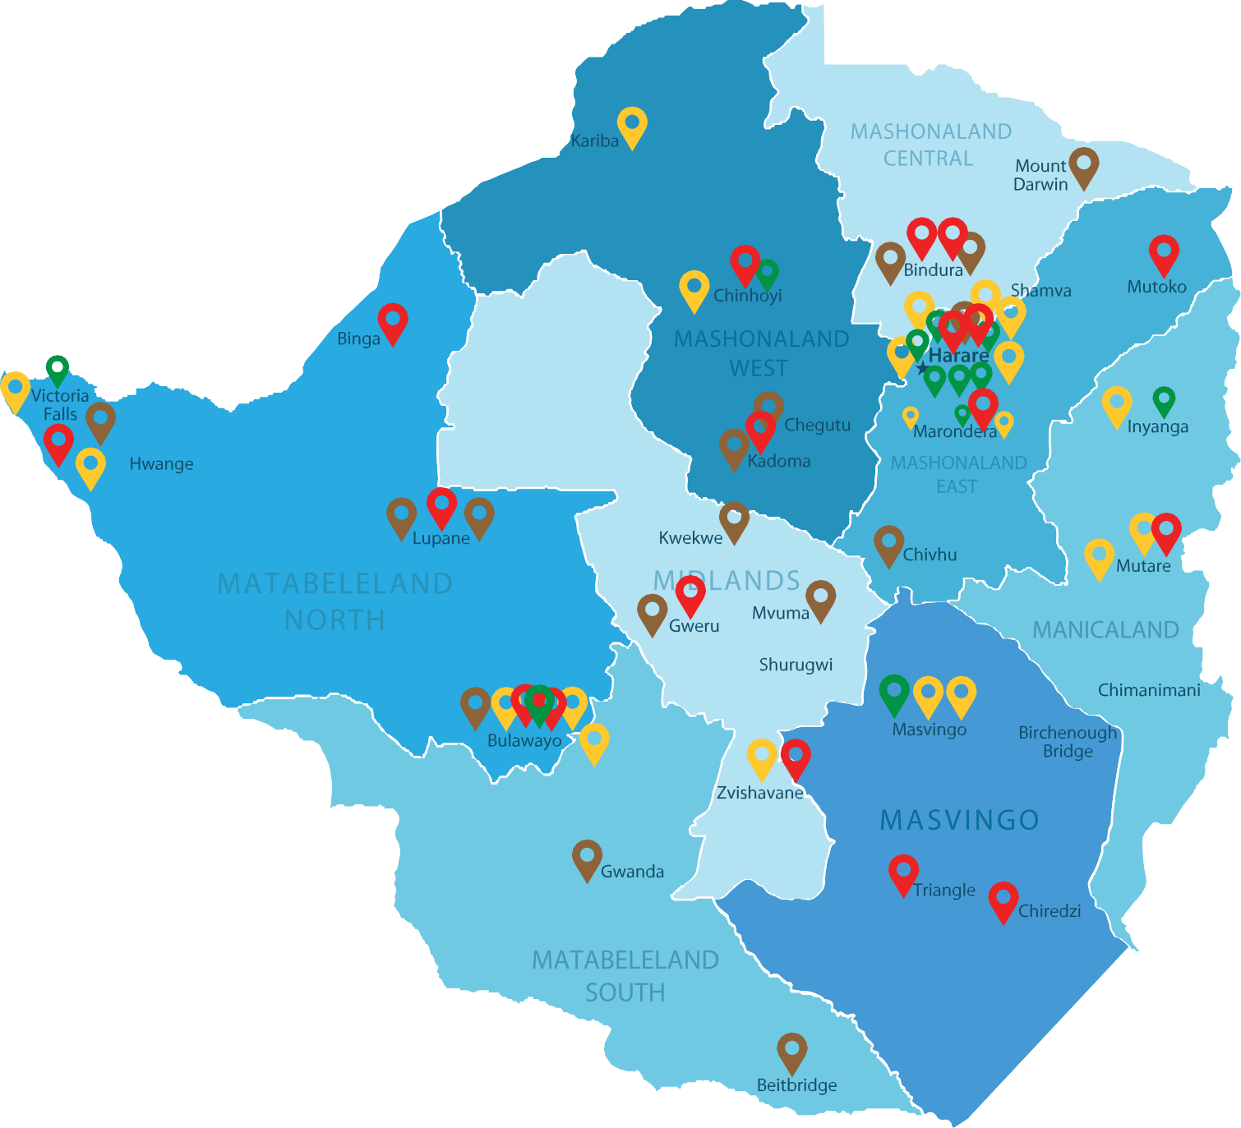
PSPF Portfolio Investment Map
Investment Key
Completed
Murambinda
Ongoing
Upcoming Under Appraisal
NOTE:
Offshore Investments in South Africa
8.

Slide 24
Pension Funds investing together… pooled capital g together

Slide 25
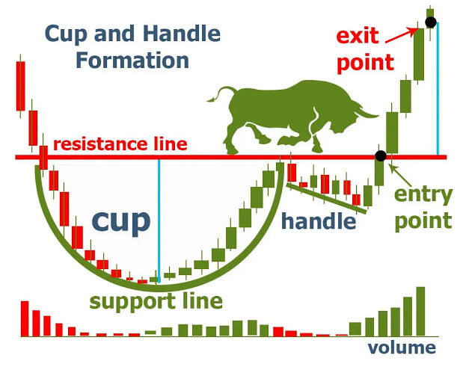
SPV investment entrance and exit… reliable bullish strategy

