Slide 1
The Past, Present, and Future of Zimbabwe's Pension Fund Industry
A Presentation for the ZAPF 50th Anniversary Event
Victoria Falls, May 16th, 2025
Luke Ngwerume

Slide 2
Celebrating 50 Years of ZAPF: A Time for Reflection and Action

Slide 3
Industry Size: Total Pension Fund Assets vs. GDP
A downward trend of pension assets relative to GDP.
Is our significance declining in the national economy?
Who is driving the GDP?

Slide 4
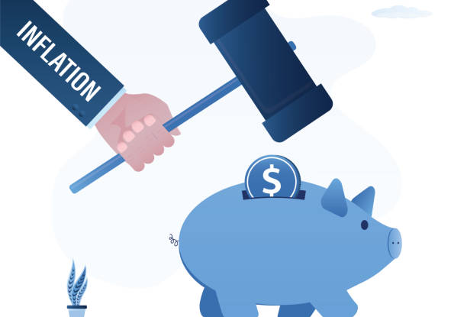
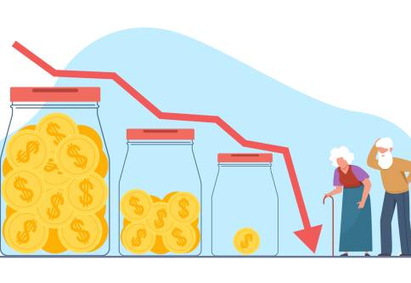
The Painful Reality: Erosion of Pension Values
The significant loss of pension values experienced by individuals due to policy decisions.
This is the 'elephant in the room' that cannot be ignored.
The urgent need to address the issue of compensation/Relief for affected pensioners.
Government should acknowledge past policy decisions caused severe loss of value for pensioners.
Allocate tax revenues (IMTT/AIDS levy/VAT/toll gate revenue etc) to a relief fund for pensioners.
State land can be used to add assets into this fund.
Mandatory occupational pension plans with minimum contribution rates.

Slide 5
Futility of Expecting Pension Funds to Compensate
If all current pension fund assets were liquidated and distributed among individual members, the average payout would be $2,000 per member.
This demonstrates the impracticality and inadequacy of relying solely on pension funds for compensation.
Historical Precedent:
In instances of widespread economic crises and policy-induced losses elsewhere, the state has often played a central role in providing relief.
Taxes e.g. IMTT/VAT can be chanelled towards social security.
To grow the tax base, you need formalisation of business.
Incentivise formalisation
Increase ease of doing business

Slide 6
Inflows: Pension Funds vs. National Growth
Contribution rates are declining.
Do the young graduates appreciate retirement savings?
Decrease in pensionable salary?
Decline in contributions vs GDP
Is this informalisation?
Are pension contributions the first expense employers drop when strained? Why?

Slide 7
Erosion of Trust, Erosion of Capital Formation
The perceived destruction of pension values has significantly undermined public trust in long-term savings mechanisms.
This loss of faith directly impacts the country's ability to form crucial long-term capital for investment and growth.

Slide 8
The Latest Setback: Impact of the 2024 Currency Changes
The devastating impact of the most recent currency changes on those retiring in 2024.
Exchange rate movement from ~6,000 – Dec23; 22,000 – Mid-Mar24; 33,000 – End-March2024. A 50% loss in just 2 weeks of March24, and 80% drop from Jan to March.
This highlights the precarious situation retirees face due to policy volatility.
This follows a similar situation in 2019 where local currency lost 60% value 1:1 to 1:2.5 in the first two months. Pensioner Funds’ investment decisions helped mitigate the impacts.

Slide 9
The State of the Industry: Deeply Troubled
The pension fund industry is currently facing significant challenges that threaten its long-term viability.
A fundamental shift in approach is urgently required to revitalize the sector.
Contributions need to be relooked.
Post-retirement expenditure (does one have children still going to school?)

Slide 10
Resuscitation Requires Bold Policy Action
Creating a stable and predictable economic environment is paramount.
What will happen after 2030 on currency?
Government must deliberately implement policies to incentivize long-term savings among the population.

Slide 11
Regulatory Reform: Fostering Growth, Not Stifling It
The regulatory mindset needs to evolve from a purely control-oriented approach to one that actively encourages growth and innovation within the sector.
Focus should shift towards rewarding performance and facilitating the expansion of the industry.
Less prescriptive, more principle based
Equally protect pensioners, service providers and stakeholders.

Slide 12
A Vision for a Thriving Pension Fund Industry
Economic Stability and Predictable Policies
Clear and Consistent Regulatory Framework, not only pensions
Incentives for Long-Term Savings (Tax Benefits, etc.)
Support for Innovation and Product Development
Enhanced Public Awareness and Education on Retirement Planning
A Collaborative Approach Between Industry and Regulators

Slide 13
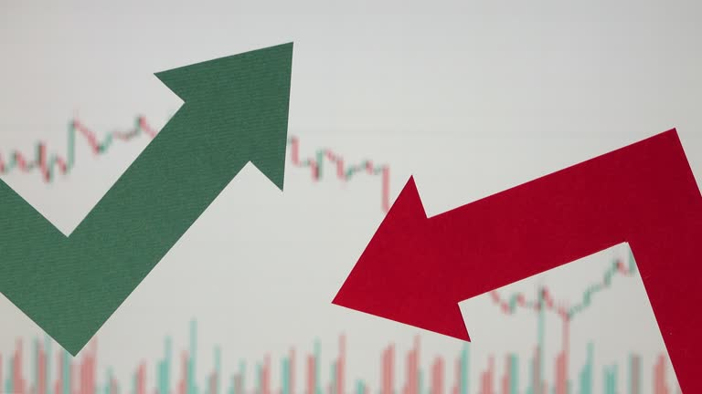
Addressing Our Shared Challenges
Offshore investment restrictions
Consistent Exchange rate liberty
What to expect after 2030
Consistent inflation reporting
Currency obsession vs focus on VALUE
Incentives for public private partnerships

Slide 14
The Future of Zimbabwe's Pensions: A Collective Responsibility
The need for urgent and collaborative action from policymakers, regulators, and industry players.
Rebuilding trust and creating a sustainable pension system is crucial for the financial security of Zimbabweans and the nation's economic development.
Let's work together to build a brighter future for pensions in Zimbabwe.

