Slide 1
Mobilizing Pension Funds For Development
Fiona Stewart
Global Lead Aging & Pensions

Slide 2
agenda
WHY ARE FUNDED PENSION SYSTEMS NEEDED?
WHAT ARE THE ENABLING CONDITIONS FOR FUNDED PENSION SYSTEMS?
WHAT IS THE LINK BETWEEN PENSION FUND GOVERNANCE & INVESTMENT?
HOW CAN WE CREATE THE RIGHT INVESMENT OPPORTUNITIES FOR PENSION FUNDS?

Slide 3
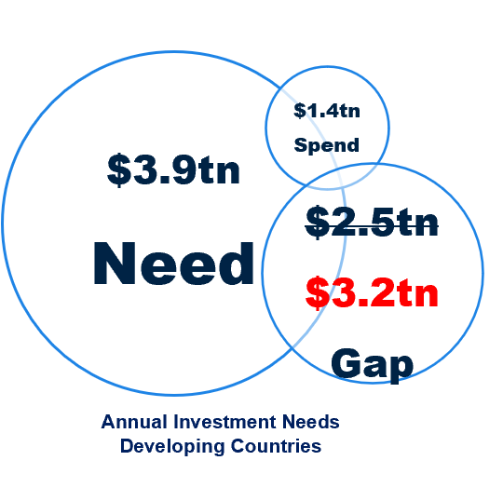
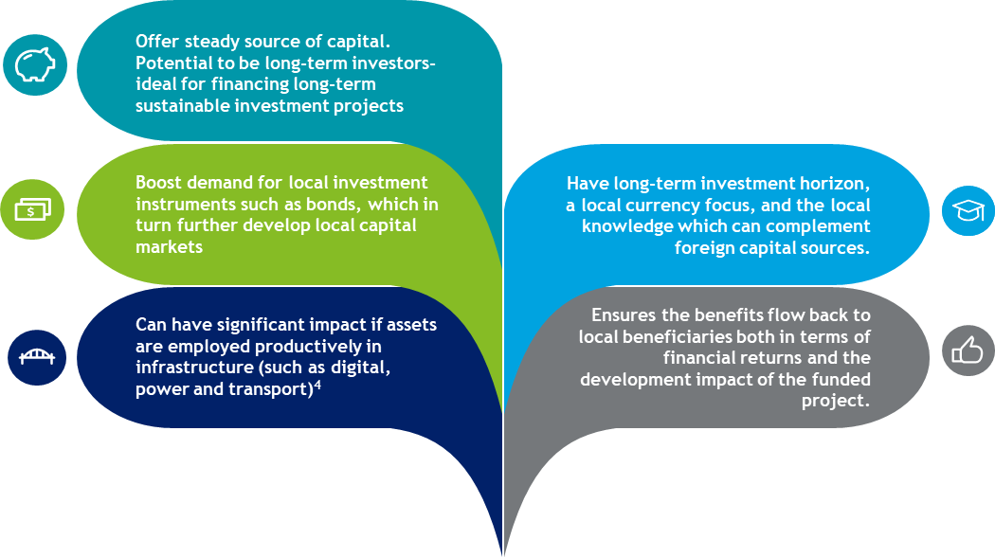
Importance of funded pension systems

Slide 4
agenda
WHY ARE FUNDED PENSION SYSTEMS NEEDED?
WHAT ARE THE ENABLING CONDITIONS FOR FUNDED PENSION SYSTEMS?
WHAT IS THE LINK BETWEEN PENSION FUND GOVERNANCE & INVESTMENT?
HOW CAN WE CREATE THE RIGHT INVESMENT OPPORTUNITIES FOR PENSION FUNDS?

Slide 5
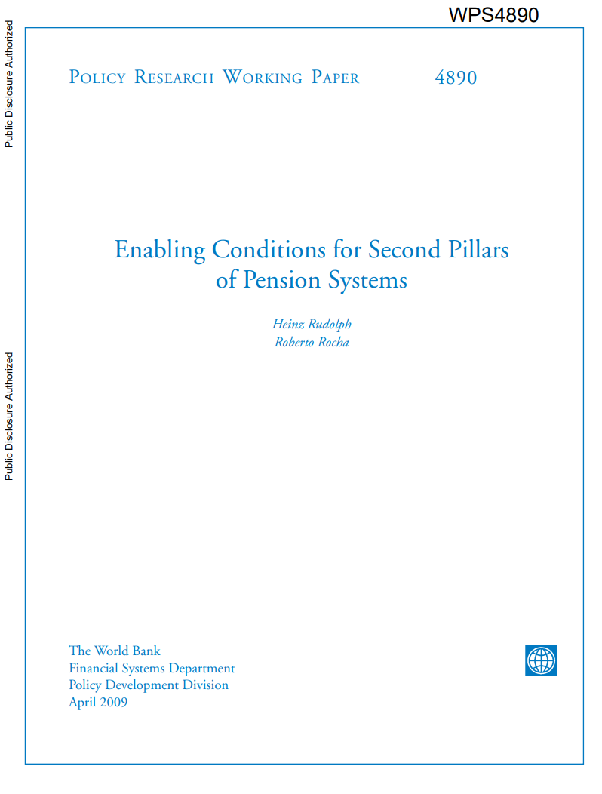
Pension system enabling conditions
Macroeconomic stability
A strong and lasting political commitment to the reform
A sound financial infrastructure
  Legal framework
  Institutional framework (payment systems/ securities settlement/ electronic trading/ custodian institutions/ accounting & audit
  Available financial instruments
  Regulatory & supervisory framework

Slide 6
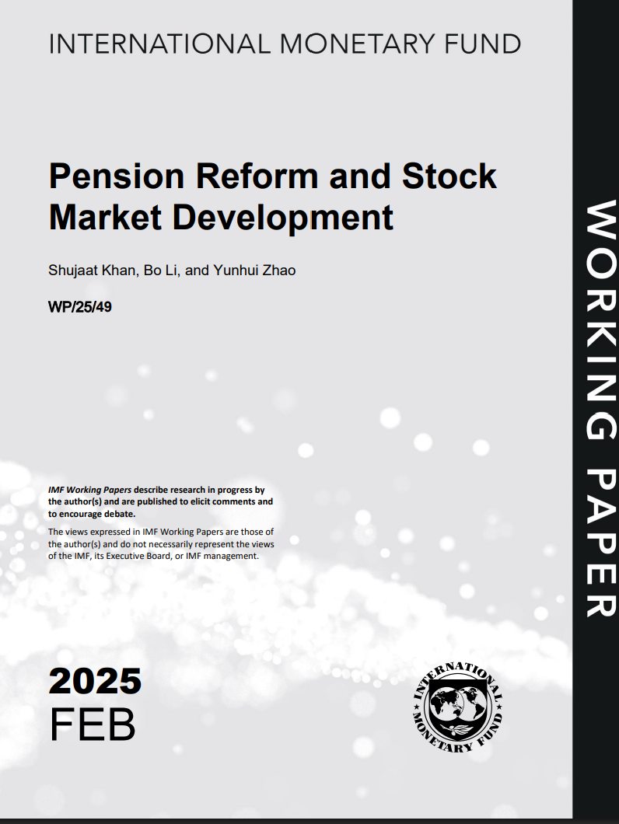
Pension system enabling conditions
Country needs to implement vigorous structural reforms to meet enabling conditions
  robust fiscal strategy
  sound financial infrastructure.
Imperative for policymakers to act promptly, decisively, and persistently – strong and long-lasting political commitment a prerequisite
Younger nations benefit considerably from developing a funded pension pillar early.

Slide 7
agenda
WHY ARE FUNDED PENSION SYSTEMS NEEDED?
WHAT ARE THE ENABLING CONDITIONS FOR FUNDED PENSION SYSTEMS?
WHAT IS THE LINK BETWEEN PENSION FUND GOVERNANCE & INVESTMENT?
HOW CAN WE CREATE THE RIGHT INVESMENT OPPORTUNITIES FOR PENSION FUNDS?

Slide 8
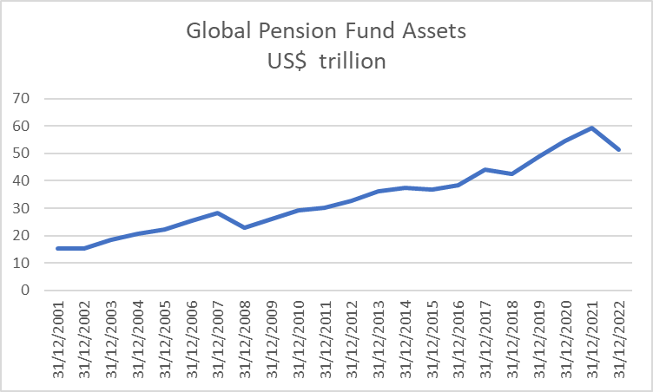
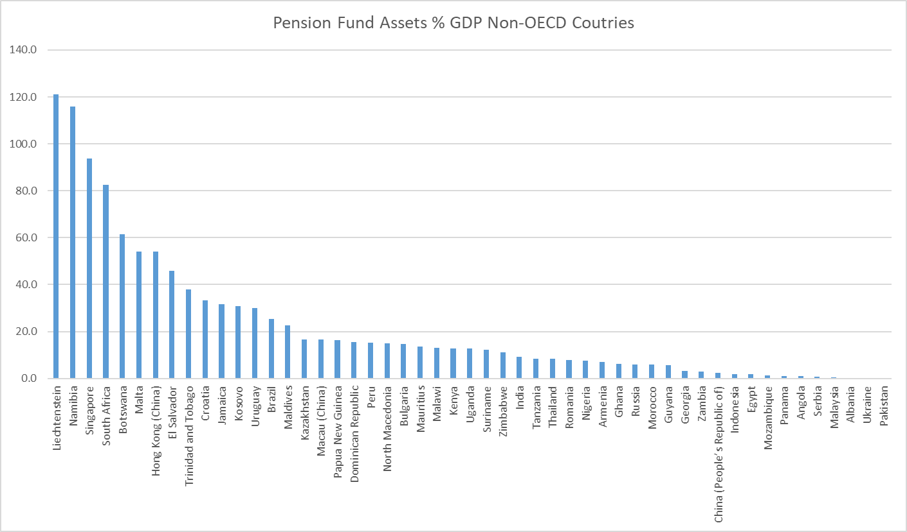
Importance pension fund assets
Global Pension Assets >$50tn / 70% USA <5%non-OECD + China

Slide 9
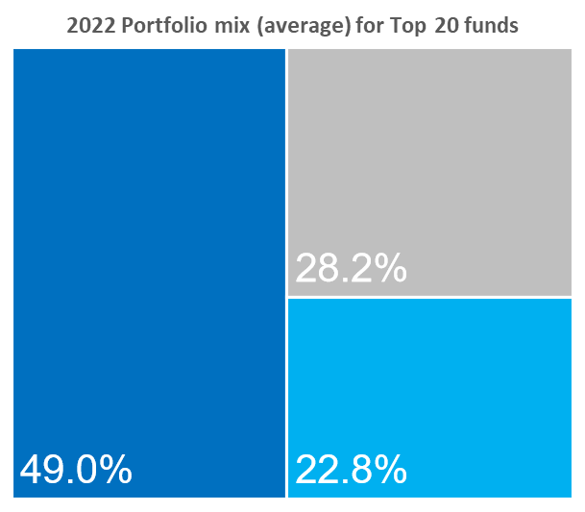
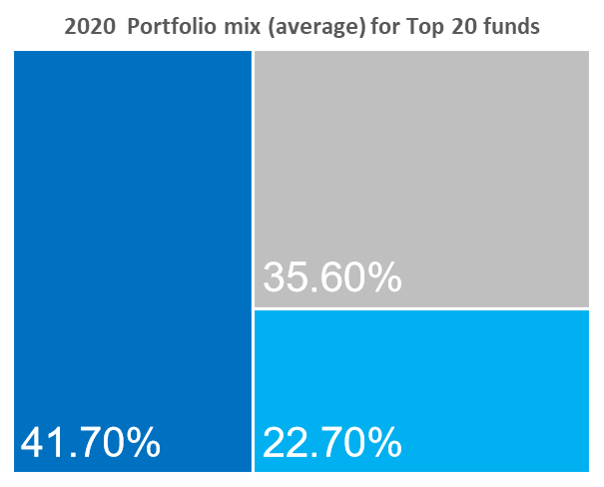
Asset allocation top 20 pension funds
Equities
Bonds
Alternatives & Cash
Source: September 2023: Global top 300 pension funds – A Thinking Ahead Institute and Pensions & Investments joint study
Note: Asset allocation for the National Social Security fund of China, for the Central Provident Fund of Singapore and for the Employees’ Provident Fund India was not available
Notes:
The average portfolio of globally top 20 pension funds is fairly diversified across equities, fixed income securities and alternatives asset classes
Top 20:
In 2022, the Employees’ Provident Fund of India was a new entrant in the top 20 funds
Rank Fund Market Total Assets
1 Government Pension Investment Japan $1,448,643
2 Government Pension Fund Norway $1,300,214
3 National Pension South Korea $706,496
4 Federal Retirement Thrift U.S. $689,858
5 ABP Netherlands $490,382
6 California Public Employees U.S. $432,235
7 Canada Pension Plan Canada $420,764
8 Central Provident Fund Singapore $406,711
9 National Social Security China $347,214
10 California State Teachers U.S. $290,384
11 New York State Common U.S. $233,227
12 PFZW Netherlands $231,781
13 New York City Retirement U.S. $228,170
14 Employees Provident Fund Malaysia $227,781
15 Local Government Officials Japan $207,145
16 Florida State Board U.S. $183,092
17 Ontario Teachers Canada $182,410
18 AustralianSuper Australia $176,446
19 Texas Teachers U.S. $173,277
20 Employees' Provident India $158,722

Slide 10
ASSET ALLOCATION MORE FIXED INCOME NON-OECD
BONDS 42% VS. 51% (also higher % gov. vs. corporate)
Asset Allocation OECD
Asset allocation non-oecd

Slide 11
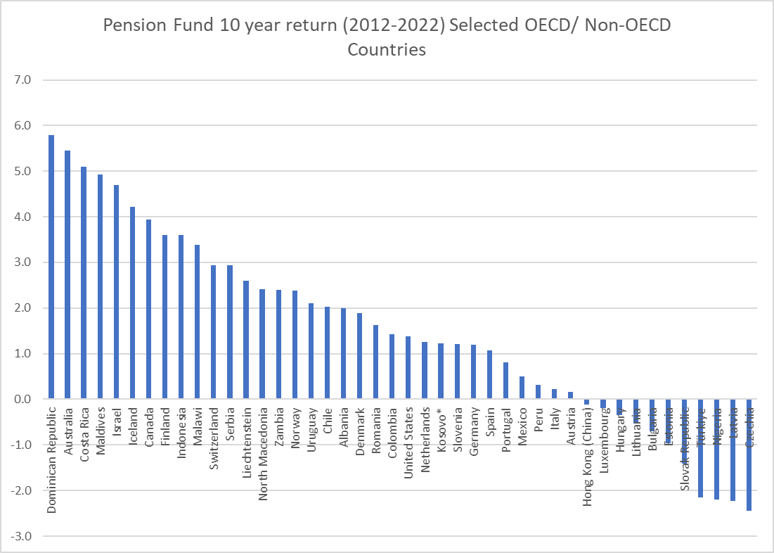
Investment Returns mixed picture
Averaged 1.5% 10 years (~2% 20 year- smaller sample)
Mixed across countries
Public pension funds slightly better (3-4% 10/20years)
NB MEASUEMENT CAVEATS

Slide 12
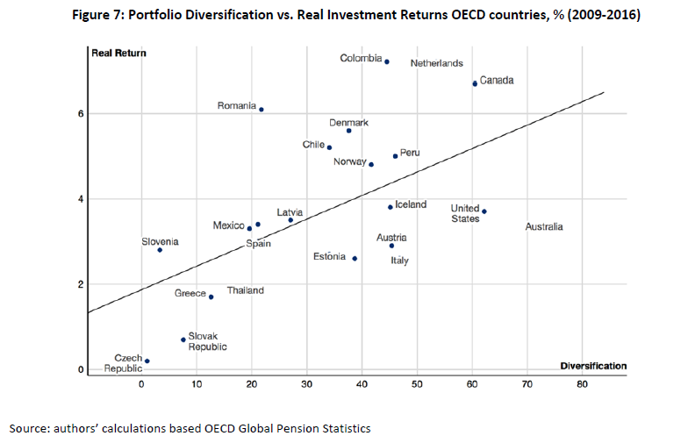
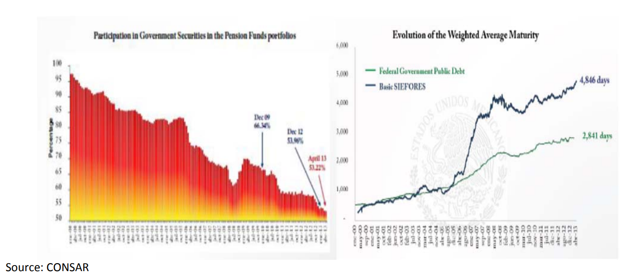
DIVERSIFICATION DRIVES INVESMENT RETURNS
Portfolio Diversification vs. REAL Investment Returns, 2009-2015
Despalains, Remizova & Stewart (2017)

Slide 13
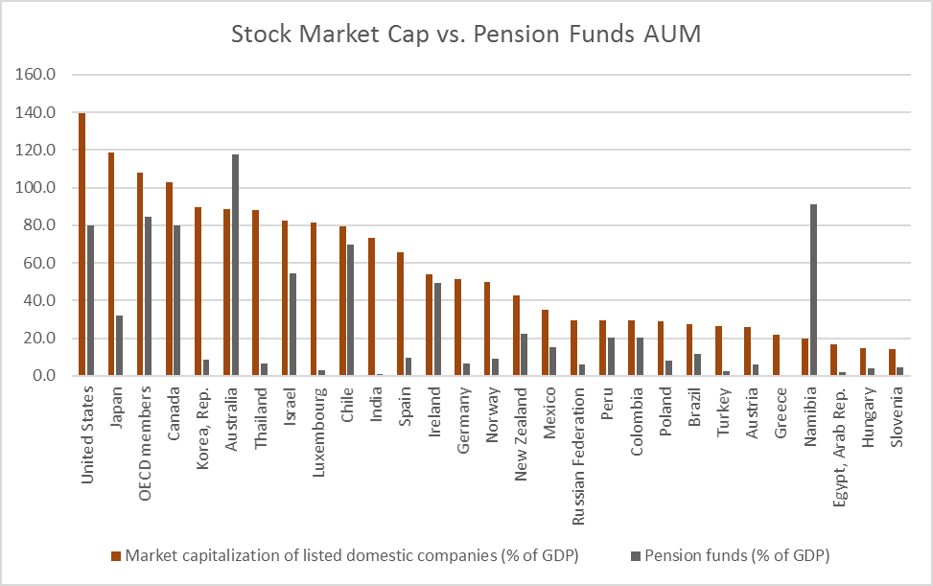
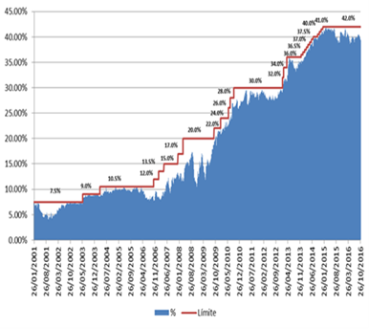
local development + international diversification
  Development of Investment Abroad vs. Investment Limits
  Chile + Peru

Slide 14
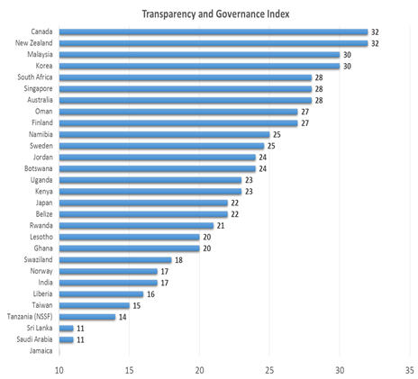
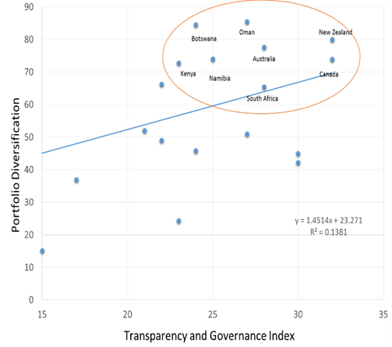
Governance + investment linked

Slide 15

Pension fund governance
In the ISSA framework there are 3 cross cutting – impacting all outcomes:
  Strategic Planning – Guidelines 45-49
  Operational Risk Management – Guidelines 50-53
  Internal Audit of Operations – Guidelines 54-57
There are then six specific categories
  Actuarial Soundness – Guidelines 58-61 (which will deliver financial stability)
  Enforcing Prudent Person – Guidelines 62-70 (which will deliver sound investments)
  Prevention and Control of Corruption and Fraud, and Service Standards for Members and Beneficiaries Guidelines 71-75 (which deliver Member Coverage, Contributions, Benefits and Services); and
  HR Policies and Investments in ICT – Guidelines 76-85 (which refer to Resources).

Slide 16
Investment vehicle choices also depend on governance capacity
Unlisted Securities
Foreign Securities
Property
Governance Strength Needed
Listed Securities: Equity, Debt
Longer-dated Government Securities
Mutual Funds
Short-dated Government Securities
Bank Deposits
Inflation Protection and Diversification
Source: Guven, M., H. Jain and C. Joubert. 2021. “Social Protection for the Informal Economy: Operational Lessons for Developing Countries in Africa and Beyond.” World Bank Group.
Notes:
Possible instruments to consider for diversification based on risk appetite and available governance capacity

Slide 17
Capital market instrument vs. risk profile
CORPORATE INSTRUMENTS
Bank deposit
Gov bonds
Private debt
Listed equity
SOE bonds (guarantee)
Corporate bonds
Unlisted equity / PE
HOUSING INSTRUMENTS
Social bond (gov)
SOE bond (house corp)
MFI bond (guarantee)
Direct investments
Housing fund
MBS
INFRASTRUCTURE INSTRUMENTS
Infra bond (gov)
Utility/ SOE bond
Covered bonds
Project bonds
Infrastructure funds
Securitization

Slide 18
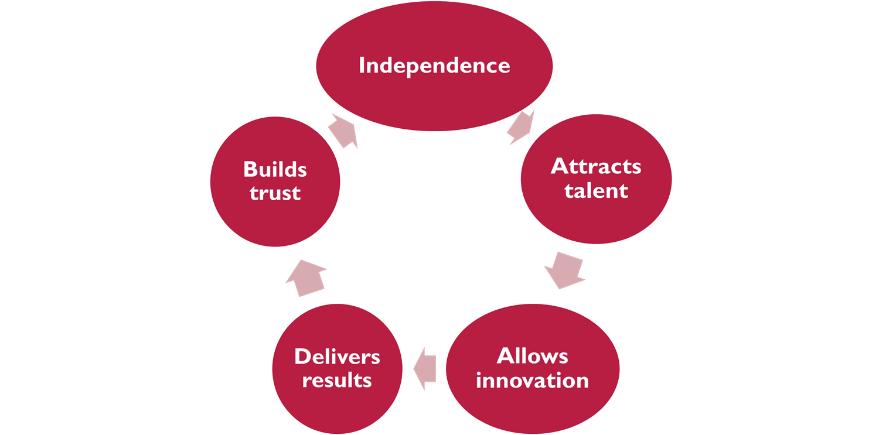
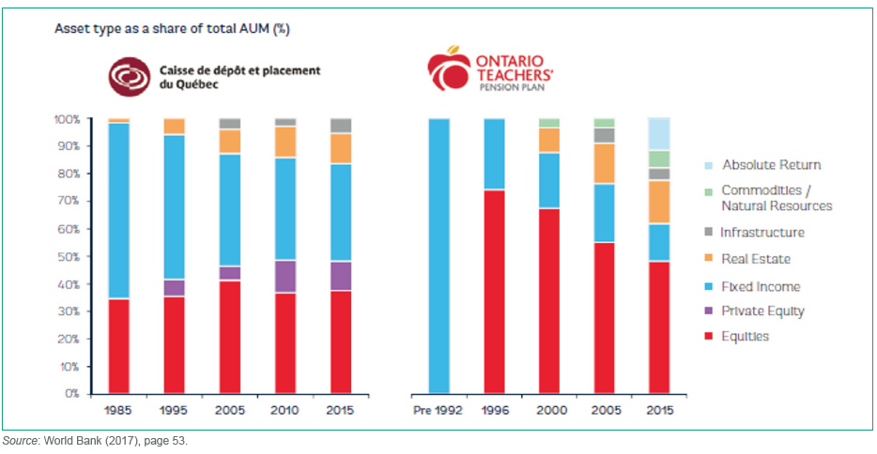
Lessons from Canadian pension plans

Slide 19
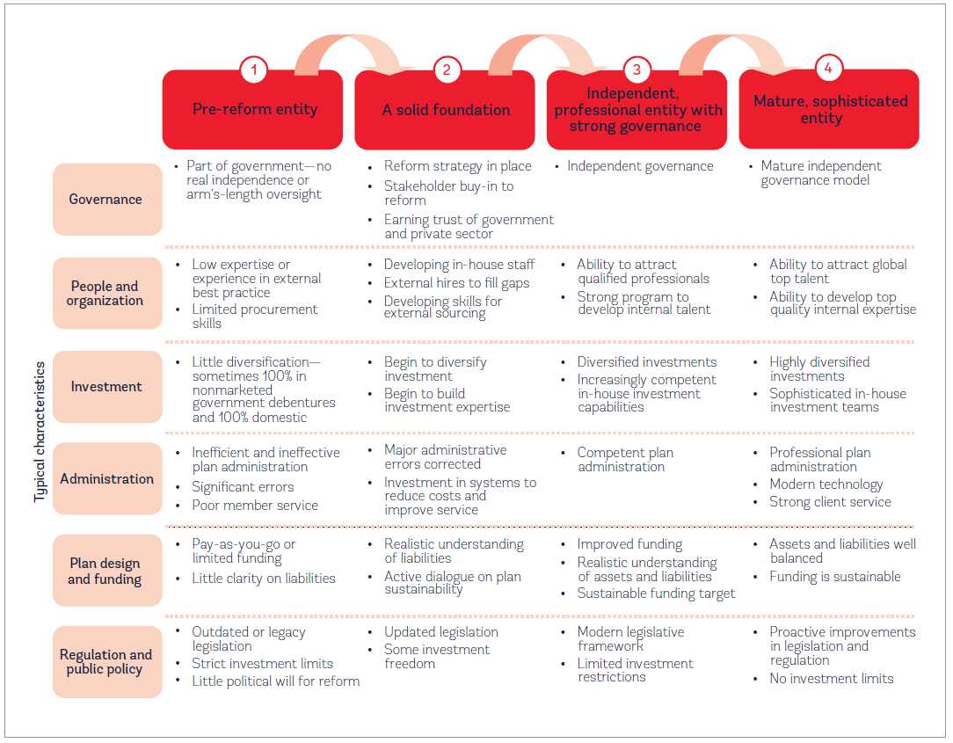
BUT 20 YEARS AGO WERE IN THE SAME SITUATION AS MANY EM SCHEMES ARE TODAY

Slide 20
Provident fund model
The provident fund model has two key features that make it an attractive choice for emerging markets:
Provident fund savings can be harnessed to advance national development objectives.
Provident funds can serve a
wide range of savings needs beyond
the need to save for retirement.
To be successful, provident funds must strike the right balance between their competing goals. What the right balance is, moreover, will necessarily shift over time as countries develop and their populations age.

Slide 21
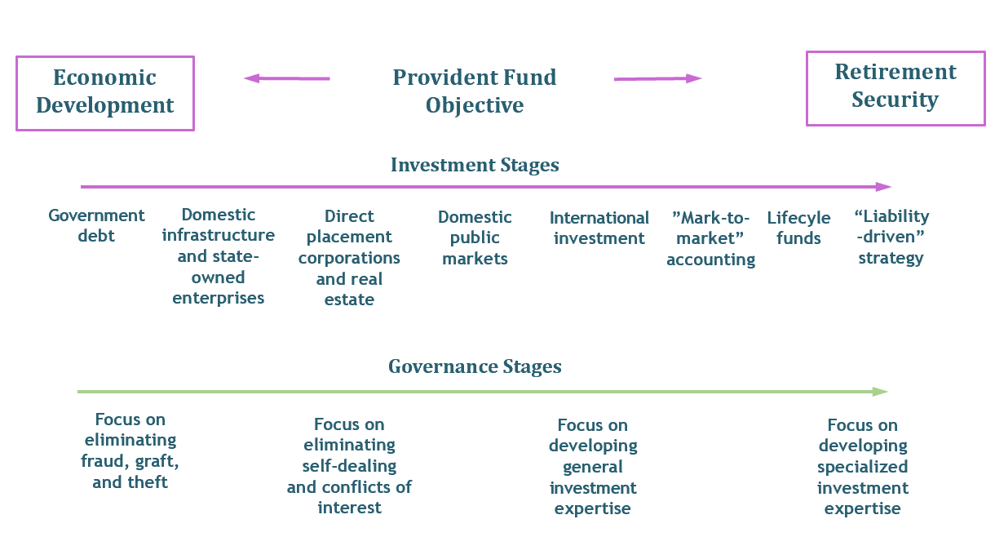
Evolution of investment & governance

Slide 22
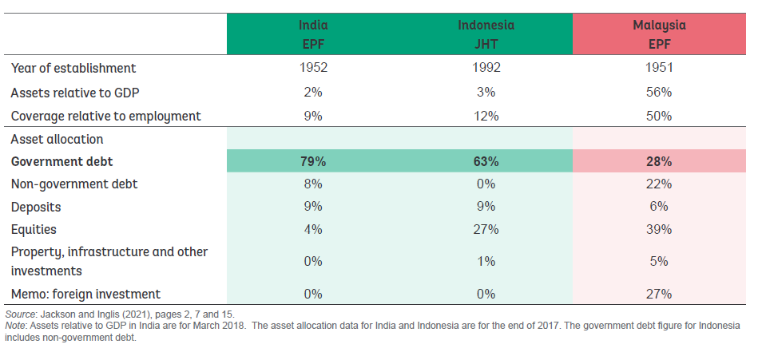
PROVIDENT FUND MODEL

Slide 23
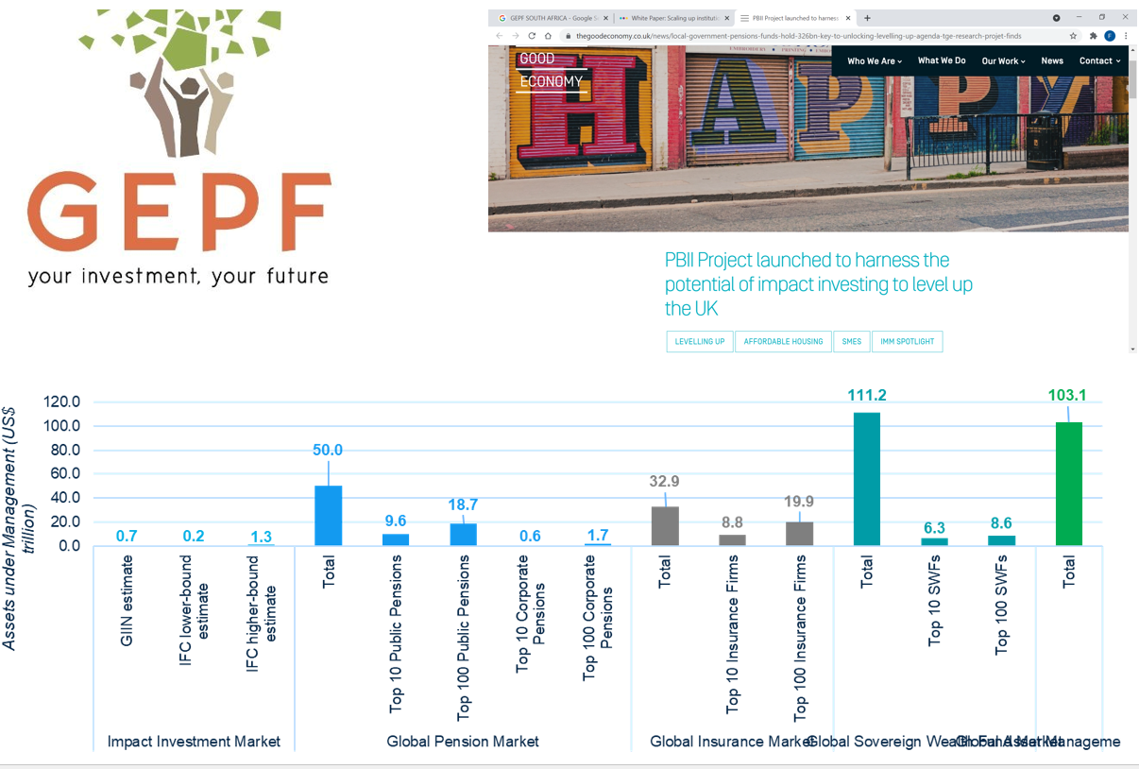
Universal owners – universal goods

Slide 24
agenda
WHY ARE FUNDED PENSION SYSTEMS NEEDED?
WHAT ARE THE ENABLING CONDITIONS FOR FUNDED PENSION SYSTEMS?
WHAT IS THE LINK BETWEEN PENSION FUND GOVERNANCE & INVESTMENT?
HOW CAN WE CREATE THE RIGHT INVESMENT OPPORTUNITIES FOR PENSION FUNDS?

Slide 25
Rethinking capital markets
Listed / on-market instruments
Hybrid approaches
Unregulated/ private markets
Potential bond issuers
Direct lending
Fund Structures
SME financing

Slide 26
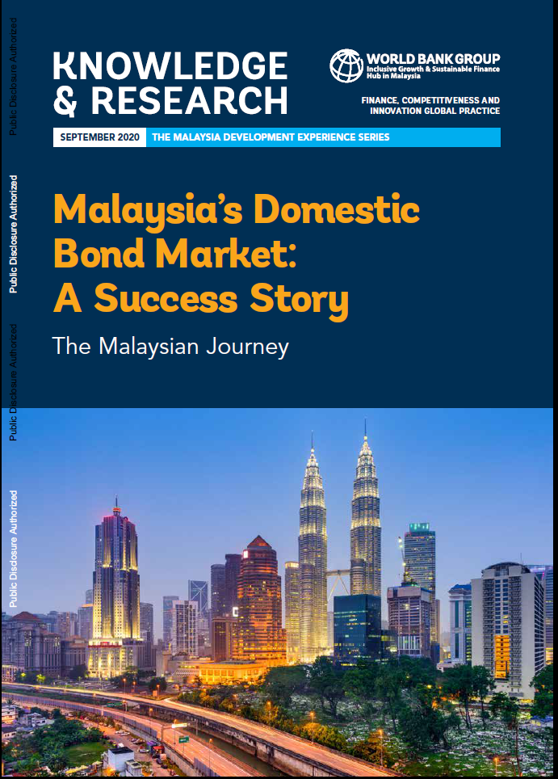
PoTENTIAL ISSUERS
Potential bond issuers
SOEs | ICE Costa Rica 1st green bonds
Sector agencies / NBFIs | India (PFC, RFC, HDFC etc.)
Municipals | USA / South Africa
National development banks | Brazil (BNDS) South Africa (DBSA)
MFIs | Bancamia Colombia Kenya, Tanzania, and Zambia
Mortgage finance corporations | Nigeria (NMRC) Armenia (NMC) Cagamas Malaysia
Infrastructure bonds | Malaysia Chile (monolines)
Others | Covered bonds/ sukuks

Slide 27
PoTENTIAL structures
Funds
Housing funds / REITS | South Africa
InfraREITS | India
TIMOs | Uruguay
SPV structures | Namibia LAC/ Peru
Infra debt funds | Colombia
Direct Lending
Home loans | South Africa (“SAHL”) Malaysia Cagamas IFC warehouse/ line of credit
Infra asset recycling | Australia Indonesia
Loans | Malawi Canadian /European pension funds

Slide 28
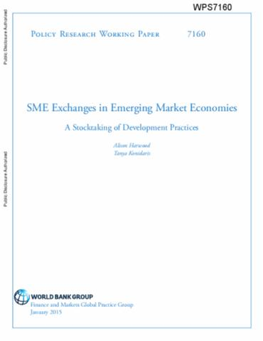
Sme financing
SME Funding
-Bond issuances by SMEs/ SME lenders | Peru
Securitization of SME loans | Securitization SME loans Korea India Factoring funds Peru / Chile / China Factoring platforms – Costa Rica
SME debt funds | LAC
SME covered bonds | Turkey
Platforms | Peru

Slide 29
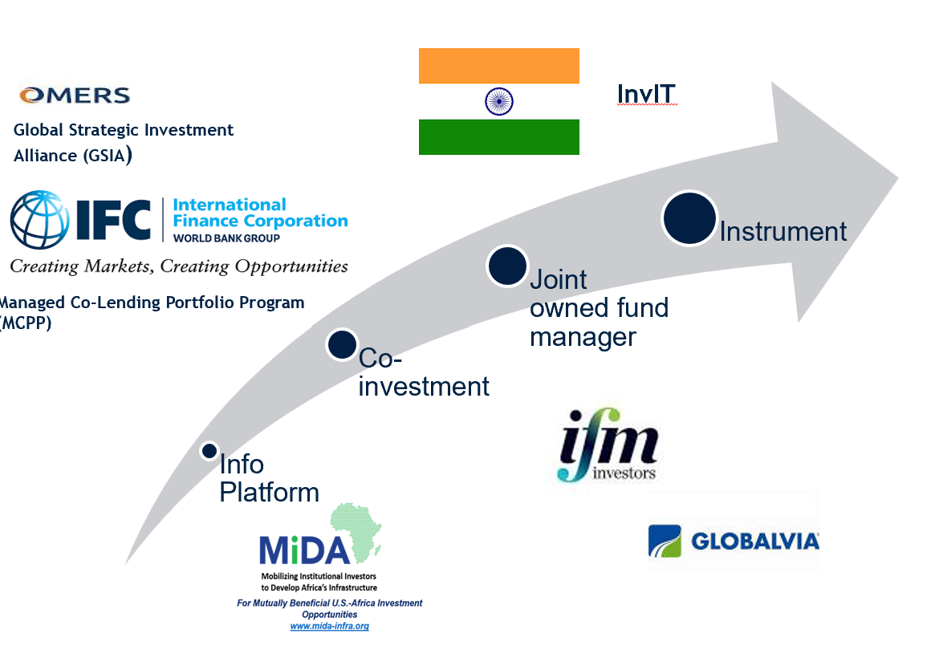
Models of pension fund co-investment

Slide 30
KEY TAKEAWAYS
For funded pension systems to contribute to development must have right set of enabling conditions in place:
  Macro stability
  Solid financial sector
For funded pension systems to deliver adequate returns:
  Get the governance right
  Gradually diversify portfolios
Creating diversified investment opportunities needs:
  Creative thinking – beyond traditional capital market instruments
  Cooperation between investment funds, pension regulators, capital market regulators

