Slide 1
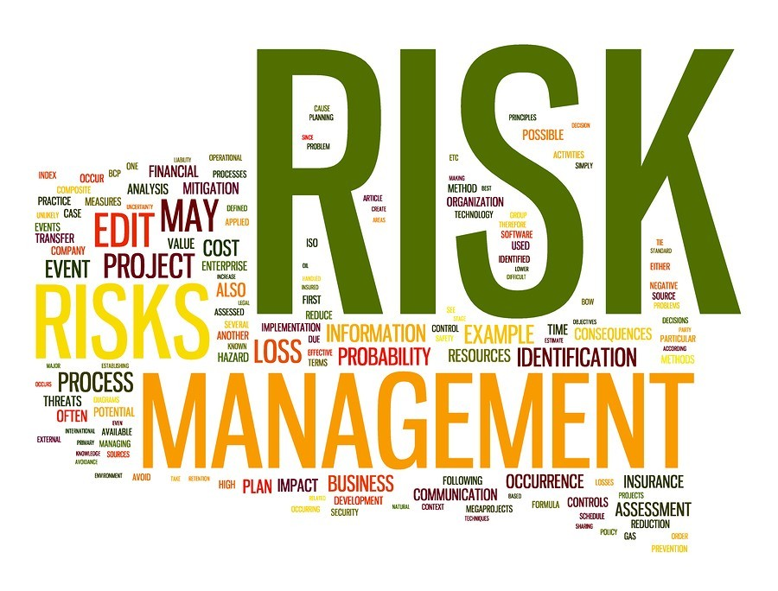


Navigating Uncertainty: Risk Management Strategies for Preservation and Growth
GLORIA ZVARAVANHU
Notes:
I feel privileged to be here standing at the intersection of legacy and innovation combining wisdom of the past 50 years with the promises of the future!
So iam excited to contribute to the future as we discuss navigating uncertainty and how risk management is a good tool for both preservation and growth

Slide 2

Setting the Scene
Uncertainty is the new operating environment
Pension funds face rising pressure from global and local forces
We will cover;
Practical risk management strategies, leadership principles, and practices for preservation and growth
Reinforce trustees' vital role in governance and risk oversight
Notes:
Uncertainty is by nature unsettling but it can be a good catalyst for embracing change giving the pensions industry an opportunity to look at things differently and build resilience and adaptability.
Uncertainty is no longer an exception but the expectation! It is the new steady state, it is now the baseline we have to work it.
BANI-Brittle, Anxious, Non Linera and Incomprehensible Nature
TCWGs

Slide 3
ARE PF TRUSTEES LOSING SLEEP OVER…
Member trust and equity?
Longevity risk?
Liquidity and solvency?
Investment risk and volatility?
Governance and fiduciary responsibility
Depleting role in economic security?
Increasing complexity and scrutiny?
Regulatory Compliance?
Notes:
1.Member trust and equity-trust crucial as growing awareness of pension fund management practices and increasing transparency expectations( ESG considerations)
2. Life expectancy increasing globally require preparation for longer period payouts (WHO-global life expectancy increased by 5.5 years between 2000 and 2019 with estimations of pension fund liabilities by 3-5% by 2050 (Mercer)
2&3-market volatility/ geopolitical tensions, impacts of tariff wars
4.Governance-global pension fund scandals in the UK/US. Regulatory changes next door in SA there has been a few introduced by the Financial sector conduct authority (skills and training requirements for trustees)
5. Depleting economic security i.e. declining industries, natural resources depletion, trade wars- these circle back and bite on the returns, funding levels, benefit payments

Slide 4
ROLES AND RESPONSIBILITIES OF TRUSTEES IN RISK MANAGEMENT
Act in beneficiaries’ best interest
Approve and monitor risk strategy
Ensure controls and structures
Manage conflicts of interest
Notes:
There can be blind spots with regards these roles and responsibilities
1.Insufficient understanding of beneficiary needs and expectations
2. Failure to consider long term implications of decisions
3. Insufficient resources allocated to risk management
4.Failure to identify and disclose potential conflicts
5. Insufficient communication
6. Overemphasis on short term gains

Slide 5
Managing the Governance risk
Regulator trustees training and Development
Diverse perspectives and Expertise
Robust governance frameworks
Conflict of Interest Management
Long term planning
Notes:
Stay up to date with global developments, regulatory changes etc
Diversity-timed changes/experts
Short term planning vs long term views?
Conflict management systems that are regularly reviewed

Slide 6
OVERSIGHT AND GOVERNANCE BEST PRACTICES
Annual board risk workshops
Risk and audit committees
Expert reviews
KPI-linked risk evaluation
Risk in strategic agendas

Slide 7
THE GLOBAL RISK LANDSCAPE – WHY IT MATTERS
Risk | Relevance to Pension Funds
Inflation & Interest Rate Volatility | Reduces the real value of retirement payouts; disrupts bond pricing and actuarial assumptions.
Geopolitical Instability | Impacts offshore investments and causes market volatility, affecting portfolio performance.
Tech Disruption (AI, Cyber) | Threatens member data, administration platforms, and investment management systems.
Climate Extremes | Damages physical assets; increases exposure to underinsured risks.
Regulatory Shifts | Alters compliance obligations; affects asset allocation and long-term strategy.
Demographic Trends | Longer life expectancy increases liabilities; necessitates adaptive actuarial and funding models.
Notes:
Geopolitics/ tariff wars causing supply chain disruptions, energy price fluctuations, monetary policy changes-inflation and interest volatility
Tech-cyberacttacks,data breaches,misinformation via social plaforms
Geopolititics-impose sanctions, taxes, tariffs, or even asset seizures
Regulatory shifts- we are already witnessing this

Slide 8
Managing the Global/Emerging Risks
Diversification and flexibility
Scenario planning and stress testing
Investing in resilience
Global networks and partnerships
Continuous learning and Innovation
Notes:
Diversification across markets and asset classes
Resilience investments entail building sustainable practices, digital security, insurance to mitigate impacts of disruptions
Global networks to stay informed on emerging trends and risks and leverage collective expertise and resources to address challenges

Slide 9
LOCAL RISK CONTEXT – ZIMBABWE
Currency volatility, inflation
Real estate over-concentration
Infrastructure and political risks
Regulatory Changes
Confidence erosion
Notes:
-real estate( illiquidity and affect agility), concentration risk and market volatility risk
-Data protection act( secure use of information and communication technologies) guard against risks such as data destruction. Breaches
-New Zim Insurance act currently being debated by parliament

Slide 10
Risk management Responses…
Currency diversification (offshore)
Manage real estate concentration through class diversification/regular rebalancing
Sectoral diversification
Transparent communication

Slide 11
Pension Fund Risk Management Strategy
⚖️ 1. Governance and Oversight
📊 2. Investment Risk Management
🏦 3. Operational Risk Controls
🛡️ 4. Regulatory and Compliance Risk
🔄 6. Liquidity and Cash Flow Risk
🔍 7. Transparency and Member Communication
📈 8. Performance and Risk Metrics

Slide 12
Insurance as a Risk Transfer Strategy
Insurance Type | Application in Pension Fund Governance
Fidelity Guarantee | Covers losses from fraud or theft by fund or admin personnel.
Directors & Officers (D&O) Liability | Protects trustees and directors against personal liability in governance decisions.
Cyber Insurance | Mitigates financial loss from cyberattacks, ransomware, or data breaches.
Professional Indemnity | Covers advice-related errors by asset managers or fund administrators.
Property Insurance | Protects real estate or infrastructure assets held in the investment portfolio.

Slide 13
Strategic Investment Risk Management – Preserving Value
Strategy | Pension Fund Application
Diversification | Spreads risk across geographies and asset classes, reducing exposure to local shocks.
Hedging | Shields against currency volatility and inflation risk.
ESG Integration | Builds resilience by aligning investments with long-term sustainability and regulatory trends.
Liquidity Planning | Ensures cash flow to meet benefit payments without fire-selling assets.

Slide 14
Risk Management Strategies for Growth
Strategy | How It Drives Growth
Dynamic Asset Allocation | Allows tactical shifts in portfolio weights to seize market opportunities and adapt to macro conditions.
Diversification (Global & Sectoral) | Enhances return potential by accessing high-growth sectors and geographies while reducing concentration risk.
Inflation-Linked Investments | Protects purchasing power while unlocking growth in sectors like infrastructure and commodities.
Alternative Assets | Adds yield and diversification through private equity, real estate, infrastructure, and hedge funds.
ESG-Driven Investment | Taps into long-term growth megatrends (climate tech, sustainable infrastructure); enhances resilience.
Robust Governance | Ensures agile yet accountable decision-making aligned to growth mandates.
Liquidity Optimization | Balances growth allocation with readiness to meet obligations; avoids forced selling in downturns.

Slide 15
Leadership Principles for Uncertain Times
Lead with clarity
Agile decision-making
Risk fluency
Long-term decision-making
Purpose-led culture
Notes:
Vision and plans in place
Decision matrices
Up to date on risk developments-emerging risks etc
Culture eats anything for breakfast, lunch and dinner!-risk management culture

Slide 16
Opportunities in Adversity
Climate-resilient infrastructure
Digital transformation
Regional pension collaborations
REITs and alternative assets
Align with ESG
Notes:
-Climate resilient infrastructure-buildings designed to withstand impacts of climate change like our Eastgate mall
-Pension collaborations-pooled funds/joint investments, regional summits for knowledge sharing
-Digital transformation for member benefit administration efficiency
-Real estate investment trusts-whole a part of a bigger thing, diversified portfolios, access to large scale properties
-Alternative assets-diversification but also potential for higher yielding investments
-ESG, access to funding, transparency, safeguards for governance, sustainable infrastructure

Slide 17
Action Plan for Trustees and Fund Managers
Refresh risk registers
Reassess insurance
Align investments to liabilities
Build ESG capacity
Member communication and self-assessments

Slide 18
Final Reflection
"Uncertainty isn’t something to avoid – it’s something to lead through."
Preserve value. Grow with purpose.
Thank You.

