Slide 1
When elephants fight, it is the grass that suffers
May 2025

Slide 2
KEY MESSAGES
Trump’s tariffs introduce additional uncertainty into an already complex world
Appropriate portfolio diversification is more important than ever given the increased likelihood of unintended consequences
Sanlam Private Wealth can help you manage the offshore component of your investments appropriately

Slide 3
Trump & Tariffs
1

Slide 4
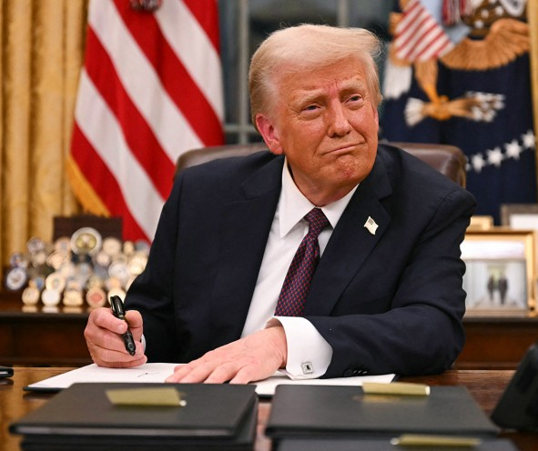
Anyone who didn’t expect tariff increases from Trump wasn’t concentrating.
BUT few would have expected such ill-considered actions

Slide 5
GLOBAL TRADE WARS – HOW DID WE GET HERE?
Countries’ share of global manufacturing: 1995 vs now
Source: Deutsche Bank Research
Notes:
The loss of manufacturing share by the US and Western Allies to China over the past 30 years may now have gone too far.
For some reason, all politicians love manufacturing, and there is bipartisan support for reviving the U.S. manufacturing industry. Nevertheless, from Trump 1.0 to the Biden administration, the U.S. government has implemented a range of policies to encourage manufacturing businesses. These efforts have produced little impact. U.S. manufacturing as a share of GDP has continued to fall, along with manufacturing employment

Slide 6
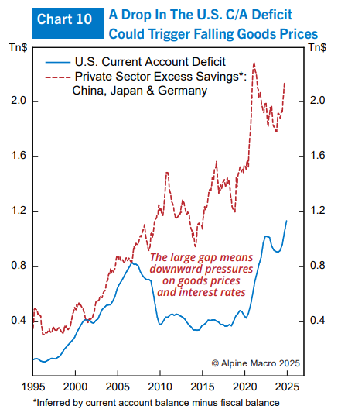
CONSUMER OF LAST RESORT – USA HAS BEEN ABSORBING EXCESS GLOBAL SAVINGS
US current account balance vs China/Japan/Germany excess savings
Source: Alpine Macro

Slide 7
BUT THE US FISCAL TRAJECTORY IS NOT SUSTAINABLE LONG TERM
US budget deficit
US Federal debt to GDP
Source: Congressional Budget Office

Slide 8
THE POTENTIAL SELF-REINFORCING NEGATIVE CYCLE
Price of goods imports to USA rises
Tariffs increase
Volume of goods purchased by USA declines
Participants all along the global value chain make less profit
Confidence & growth spending drop
Fewer people employed
Lower global GDP
Initial once-off inflation increase
Deflationary impact in year 2
Allows rate cuts

Slide 9
IMPACTS ON ZIMBABWE & OTHER FRONTIER MARKETS
Lower global GDP
Less demand for resources
Fewer tourists
Lower oil price
Greater uncertainty means more demand for gold
A multi-polar world
Greater DM defense spending
Likely less focus on Africa
With collateral damage e.g. Lesotho
Increased urgency from Germany / China and others to stimulate their own economies
Nothing happens in isolation: governments have/will act

Slide 10
THE ‘POLICY PUT’ WAS ACTIVATED, BUT WHAT ONGOING DAMAGE?
 | BEFORE TRUMP INAUGURATION | AFTER LIBERATION DAY | AFTER CLIMBDOWN
Trump behaviour | Erratic & unpredictable | Erratic & unpredictable | Erratic & unpredictable, but we know pain threshold
Global relationships | Reasonably healthy | Badly damaged | Still damaged, but less badly
US average tariff | ~2.5% | ~25% | ~10% ex-China
Consumer confidence | High | Very low | Low
CEO confidence | High | Very low | Very low
Short-term inflation risk | Low | High | Medium
Market sentiment | Calm, comfortable | Panic | On edge, but not panic
Gold price | $2 650 | $3 100 | $3 230

Slide 11
THE MARKET DOESN’T LIKE THE UNCERTAINTY
Bloomberg US Policy Uncertainty Index; exceeding Trump 1.0
Source: Bloomberg
“Uncertainty is the friend of the buyer of long term values. The future is never clear; you pay a very high price in the stock market for a cheery consensus.” Warren Buffet

Slide 12
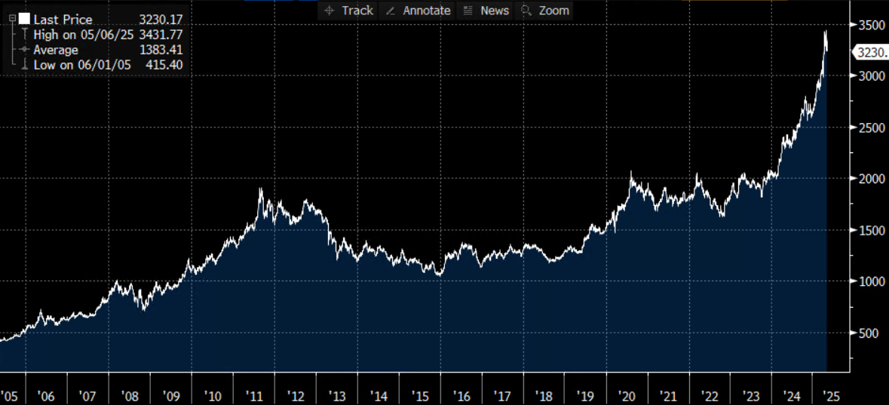
SO THE GOLD PRICE IS UP

Slide 13
THE UNCERTAINTY IS IMPACTING CONFIDENCE. RISK OF A DOWNWARD SPIRAL
CEO and consumer confidence surveys
Source: Bloomberg

Slide 14
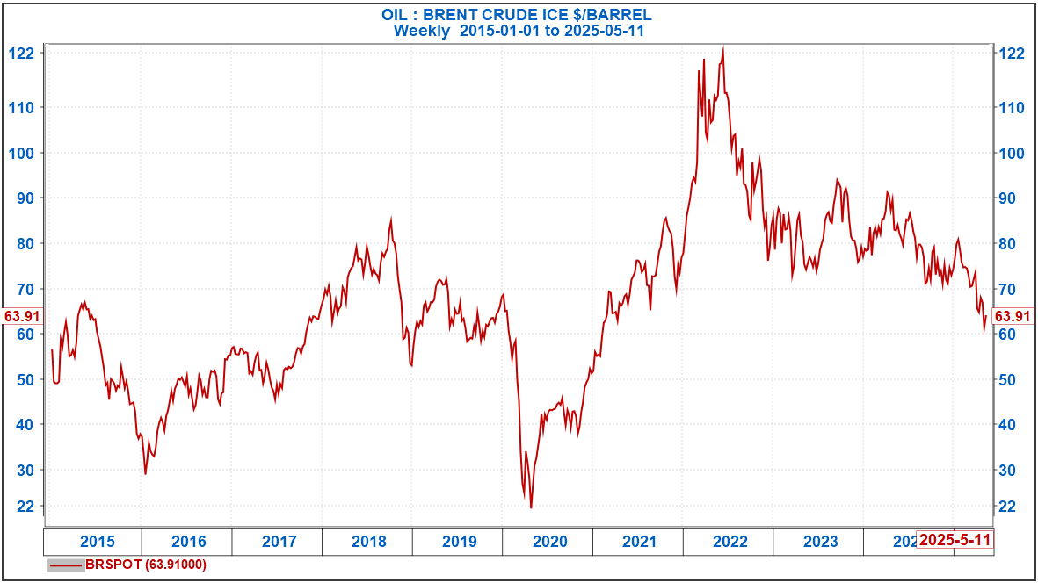
SO THE OIL PRICE IS DOWN (USD/BBL)

Slide 15
BUT THE SEQUENCING OF TRUMP ACTIONS IS IMPORTANT
Tariffs
Tax cuts
De-regulation

Slide 16
HOW THIS IMPACTS INVESTMENTS
2

Slide 17
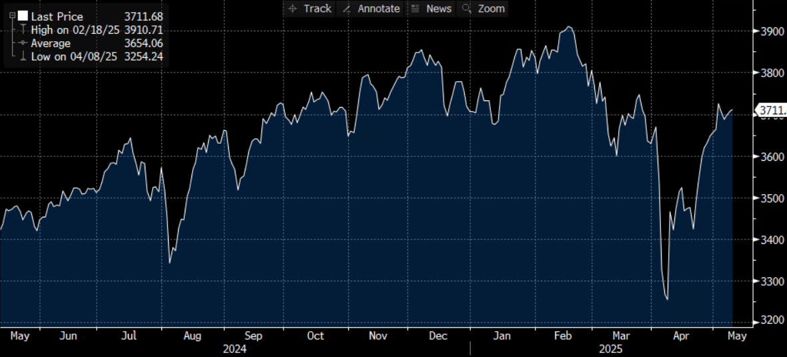
MSCI WORLD INDEX – SHORT TERM
-17% in 6 weeks!

Slide 18
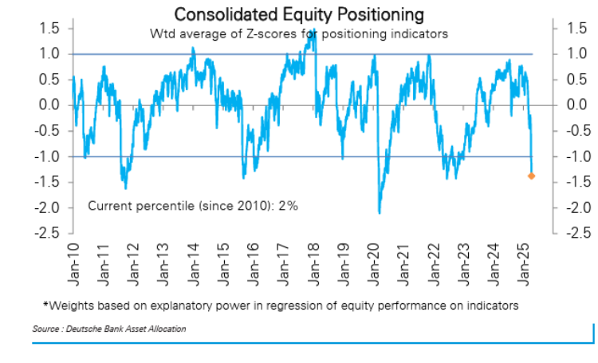
APRIL PANIC = OPPORTUNITY
Emotion is the enemy of investment performance
We added to AMZN, MSFT & US mid-caps in April

Slide 19
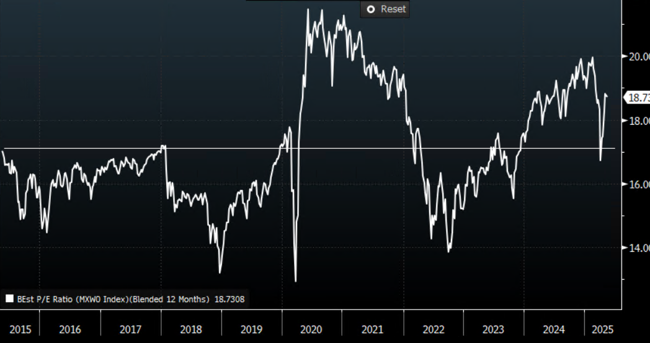
MSCI WORLD FORWARD P/E IS EXPENSIVE AGAIN

Slide 20
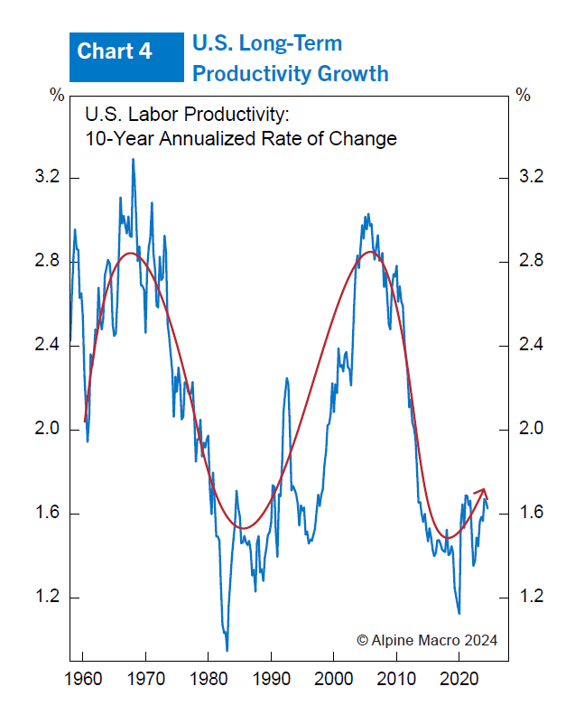
BUT ARE WE GETTING A US PRODUCTIVITY BOOM?
US Long-Term Productivity growth
Ripe conditions: new technology (AI) + tight labour market
Great for economy – growth without inflation pressure
Increases the neutral risk free rate (r*)
Higher nominal growth + demand for capital
Source: Alpine Macro

Slide 21
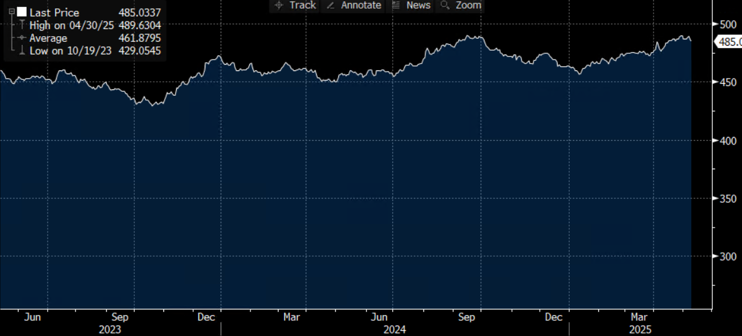
GLOBAL BOND INDEX
+2.9% in April

Slide 22
WHY OFFSHORE?
3

Slide 23
WHY OFFSHORE?
Diversification
Counters cyclicality of any single local economy
Zim is less than 0.5% of global GDP
Opportunity set
Exposure to the world’s great businesses
Exposure to different industries
Returns
Global equities >10% pa in USD last 10 years
Protection of hard currency
Liquidity

Slide 24
THE ROLE OF GLOBAL EXPOSURE FOR ZIMBABWEAN PENSION FUNDS
Protect value in real terms
Hard-currency anchor
Returns
Volatility reduction

Slide 25
ASSET ALLOCATION: RETURN MULTIPLES OVER THE LAST 40 YEARS IN USD

Slide 26
PHILOSOPHY IN ACTION
4

Slide 27
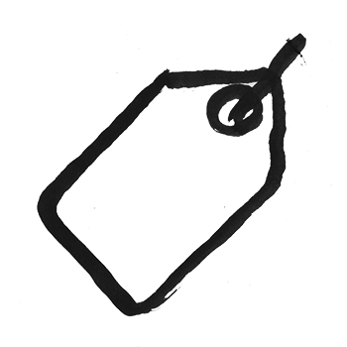
SANLAM PRIVATE WEALTH’S INVESTMENT PHILOSOPHY IN A NUTSHELL
PRICE
PERSPECTIVE
PATTERN
Intrinsic value when dealing with asset
Price when thinking asset allocation – price triggers action
Correct perspective – defines price levels correctly
Pattern regularly repeats … still there is always some plausible theory that low prices will not follow high prices and vice versa

Slide 28
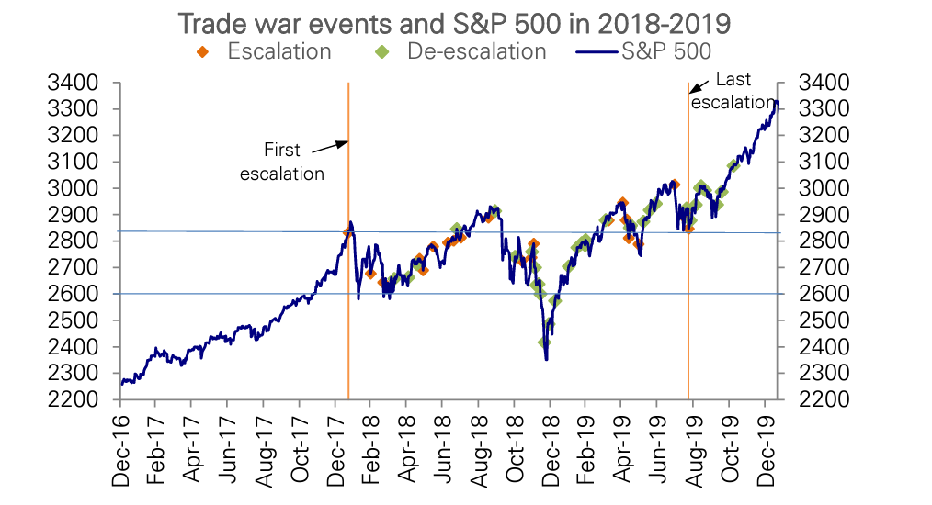
TRADE WAR EVENTS AND S&P 500 IN TRUMP’S FIRST TERM
Source: Deutsche Bank Research

Slide 29
COMBINING QUALITY AND VALUE HAS BEEN A WINNING STRATEGY OVER TIME
Annualised excess returns since 1990 (win rate in brackets)
 | CHEAP | MKT. LIKE | EXPENSIVE
HIGH QUALITY | 4.9% (55%) | 2.5% (55%) | -1.8% (48%)
MODERATE QUALITY | 3.1% (55%) | -1.6% (45%) | -6.3% (43%)
LOW QUALITY | 0.2% (51%) | -3.5% (46%) | -10.8% (38%)
Source: Schroders QEP

Slide 30
STYLE POSITIONING OF SELECTED EQUITY FUNDS
Based on Z-scores vs the group

Slide 31
CROSS-CORRELATION
December 2018 – December 2024
Investment | 1 | 2 | 3 | 4 | 5 | 6 | 7 | 8 | 9 | 10 | 11 | 12 | 13 | 14
1 Global Real Estate
2 USD cash | 0.00
3 Global Bond Fund | 0.73 | 0.13
4 Global Credit Fund | 0.77 | 0.14 | 0.85
5 Quality defensive equity fund | 0.81 | 0.06 | 0.67 | 0.74
6 Real Assets fund | 0.87 | -0.12 | 0.69 | 0.73 | 0.69
7 Value equity fund | 0.79 | 0.00 | 0.62 | 0.76 | 0.89 | 0.70
8 Multi-Strat | -0.16 | -0.06 | 0.01 | 0.02 | -0.04 | -0.06 | -0.01
9 MSCI World Index | 0.85 | 0.04 | 0.65 | 0.76 | 0.94 | 0.73 | 0.92 | -0.13
10 US Government Bonds | 0.39 | 0.14 | 0.76 | 0.48 | 0.26 | 0.38 | 0.08 | -0.01 | 0.21
11 Quality growth equity fund | 0.83 | 0.04 | 0.61 | 0.72 | 0.93 | 0.70 | 0.92 | -0.14 | 0.99 | 0.17
12 Defensive growth equity fund | 0.82 | -0.01 | 0.66 | 0.74 | 0.92 | 0.70 | 0.84 | -0.14 | 0.97 | 0.28 | 0.96
13 Value equity fund | 0.63 | -0.11 | 0.44 | 0.61 | 0.73 | 0.58 | 0.85 | 0.05 | 0.77 | -0.10 | 0.78 | 0.67
14 Growth equity fund | 0.59 | 0.07 | 0.59 | 0.57 | 0.62 | 0.56 | 0.54 | -0.12 | 0.74 | 0.34 | 0.71 | 0.74 | 0.51
Source: Morningstar Direct

Slide 32
SPW GLOBAL CAUTIOUS PORTFOLIO
Asset allocation

Slide 33
SPW GLOBAL CAUTIOUS PORTFOLIO
Performance in US$ (based to 100, net of all fees)

Slide 34
CONCLUSION
The USA’s previous economic path was not sustainable
Global uncertainty has increased materially
Confidence is a key variable
Sanity appears likely to prevail
Smart diversification of investments is key
It is easier than ever to be surprised
Must understand the cross-correlation of portfolio assets
Sanlam Private Wealth can be your guiding partner for investing offshore

Slide 35
If you want to go fast, go alone. If you want to go far, go together.

