Slide 1




MASTERING THE ART AND SCIENCE OF INVESTMENT DECISION-MAKING
Presentation to
Principal Officers & Chairpersons Masterclass
30 July 2025

Slide 2


Is Investing an Art or Science?
The Science of Investing
-Data & Information
- Research & Analysis
- Valuation & Modelling
The Art of Investing
- Intuition & Experience
- Judgement
- Timing & sentiment

Slide 3
Is investment success based on skill or luck?
Efficiency of markets
Timing of entry/exit
Economic and investment cycles
Evaluation period: Short vs Long-term
Benchmarks and consistency

Slide 4
Investment Decision-Making Process for Pension Funds
Strategic Asset Allocation
Liability Structure
Investment Policies
Capital Market Expectations
Asset Picks
Investment Portfolio
Performance
Trading

Slide 5
Key Pillars of Investment Decisions
Returns
Risk
Diversification

Slide 6
The Investments Universe
INVESTMENT ASSETS
TRADITIONAL INVESTMENTS
Fixed Income
Equities
ALTERNATIVE INVESTMENTS
Real Assets
Derivatives/ Structures
Quasi-Equity
Pooled Vehicles

Slide 7
Investments Universe – Traditional Investments
ASSET CLASS | DESCRIPTION
Cash/Call placements | Liquidity set aside for withdrawals, transitory or tactical investment strategies
Fixed Income (Money Market) | Placements with banks for less than 1-year through instruments such as Bankers’ Acceptances, Negotiable Certificates of Deposits, Treasury Bills, etc.
Fixed Income (Bonds/Debentures) | Investments in debt instruments issued by the Government, quasi-government entities or corporates usually with a tenure of over a year.
Listed Equities | Investments in shares of companies listed on a licensed securities exchange e.g. ZSE, VFEX, FINSEC
Listed Property Companies | Investments in shares of companies listed on a licensed securities exchange e.g. ZSE, VFEX, FINSEC whose primary business is owning real estate
Quasi-equity instruments | Instruments that have characteristics of both debt and equity e.g. preference shares, convertible debentures

Slide 8
Investments Universe – Alternative Investments
ASSET CLASS | DESCRIPTION
Unlisted Property/ Real Estate | Investments in undeveloped or developed land or buildings for the purpose of developing and/or receiving rental income. The property can be residential, industrial or commercial.
Unlisted/ Private Equity | Investments in shares of companies that are privately-owned or whose shares are not listed on a recognised securities exchange
Commodities | Investments in agricultural or mineral commodities whose prices fluctuate in line with global demand and supply.
Derivatives | Investment instruments whose value is derived from other instruments or market variables such as listed equities, commodities, interest rates, exchange rates, etc. Can be structured in various ways e.g. forwards, options
Distressed Assets/ Investments | Target securities issued by companies currently struggling or on the verge of collapse or neglected properties with a view to buy at a discount and turn them around.

Slide 9
Investments Universe – Pooled Investments
FUND | DESCRIPTION/CHARACTERISTICS
Unit Trusts/ Mutual Funds | Pooled investment vehicles that invests in traditional asset classes and targeted small retail investors. Each Fund has a pre-defined investment objective and strategy, as well as asset class(es) it will invest in
Real Estate Investment Trusts (REITs) | Pooled funds that invests in real estate. REITs are normally given a tax dispensation on condition that the benefits (rental income and development profit) larges passes through to the investors.
Private Equity / Venture Capital Funds | A specialist fund that invest in unlisted companies and typically run by general partners with investors as limited partners. Typically had a limited life e.g. 10yrs and GP paid basic fee plus carried interest.
Exchange Traded Funds (ETFs) | A fund that is made to track a parcel of securities traded on an exchange and is also listed. Typically equities and commodities.
Hedge Funds | Pooled funds with discretion to follow a particular unique investments strategy largely designed to lower downside for investments through use of both buying and short-selling shares as well as using derivatives. Funds that use exclusively derivatives are often called Managed Futures.
Structured Notes | These are structured for a particular purposes mainly to provide capital guarantee whilst limiting upside.

Slide 10
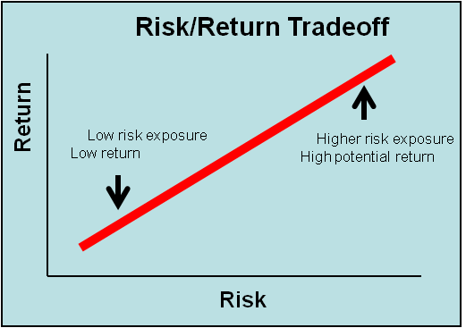
Private Equity & Other Alternative Investments
Listed Equities
Unlisted Property
Bonds
Money Market
Cash

Slide 11
Why Diversification is Important
“Do not put all your eggs in one basket”
Reduce risk without reducing expected return
Insulates against “disaster”
The lower the correlation among assets, the lower the risk and the greater the diversification

Slide 12
Role of Chair & Board in Investment Decisions
Decide on Approach to Investment Decisions & Implementation
Outsourcing
Insourcing
Policies & Strategic Asset Allocation
Liability Structure
Capital Market Expectations
Manager Selection & Monitoring
Active
Passive

Slide 13
Common Pitfalls to Avoid
Behavoural Bias | Cause & Effects | Possible Remedy
Overconfidence | Over-estimating self capacity Tend to under-estimate risks | Committee decisions
Conservativism /Confirmation Bias | Tendency to prefer status quo or what confirm prior beliefs | Have a fresh look at every decision
Loss Aversion | Being over-cautious instead of the risk-return principle | Diversification Fund investments
Regret Aversion | Avoidance to make decisions due to fear it may go wrong Either miss opportunities or hold on to losing positions for long | Committee decisions Objectivity in decision-making
Representativeness | Taking or avoiding investments based on prior experience instead of own merits | Consider each investment independently
Framing | Investment decisions based on how they are presented or packaged | Focus more on content than presentation

Slide 14


Contact Details
Tel: +263 4 783069-71
Mobile: +263 772 240 733
Email: welcome.mavingire@intellego-ic.com

