Slide 1
INTERGRATED HEALTH CARE STRATEGIES
FOR RETIREMENT WELL BEING:
From workforce vitality to Pensioner Dignity
Presentation done by : DR. A.K.K. CHIVAURA

Slide 2
RETIREMENT DEFINED…..
Retirement is the transition from full-time work to a phase of life
characterized by reduced or no work,often accompanied by
changes in income, social roles,
and activities, …..

Slide 3
AAA
TYPICAL SCENARIOS, PROBLEMS AND ISSUES
FACED BY PENSIONERS IN RETIREMENT

Slide 4
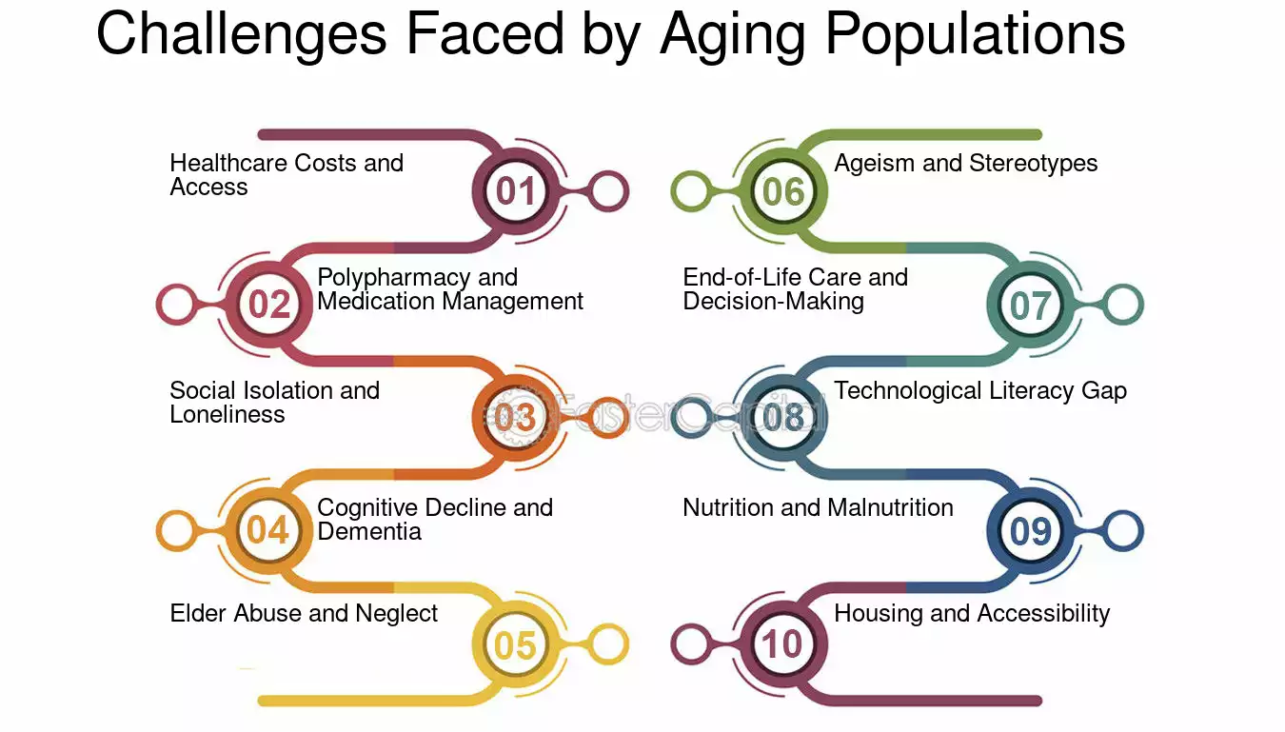
Challenges faced by Aging Populations Summary

Slide 5
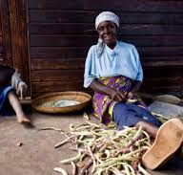
Challenges for Pensioners in accessing Healthcare
….these include
Pensioners in Zimbabwe face challenges accessing healthcare due to limited funding, staff shortages, poor infrastructure, and high poverty levels, which prevent payment for services and transportation.
Economic hardships and high costs
Low pension value: pension values have been eroded leaving many elderly citizens in poverty.
Cost of Medication: While Government policy is to provide free services for those over 60, public facilities are often under resourced and lack essential drugs leaving the pensioners to buy from expensive private providers.
Limited Medical Aid: medical aid for the elderly is scarce and expensive- leaving many elderly uninsured.
Exclusion from schemes- Most elderly people especially those from the informal sector or rural areas were excluded from contributory pension schemes and have no financial safety net.

Slide 6
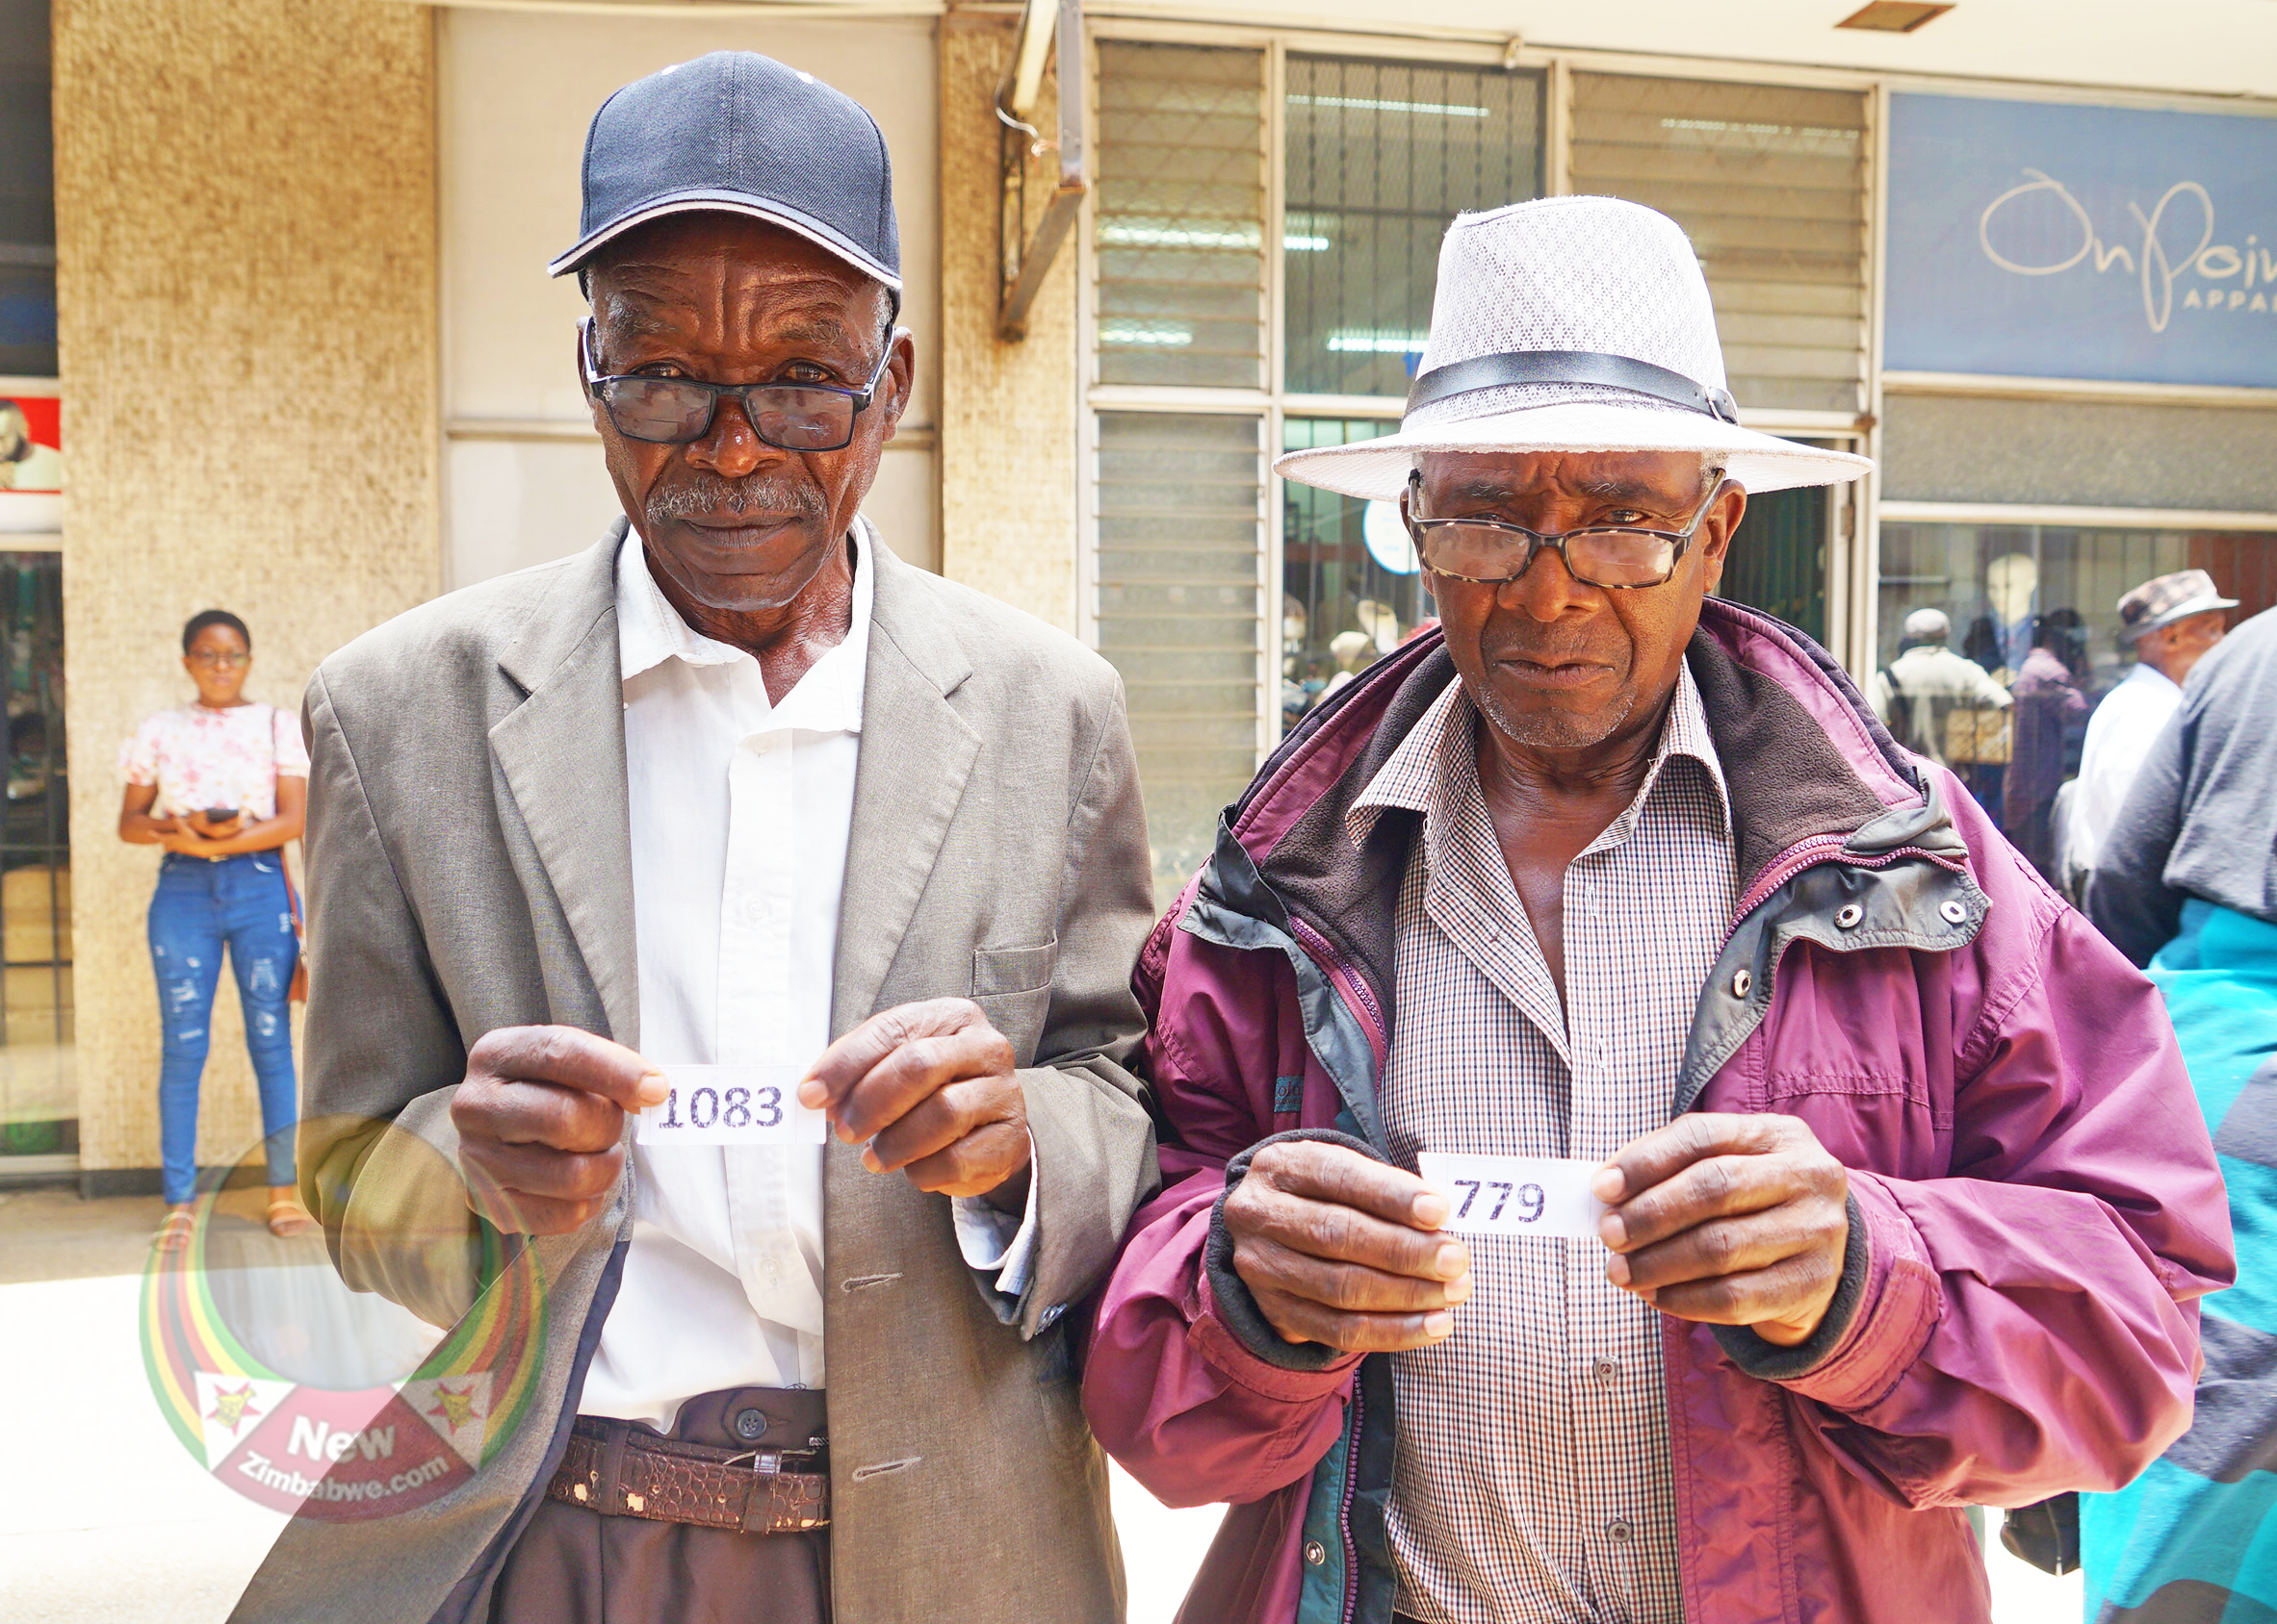
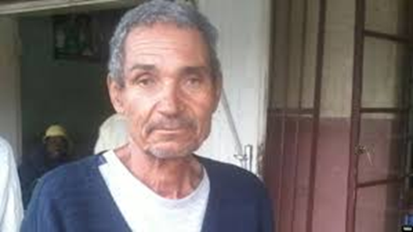
Challenges for Pensioners in accessing Healthcare… These include
2. Healthcare System and Infrastructure
Under resourced facilities: public hospitals and clinics lack basic equipment , essential medicines and trained personnel especially in the rural areas.
Long distances and transport costs: Pensioners must often travel long distances to reach clinics or hospitals.
Long wait times: Patients, particularly the elderly face excessively long waiting periods at understaffed public clinics.
Inadequate chronic disease management: lack of specialised services for age related conditions like diabetes , hypertension and arthritis.
3. Social and attitudinal barriers
Ageism: some healthcare providers treat older patients as low priority and devaluing their treatment
Dependence on family: economic hardships and migration make it difficult for the older people to depend on their families.
Health Illiteracy: lack of health information can hinder effective communication and health seeking behaviours among the elderly.

Slide 7
RETIREMENT LIFE NEEDS…..
These , primarily , include
HEALTH CARE
LIVING EXPENSES
SHELTER
ACTIVITIES
SOCIALISATION

Slide 8
BBB
STRATEGIES,INTERVENTIONS AND ACTION PROGRAMS
FOR CONTINUED/, MPROVED HEALTH AND WELL BEING
FOR PENSIONERS

Slide 9
Lifelong Promotion for Fund Members:
Fitness and Wellness strategies
Workplace health programs and Incentives
Effective fitness and wellness strategies for retirement members include maintaining physical activity through low-impact exercises like walking and swimming, eating a balanced diet rich in fruits and vegetables.
Nurturing social connections through clubs and volunteering, keeping the mind active with puzzles and learning, managing stress with meditation, and ensuring regular health checkups.
Physical wellness strategies
Aim for regular exercise: Aim for at least 150 minutes of moderate-intensity(Walking).
Choose low impact activities: Walking, Swimming, yoga.
Mental & Emotional Wellness
Find purpose: Stay engaged by setting new goals, pursuing hobbies, or volunteering, which provides a sense of purpose and fulfillment

Slide 10
Solutions to improving healthcare access for pensioners
People who age in better health can remain productive for longer, continuing to make significant contributions to their families and communities and reduced need for family support and particularly for the emergency care which often causes financial as well as health crises in poor households. As a result, the health and care system need to respond to both existing and growing health and care challenges faced by people in older age, providing flexibility for a context specific analysis of the diseases and issues to be addressed to promote a comprehensive public-health response to population ageing.
Health systems operations
Governments should ensure the rights of older people to age-friendly prevention, diagnosis and treatment, as well as home-based services and the economic and social contributions of older people are fully recognised such as caregivers of children orphaned by AIDS to promote healthy ageing of older populations.
The health systems should be aligned to the needs of the older populations and have their health workforce including the community health workers appropriately trained with basic and/or specialised training on gerontological and geriatric skills to meet the health needs of the increasing number of older people.
Health facilities need to be age-friendly through practical changes such as dedicating special clinic days for older people, promoting a no-queue policy for older people, training older HIV counsellors, and ensuring older patients (as well as their care givers) receive appropriate advice and follow up on the treatment regime which they should follow. More so, the essential drugs list for primary health care facilities should include medicines and consumables to treat the common health conditions related to NCDs, particularly for the prevalent conditions such as hypertension, arthritis, eye care and diabetes.

Slide 11
Solutions to improving healthcare access for pensioners
2. Health information and research Health management:
Information should be structured so that it can generate disaggregated data by gender and age for the 50+ age group to inform health policies, strategies and practice. Population based surveys, such as the DHS, should collect, analyse and report disaggregated data by age and gender for the 50+ age group. This would inform the health practices and policies to reflect the needs and rights of all people of all ages
3. Community awareness
Awareness raising programmes and campaigns which are age-appropriate are urgently needed to ensure older people have the right information on their rights to prevention, diagnosis and treatment of common health conditions including chronic conditions.
4. Coordination and partnership
There is need for a coordinated and integrated approach in which older people, local government, private sector, civil society and other stakeholder work together in promoting wholistic approach in promoting health ageing by ensuring stand along frameworks for older people are in place at national and local levels and are well resourced (skilled personnel on ageing and adequate budget). Additionally ensuring that sectors have adequate technical capacity and have included issues and rights of older people in their policies and programmes to ensure that older people benefit.
5. Livelihood and Social protection
Livelihood and social protection programmes, particularly social transfers which are inclusive of older people, are proving to be an effective strategy to address barriers to access to health services and need to be replicated and scaled up

Slide 12
RETIREMENT PLANNING
…Setting up of financial and lifestyle goals… as well as making decisions
And taking actions to achieve a desired standard of living during retirement
Some common mistakes
Putting off savings
Ignoring long term care
Having no other income streams other than salary
Not having a home
Neglecting estate planning

Slide 13
Palliative Care As A Pillar for Retirement:
Early Screening, Chronic Disease management
Mental Health and Stress Reduction
Preventative healthcare is a pillar of retirement planning because it promotes a long, healthy, and active retirement by detecting and preventing diseases early through lifestyle changes, regular check-ups, and screenings.
Why Palliative Healthcare is Crucial for Retirement
Extends your Life span: By focusing on prevention, you can increase the number of years you enjoy a high quality of life, rather than just extending your lifespan.
Early Screening, Chronic Disease Management
Early screening for retired members is vital as it identifies chronic diseases like heart disease, diabetes, and cancer at their earliest stages, enabling timely intervention to prevent severe complications and improve quality of life
Effective management includes regular medical check-ups, adherence to prescribed medications, healthy lifestyle changes such as a balanced diet and regular physical activity, and participation in support groups for emotional well-being

Slide 15
NAVIGATING THE BURDEN OF NON-COMMUNICABLE DISEASES:
Long term financial and social implications
Role of Pension funds helping affected members
Navigating the burden of long-term non-communicable diseases (NCDs) requires a comprehensive, multi-sectoral approach that includes risk factor reduction through healthy lifestyles, improved access to screening and treatment in primary healthcare, and investment in management and palliative care.
Financial Implications
Non-communicable diseases (NCDs) create significant financial burdens at the individual, national, and global levels through increased healthcare costs, lost productivity from disability and premature death, and reduced economic growth
Out-of-pocket expenses: NCDs require ongoing, often expensive, care, leading to high out-of-pocket payments for individuals and families, especially in countries with inadequate insurance and public health spending.
Social Implications
Poverty and Impoverishment: The high cost of NCD treatment can push individuals and families into poverty, as they struggle to afford healthcare and often choose to forgo necessary treatment

Slide 16
Role of Pension Funds in Helping Affected Members
Investing in NCD Prevention: Pension funds can allocate some of their investments to funds or projects focused on NCD prevention, health promotion, and the development of healthier communities.
Supporting Healthcare Systems: By investing in sectors that strengthen healthcare infrastructure and services, such as public health initiatives and chronic disease management programs, pension funds can indirectly contribute to better NCD outcomes.
Promoting Health-Focused Investments: They can channel investments into companies and industries that align with public health goals, such as those involved in the development of affordable NCD medication and health technologies.

Slide 18
Healthcare needs for Ageing Populations:
Geriatric care models and palliative support
The healthcare needs of aging populations are complex and require person-centered, integrated approaches due to increased chronic conditions, cognitive decline, and social factors
Key needs include managing multiple chronic conditions like heart disease, diabetes , and dementia , as well as addressing fall prevention, access to care, and social support to promote overall well-being
Geriatric Care Models
Geriatric care models provide frameworks for delivering person-centered, comprehensive care to older adults by addressing their unique needs.
These needs include the 5 M’s, foundational framework for Geriatric care focusing on: Mobility, Medication. Multimorbidity, Mentation and What Matters Most
Palliative Support
Key Aspect in Palliative support for Ageing people:
Symptom management-Addresses distressing physical symptoms such as pain, breathlessness, and delirium
Family Support-Provides assistance to families throughout the illness and helps them cope with the process of bereavement
Quality of Life Enhancement- Aims to help patients live as actively and as comfortably as possible, focusing on their overall well-being

Slide 19
Technology driven Healthcare Access:
Telemedicine
Bridging rural-urban care delivery
Technology-based healthcare access uses digital tools to overcome barriers to care, enabling remote services through telehealth (video calls, remote monitoring), providing patients with self-management tools via mobile apps and wearable devices and improving communication via electronic health records
Bridging the Urban-Rural Gap in Care Delivery
Bridging rural and urban gaps in healthcare delivery requires using technology like telemedicine and digital health platforms to connect rural patients with urban specialists logged on to provide remote consultations. It also involves leveraging local resources, such as training village medics to act as intermediaries, and developing innovative, cost-effective hybrid models that integrate clinics and digital networks.
Leveraging Technology
Telehealth: Enables remote consultations and monitoring, ensuring essential healthcare reaches isolated communities where traditional infrastructure is lacking.
Artificial Intelligence (AI) & Internet of Things (IoT):AI-powered assistants can support healthcare providers by handling tasks like data processing and note-taking, while also providing medication reminders for rural patients

Slide 20
Future Medical Innovations and Pension Fund Sustainability:
A.I, Robotics and Biotech in elder care
Cost Implications
AI, robotics, and biotech are enhancing elder care by providing companionship, physical assistance, medication reminders, and monitoring for health and safety. Social robots offer companionship and interaction, while service robots handle household tasks
AI systems can detect health anomalies, personalize cognitive stimulation, and automate check-in calls. Biotech applications include wearable devices for health tracking and other assistive technologies that boost independence and quality of life for older adults, although challenges like cost, privacy and digital literacy need to be addressed for wider adoption.
Cost Implications
Medical innovation in elder care has mixed cost implications, with initial investments in new technologies, treatments, and infrastructure potentially increasing costs, but also offering long-term cost savings by improving health, preventing dependency, reducing hospital stays, and promoting efficient, decentralized care
Technological adoption: The cost of acquiring, implementing, and maintaining new technologies, such as digital health tools, sensors, and AI-driven systems, can be significant.
Increased service demand: Better medical technology can improve health outcomes, extend life, and increase demand for ongoing care, raising overall healthcare expenditure.

Slide 21
Governance And Policy Frameworks
Rights-Based Approach: Implementing a rights-based system for aged care ensures that the rights of older people are upheld, focusing on person-centered care and consumer experience.
Leadership & Governance: Strong, capable leadership and robust governance are vital for driving reform, improving service quality, and ensuring sustainability in the elderly care sector.
Financial Viability & Sustainability: Developing sustainable financing models and ensuring that the responsible allocation of resources are crucial for providing quality aged care services long-term.
Social Inclusion & Accessibility: Policies must ensure universal accessibility to services, regardless of socioeconomic status, and promote social inclusion for older adults.
Challenges and Future Direction
Policy Mix Effectiveness: Governments must focus on creating comprehensive, balanced, and consistent policy mixes to promote effective elder care and avoid confusing, conflicting, or mutually exclusive policy contents.
Adaptation to Reform: Governing bodies and executives need to adapt their skills and processes to navigate ongoing reforms and ensure organizational excellence and sustainability in the evolving aged care landscape

