Slide 1
ZIMBABWE ASSOCIATION OF PENSION FUNDS PRINCIPAL OFFICERS AND CHAIRMEN CONVENTION
THEME: “50 YEARS OF PENSION LEADERSHIP: SUSTAINING LEGACIES SHAPING FUTURE”
PRESENTATION: STRATEGIC INVESTMENT PATHWAYS FOR PENSION FUNDS
PRESENTED BY
HONOURABLE EZRA R CHADZAMIRA
MINISTER OF STATE FOR PROVINCIAL AFFAIRS AND DEVOLUTION

Slide 2
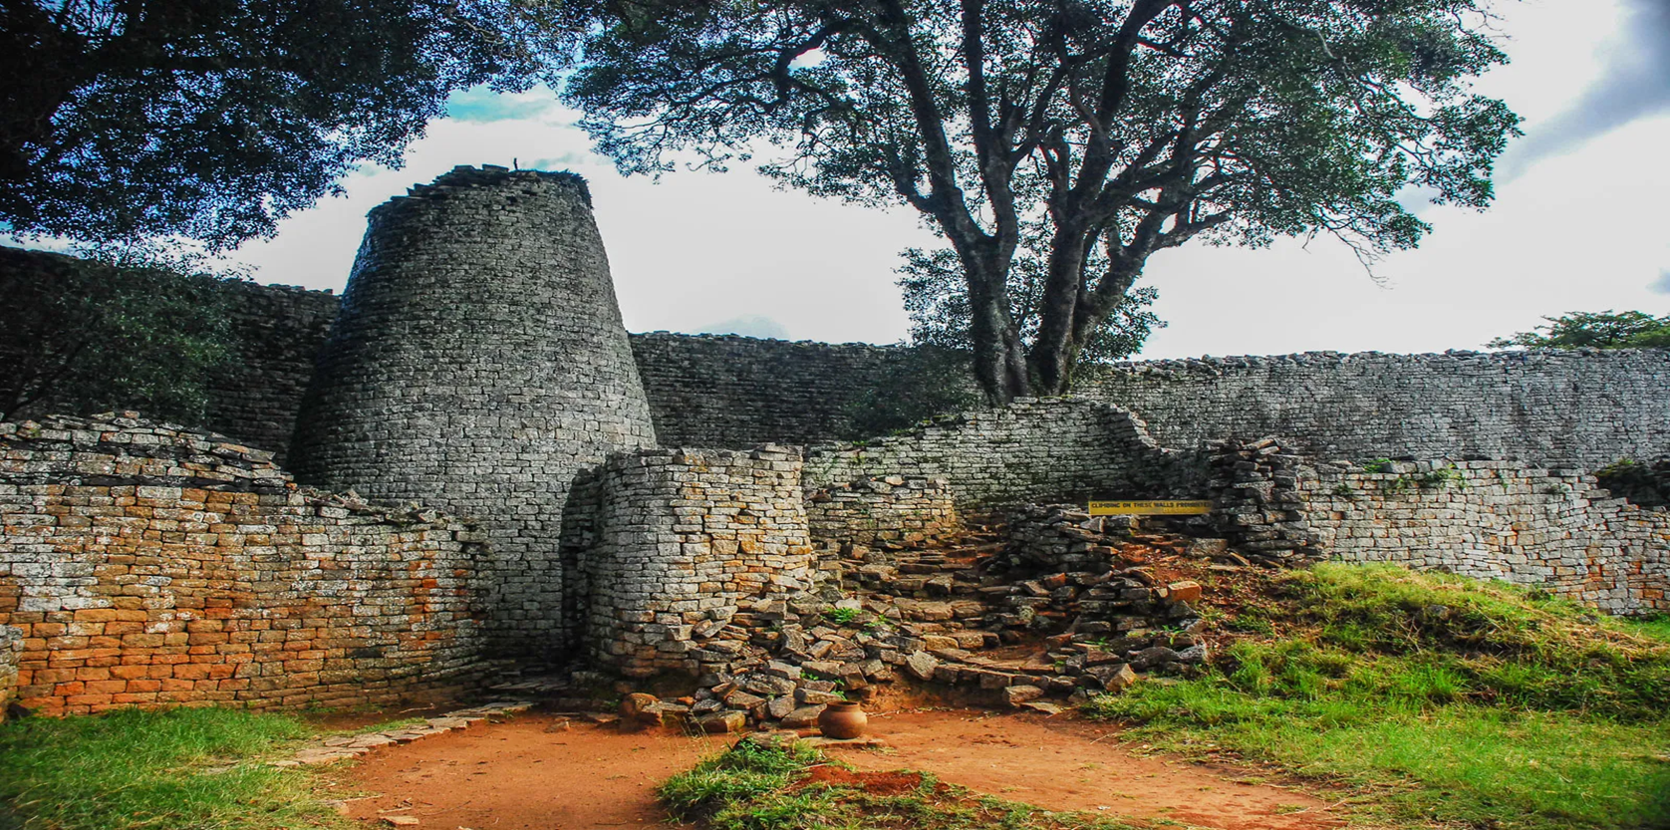
MASVINGO INVESTMENT OPPORTUNITIES

Slide 3
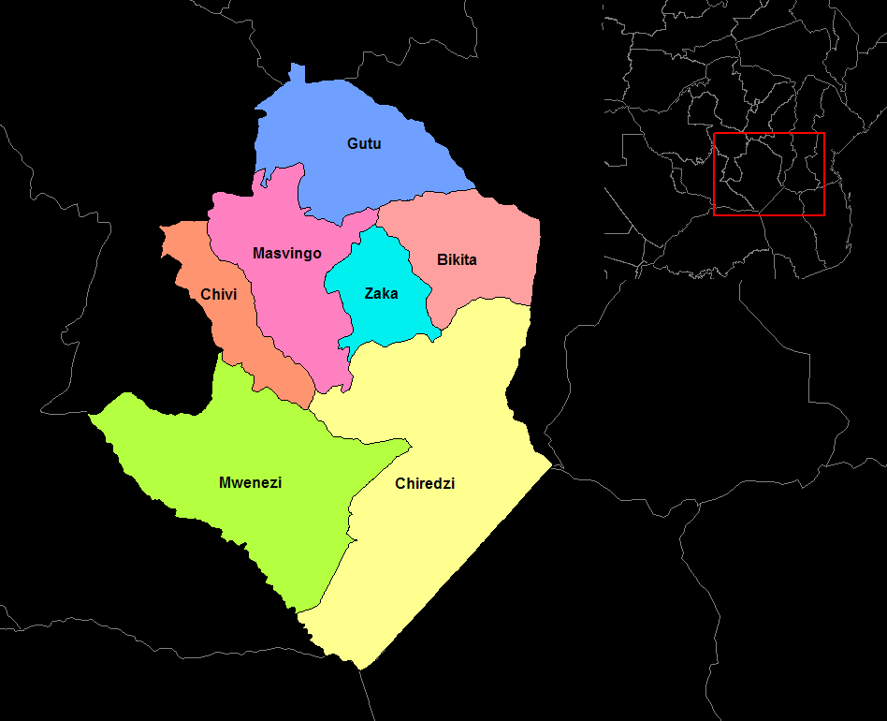
ABOUT MASVINGO PROVINCE
Category | Details
Province Name | Masvingo Province
Capital City | Masvingo City
Province Population | ~1,638,528 with 63.6% being rural population(2022 Census)
Area (Province) | ~56,566 km²
Districts | 7: Bikita, Chiredzi, Chivi, Gutu, Masvingo, Mwenezi, Zaka
Climate | Tropical Savanna, Agroecological regions 3- 5 with 62% in agro-ecological region 5
Major Water Bodies | Tokwe Mukosi Dam, Lake Mutirikwi
Key Economic Sectors | Agriculture, Mining, Tourism, Infrastructure
Major Crops | Maize, traditional grains, sugarcane, cotton,
Major Minerals | Lithium (Bikita), gold, chrome, asbestos, diamonds
Tourism Sites | Great Zimbabwe Monuments, Gonarezhou National Park, Save Valley Conservancy, Kyle Recreational Park

Slide 4
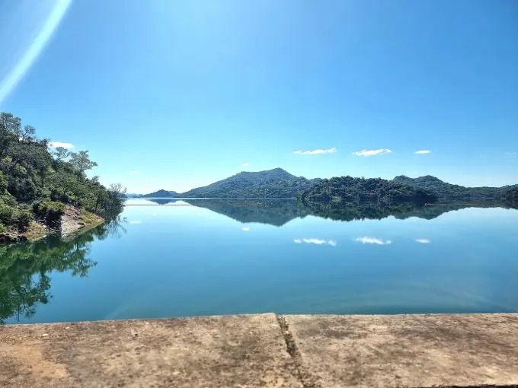
BACKGROUND OF MASVINGO PROVINCE
The Province boasts of various endowments ranging from natural resources, people, history, culture, amenities and super structures that anchor tourism development in the Province.
These include Great Zimbabwe Monuments, Chilojo Cliffs, Tugwi Mukosi, Lake Mutirikwi, Save Valley Conservancy, Malilangwe Conservancy, Manyuchi Dam and Gonarezhou National Park among others.

Slide 5
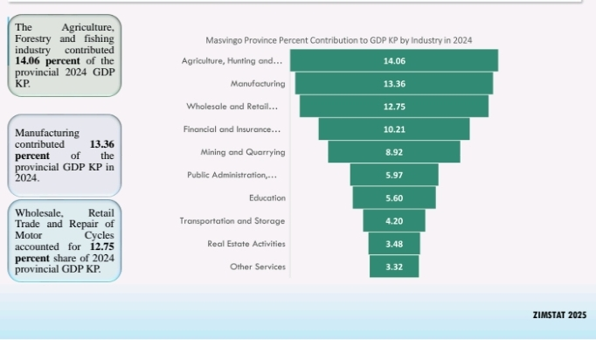
Key Drivers of Economic Activity by Masvingo Province.
According to recently published ZIMSTATS statistics surveys:

Slide 6
Prospective Economic Drivers in Masvingo Province?
Investors can capitalize on:
The proposed New Ethanol Plant in Mwenezi District
Development of Beef value chains in Mwenezi and Chiredzi Districts- tanneries and Abattoirs
Real Estate development in all urban centres and at all Growth Points
Construction of Mini Hydro Power stations- Manyuchi Dam and Siya Dam
Solar Farms – Gutu District, Chivi District, Zaka District, Chiredzi District, Masvingo, Mwenezi Districts

Slide 7
Prospective Economic Drivers conti…….
Investors can capitalize on:
Eco-Tourism Development around the Tugwi Mukosi ,Mutirikwi Dam, Siya, Manjirenji, Manyuchi
Development of Cold Chains at Tugwi Mukosi Dam
Horticulture development in all Districts
Fisheries Development at Tugwi Mukosi Dam
A prospective crocodile abattoir in Mwenezi District
Prospective Sugar milling Plants at Mkwasine & Mwenezi
Resuscitation of Asbestos Mining at Mashava Mine
Joint ventures in water conveyances development in the Lowveld

Slide 8
INVESTMENT OPPORTUNITIES IN AGRICULTURE
Of all the water in the country, 54% is husbanded in the province. Investment opportunities are thus presented in all nodes of the Agriculture Value Chain.
Construction of Tugwi-Mukosi Dam coupled with vast fertile soils and frost-free weather conditions, created massive opportunities for the agricultural sector. Investors can be involved in wheat, avocado, citrus, sugarcane, soyabeans, wheat, cotton and livestock (goats and cattle) production. These products have a huge demand both locally and internationally. This can be done through joint ventures with farmers or through long-term lease for mega projects on state land
The Province has investment opportunities in the construction and rehabilitation of sugar cane industry water conveyance systems – Offsite and infield water conveyance systems for +100 000Ha in the lowveld of the province.

Slide 9
INVESTMENT IN AGRICULTURE conti………
Value addition of fruits like mangoes, avocado and paw paws into dried products and package them for both local and international markets.
Establishment of agro-processing industries for traditional grains processing and packaging for both local and international markets. In the 2024/25 cropping season, the Province was the highest producer of Traditional grains, Sesame and Round nuts, producing 34% of the National produce.
Setting up of abattoirs and tanneries in Masvingo Province. The concentration of livestock, over 1.1 million cattle provides opportunities of resuscitating the beef to leather value chain. The country is currently producing less than 1.5 million pairs of shoes against local demand of 14.3 million pairs of shoes per annum.

Slide 10
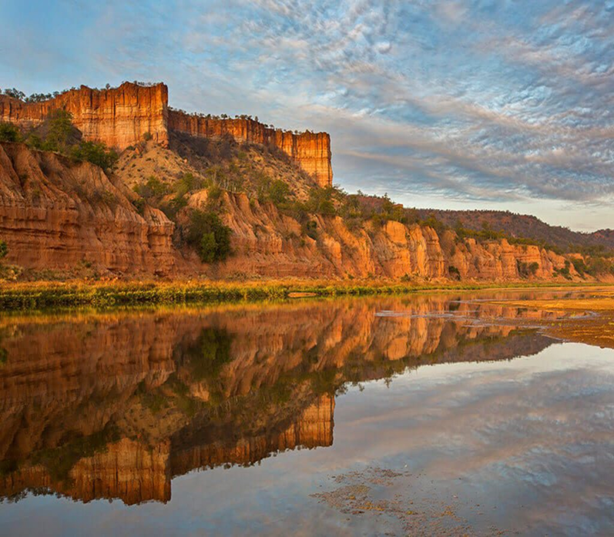
OPPORTUNITIES FOR TOURISM DEVELOPMENT
These are anchored by the following factors:
Geographical location of destination Masvingo
Abundant natural, cultural and man-made tourism products
Home to the Great Zimbabwe Monuments where our country derives its name from.
Strong destination brand anchored on Masvingo the Cradle of Our National Heritage.
Home to Tugwi Mukosi the largest inland dam in Zimbabwe.

Slide 11
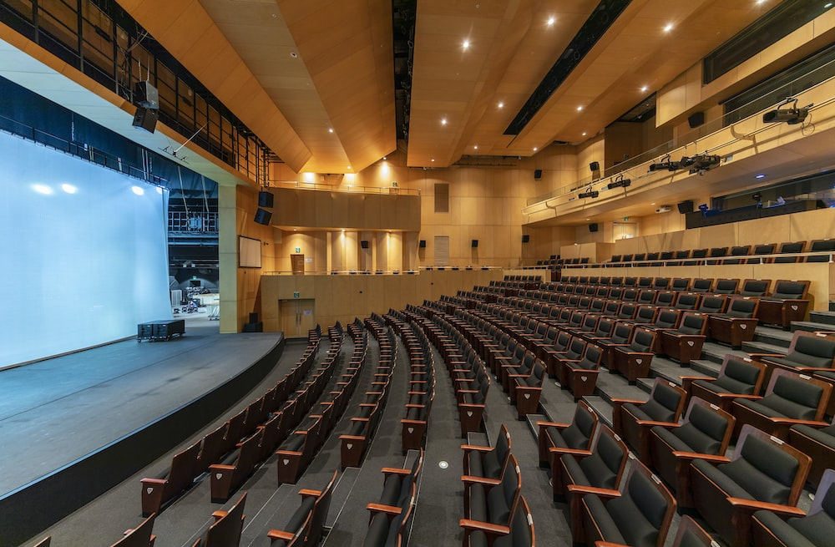
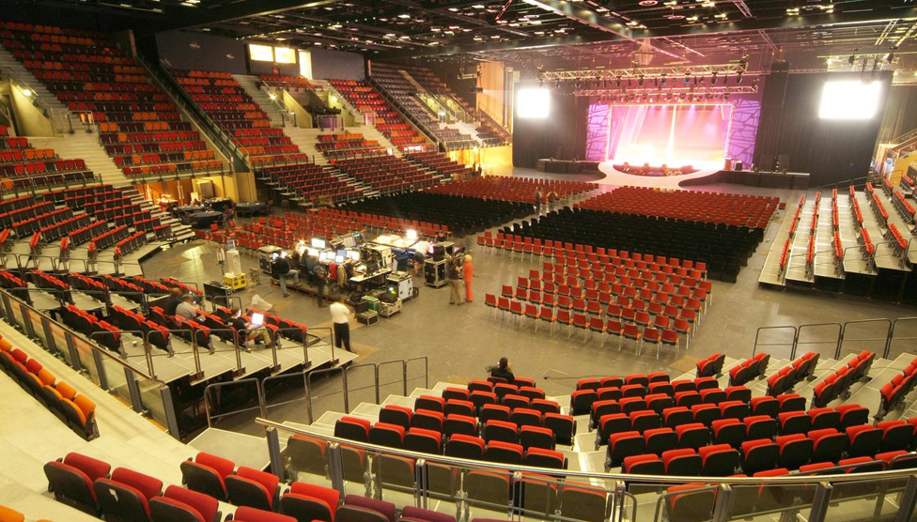
OPPORTUNITIES IN TOURISM conti……
The Province has less diversified product base and is underinvested in terms of :
Accommodation ranging from low cost to luxury lodges and hotels
Conference facilities
Activity based facilities such as amusement parks, golf estates, casinos, shopping malls, integrated resorts, photographic safaris, water sporting activities, multi- purpose convention and exhibition facilities etc
The coming in of the Sengwe Tsipise corridor
presents great opportunities for investment in
park estates, luxury hotels, exclusive lodges and
campsites

Slide 12
OPPORTUNITIES IN MINING AND MINERAL BENEFICIATION
The Province boast of various mineral deposits ready for exploitation. Some of the opportunities include:
Exploration and evaluation of kimberlites for Diamond potential in Triangle, Chiredzi, Mwenezi, Devuli and other areas.
Setting up of Tantalite, Lithium and Tin minerals beneficiation plants in Bikita and Gutu districts, and forming joint ventures with existing claim holders.
Quantification and evaluation of Coal deposits ( coking coal) in Chiredzi through Exclusive Prospecting Order (EPO) applications and special grants.

Slide 13
Opportunities in Mining conti…..
Quantification, evaluation and exploitation of numerous calcite and limestone deposits in Masvingo, Chiredzi and Bikita Districts.
Exploitation of precious minerals like Alexandrite and Emeralds in Bikita, and Gutu.
Processing of mine dumps for fibre, and other significant elements like Nickel and Magnesium.
Exploitation of semi-precious minerals like Agate, Corundum and Garnet.
Quantification and evaluation of copper deposits in Malipati.

Slide 14
OPPORTUNITIES IN ENERGY DEVELOPMENT
The Province has potential to generate hydro-electricity at Manyuchi dam, Siya Dam and Manjirenji Dam. Hydro power provides cheap, clean and renewable source of energy and investment in the Province would reduce the national grid shortfall and improve industry capacity utilization. Hydro-electric projects which can be set up will generally provide the much-needed power to the national power grid.
The Province’s large solar footprint can support and stimulate solar and renewable industries, potentially reducing energy costs for consumers and industry. The districts have vast lands where panels and related infrastructure could be installed for the generation of solar power.

Slide 15
OPPORTUNITIES IN INDUSRTY AND MANUFACTURING
Industry and manufacturing is the key pillar in the Value Chains and Structural transformation. The quick wins are:
Intensification of the use of bio-fuels and establishment of agro-processing projects.
The proposed ethanol plant in Mwenezi
The proposed cement factory in Masvingo
Proposed resuscitation of the Cold Storage abattoir
Proposed sugar processing plants in Mkwasine and Mwenezi

Slide 16
OPPORTUNITIES conti…
Proposed Agro Industries in the prospective Tugwi Mukosi economic zone for beneficiation of farm produce.
Value Addition of Traditional grains.
Value addition along Beef to Leather Value Chain nodes.
The development of various industries for beneficiation and value addition of the Province’s agricultural and other primary commodities in line with our National Blue Print NDS1.

Slide 17
OPPORTUNITIES IN INFRASTRUCTURE AND SOCIAL SERVICES DEVELOPMENT
The Province is aggressively courting investors to establish a dry port at Rutenga in Mwenezi district taking advantage of the establishment of the Sango Boli Corridor.
Local Authorities have massive housing waiting lists with a high demand for stands and houses. Partnership proposals in housing development are welcome.
Construction of water and sanitation facilities both in urban and rural areas
Student accommodation in Masvingo City and MRDC targeting students for Great Zimbabwe University, Masvingo Polytechnic and numerous vocational training colleges found in the Province
Construction/Upgrading of Masvingo Airport in Masvingo City
Construction of water conveyance systems in the Lowveld especially in Mkwasine.
Establishment of private owned Medical facilities

Slide 18

PLEASE SCAN ME

Slide 19
NYIKA INOVAKWA NEVENE VAYO
COME AND INVEST IN MASVINGO PROVINCE
MAZVITA
SIYAVONGA
THANK YOU

