Slide 1


Promoting Member Financial Wellness and Retirement Planning
ZAPF 49th Annual Conference May 2024

Slide 2

Life, work and financial wellness
Outline
Key considerations by members
Spending now or saving for later?
Alone or with others
Access to goods and services

Slide 3
Life, work and financial wellness

Slide 4
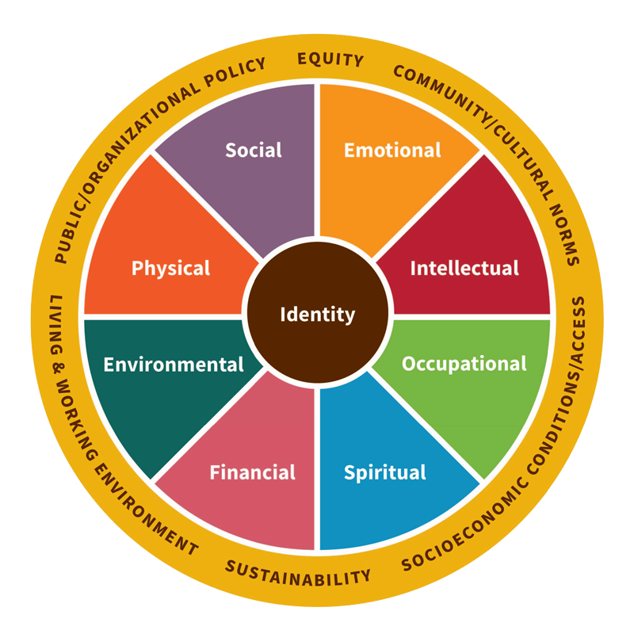

Financial Wellness?
Financial wellness is your ability to live within your means and manage your money in a way that gives you peace of mind - Lynchburg
Learning and practising how to budget, use (good) debt, save enough, investing properly and use insurance - Forbes
Being in control of your money and your money (or lack thereof) does not control you – Standard Bank
Notes:
Savings play an important role in any economy and its role is important at different levels. In particular the Insurance and Pensions Industry pools together the long term savings from Individuals and corporates and enable economic development by deploying these funds into the capital market and infrastructure development. Since dollarization in 2009, the nation has had persistent negative savings, meaning that it is spending more than it is earning. This is in contrast to rest of the World and Sub Saharan Africa which has had positive savings as can be seen in graph below.
Confidence levels in Zimbabwe are very low – low participation levels
Contributions into most pension funds are sub-optimal
People are under saving under both DB and DC arrangements.
National savings are greatly reduced
Country investment capacity is negatively affected.
Cost of borrowing for government and corporates increases
country’s infrastructure development is impaired,
Economic growth is impaired & earnings of funds unsustainable
companies will operate in a difficulty environment and thereby making the cost of borrowing higher.
This may continuously lead to perennial and unending retrenchments.
Therefore, the Zimbabwean Pension industry may not be sustainable.

Slide 5






From financial literacy to financial wellness
Financial Literacy | Financial Wellness
Concepts and tools available for managing money
Involves taking action
Component of financial wellness
Holistic approach to managing finances
Notes:
Savings play an important role in any economy and its role is important at different levels. In particular the Insurance and Pensions Industry pools together the long term savings from Individuals and corporates and enable economic development by deploying these funds into the capital market and infrastructure development. Since dollarization in 2009, the nation has had persistent negative savings, meaning that it is spending more than it is earning. This is in contrast to rest of the World and Sub Saharan Africa which has had positive savings as can be seen in graph below.
Confidence levels in Zimbabwe are very low – low participation levels
Contributions into most pension funds are sub-optimal
People are under saving under both DB and DC arrangements.
National savings are greatly reduced
Country investment capacity is negatively affected.
Cost of borrowing for government and corporates increases
country’s infrastructure development is impaired,
Economic growth is impaired & earnings of funds unsustainable
companies will operate in a difficulty environment and thereby making the cost of borrowing higher.
This may continuously lead to perennial and unending retrenchments.
Therefore, the Zimbabwean Pension industry may not be sustainable.

Slide 6
Key considerations by members

Slide 7
Visiting the member’s mind?
Earnings
I need to earn money, and more of it, plus benefits. Shall I hustle?
What if I lose my ability to work, and I am the bread winner?
What if my earnings were to change for the worse
And I am getting old? The employer surely should extend retirement age, I need my salary
What will my income be after I retire
And I could even die before my retirement age; I have young children to take care of.
Expenditure
Salary and benefit tax?
Medical aid
Social security
Pension
Net salary – to other discretionary use
  Life needs – food, shelter
  How do I cover for emergencies
  Loan commitments
  Savings?
  Funeral policy
  Insurance
The overarching objective is to be in control, to seek peace of mind
Notes:
Savings play an important role in any economy and its role is important at different levels. In particular the Insurance and Pensions Industry pools together the long term savings from Individuals and corporates and enable economic development by deploying these funds into the capital market and infrastructure development. Since dollarization in 2009, the nation has had persistent negative savings, meaning that it is spending more than it is earning. This is in contrast to rest of the World and Sub Saharan Africa which has had positive savings as can be seen in graph below.
Confidence levels in Zimbabwe are very low – low participation levels
Contributions into most pension funds are sub-optimal
People are under saving under both DB and DC arrangements.
National savings are greatly reduced
Country investment capacity is negatively affected.
Cost of borrowing for government and corporates increases
country’s infrastructure development is impaired,
Economic growth is impaired & earnings of funds unsustainable
companies will operate in a difficulty environment and thereby making the cost of borrowing higher.
This may continuously lead to perennial and unending retrenchments.
Therefore, the Zimbabwean Pension industry may not be sustainable.

Slide 8
Spending now or saving for later?

Slide 9
Spot the anomaly..
Sam Beta
Employee 0105
Earnings |  | ZiG | USD | Deductions |  | ZiG | USD
Basic / Pensionable Salary |  | 7 000 |  | PAYE |  | 4 000 | 400
Vehicle, data and other benefits |  | 3 000 |  | Medical Aid |  |  | 100
Non pensionable allowance |  |  | 1 000 | Pension |  | 525
 |  |  |  | Funeral policy |  |  | 10
 |  |  |  | NSSA |  | 340 | 25
 |  |  |  | Other payroll deductions |  | 200 | 100
 |  |  |  | Non-cash Benefits |  | 3 000
Total |  | 10 000 | 1 000 |  |  | 8 065 | 635
 |  |  |  | NET (CASH) |  | 1 935 | 365
Scheme members often need advice, access to financial literacy
Notes:
Savings play an important role in any economy and its role is important at different levels. In particular the Insurance and Pensions Industry pools together the long term savings from Individuals and corporates and enable economic development by deploying these funds into the capital market and infrastructure development. Since dollarization in 2009, the nation has had persistent negative savings, meaning that it is spending more than it is earning. This is in contrast to rest of the World and Sub Saharan Africa which has had positive savings as can be seen in graph below.
Confidence levels in Zimbabwe are very low – low participation levels
Contributions into most pension funds are sub-optimal
People are under saving under both DB and DC arrangements.
National savings are greatly reduced
Country investment capacity is negatively affected.
Cost of borrowing for government and corporates increases
country’s infrastructure development is impaired,
Economic growth is impaired & earnings of funds unsustainable
companies will operate in a difficulty environment and thereby making the cost of borrowing higher.
This may continuously lead to perennial and unending retrenchments.
Therefore, the Zimbabwean Pension industry may not be sustainable.

Slide 10
Some of the advice could be..
Managing short-term finances | Managing long-term finances | Improving present financial freedom | Achieving future financial freedom
Stick to a budget Work to increase income Understand household income statement – prioritise Consult a financial advisor Take insurance | Invest for long-term Take insurance Use good debt Review assets and liabilities. | Financial Literacy Take control of your finances Adjust habits, reinforce good habits | Retirement planning Habitual, multi-year commitments.
Notes:
Savings play an important role in any economy and its role is important at different levels. In particular the Insurance and Pensions Industry pools together the long term savings from Individuals and corporates and enable economic development by deploying these funds into the capital market and infrastructure development. Since dollarization in 2009, the nation has had persistent negative savings, meaning that it is spending more than it is earning. This is in contrast to rest of the World and Sub Saharan Africa which has had positive savings as can be seen in graph below.
Confidence levels in Zimbabwe are very low – low participation levels
Contributions into most pension funds are sub-optimal
People are under saving under both DB and DC arrangements.
National savings are greatly reduced
Country investment capacity is negatively affected.
Cost of borrowing for government and corporates increases
country’s infrastructure development is impaired,
Economic growth is impaired & earnings of funds unsustainable
companies will operate in a difficulty environment and thereby making the cost of borrowing higher.
This may continuously lead to perennial and unending retrenchments.
Therefore, the Zimbabwean Pension industry may not be sustainable.

Slide 11
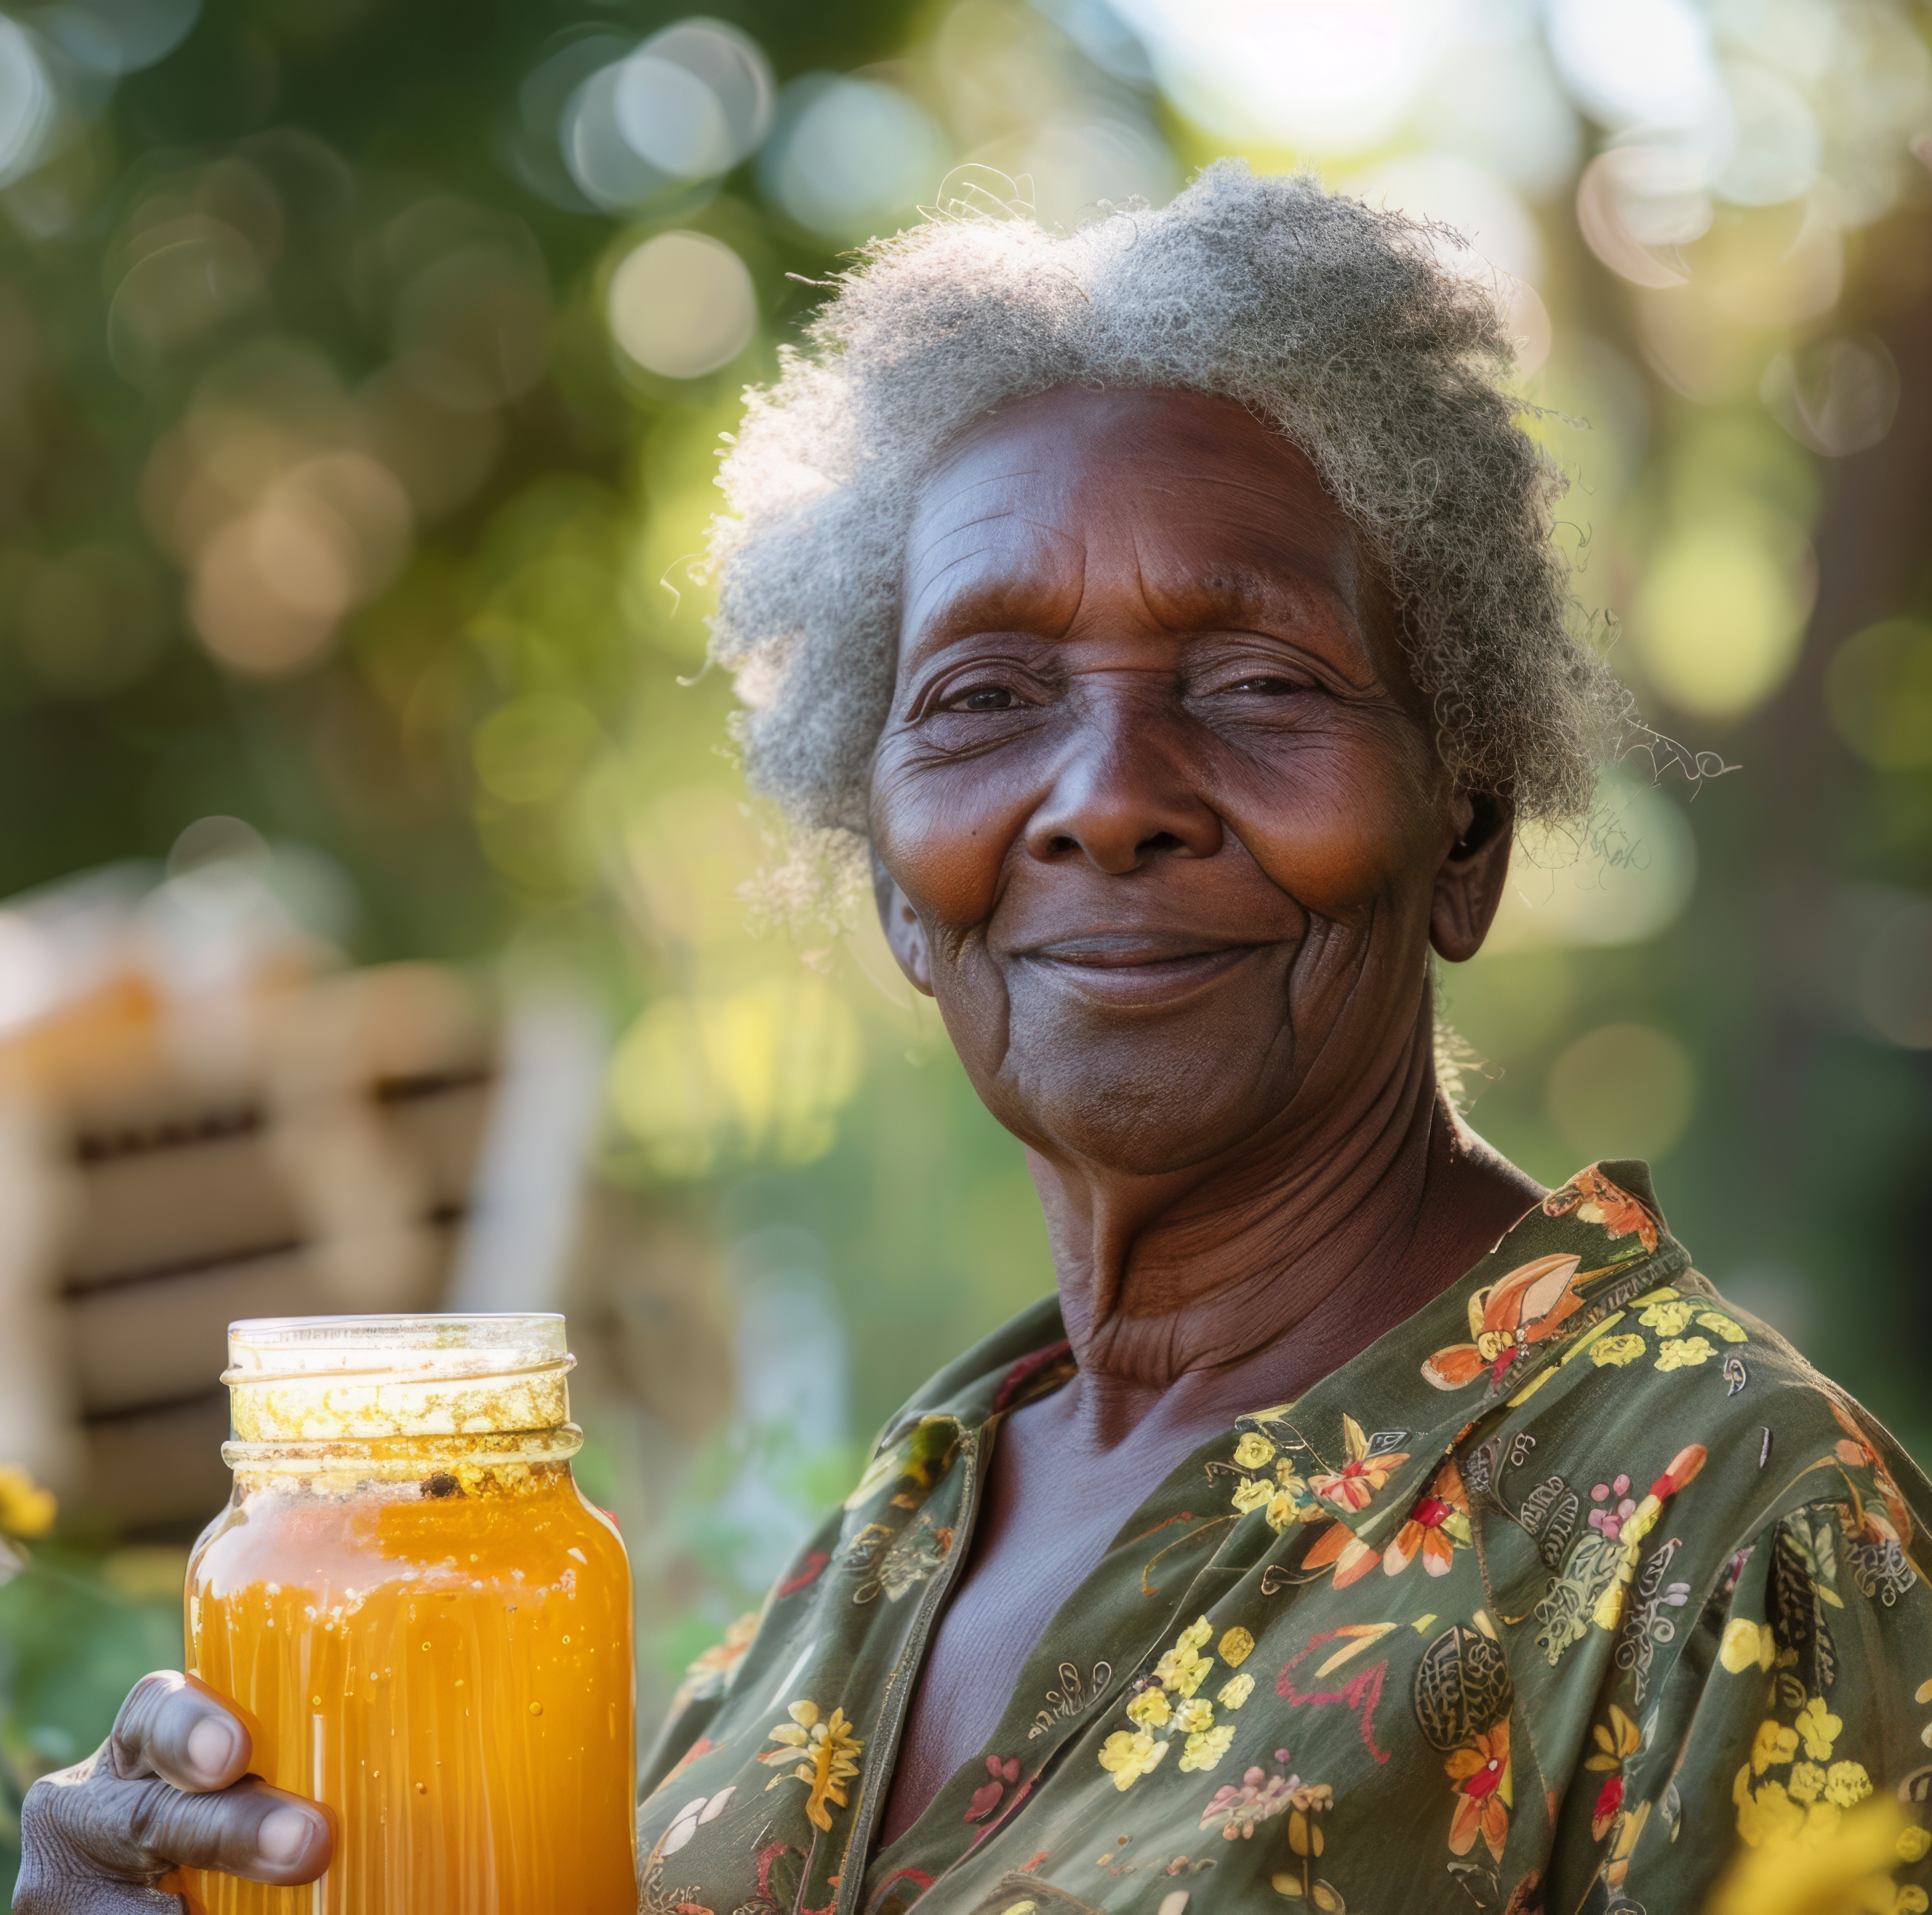






Setting oneself up for financial wellness in retirement
Work to your goals, realistic budget
Take only good debt, reduce or eliminate debt as capacity reduces
Save for emergency
Insure against life risks, and assets
Save and invest for returns. Access professional advice
Plan for the long-term, be flexible, adjust
Notes:
Savings play an important role in any economy and its role is important at different levels. In particular the Insurance and Pensions Industry pools together the long term savings from Individuals and corporates and enable economic development by deploying these funds into the capital market and infrastructure development. Since dollarization in 2009, the nation has had persistent negative savings, meaning that it is spending more than it is earning. This is in contrast to rest of the World and Sub Saharan Africa which has had positive savings as can be seen in graph below.
Confidence levels in Zimbabwe are very low – low participation levels
Contributions into most pension funds are sub-optimal
People are under saving under both DB and DC arrangements.
National savings are greatly reduced
Country investment capacity is negatively affected.
Cost of borrowing for government and corporates increases
country’s infrastructure development is impaired,
Economic growth is impaired & earnings of funds unsustainable
companies will operate in a difficulty environment and thereby making the cost of borrowing higher.
This may continuously lead to perennial and unending retrenchments.
Therefore, the Zimbabwean Pension industry may not be sustainable.

Slide 12
Alone or with others

Slide 13
Always better pooling with others..
Pension Scheme
Pooled investment funds
Investment assets
My net savings and assets
Pensions provide income replacement (or cushion) after exit from active employment
It is often suboptimal to invest alone
Pooling in pension schemes allows access to bigger diverse assets
Pooling distributes risk (longevity, disability, loss o bread winner)
Pooling can be at scheme, sector, industry or product level
IMF ‘ Engagement on Pension Issues surveillance ..Issue 4, 2022’
Notes:
Savings play an important role in any economy and its role is important at different levels. In particular the Insurance and Pensions Industry pools together the long term savings from Individuals and corporates and enable economic development by deploying these funds into the capital market and infrastructure development. Since dollarization in 2009, the nation has had persistent negative savings, meaning that it is spending more than it is earning. This is in contrast to rest of the World and Sub Saharan Africa which has had positive savings as can be seen in graph below.
Confidence levels in Zimbabwe are very low – low participation levels
Contributions into most pension funds are sub-optimal
People are under saving under both DB and DC arrangements.
National savings are greatly reduced
Country investment capacity is negatively affected.
Cost of borrowing for government and corporates increases
country’s infrastructure development is impaired,
Economic growth is impaired & earnings of funds unsustainable
companies will operate in a difficulty environment and thereby making the cost of borrowing higher.
This may continuously lead to perennial and unending retrenchments.
Therefore, the Zimbabwean Pension industry may not be sustainable.

Slide 14
Access to goods and services

Slide 15
Financial wellness and access to goods and services
Financial wellness is enhanced when:
Savings are harnessed into bigger investments that uplift quality of life
Local assets are gathered and harnessed for more efficient capital allocation
Households, communities and economies pool savings to optimize capital formation and invest in larger projects.
Greater savings support sustainable development and financial wellness in the broader sense
Notes:
Savings play an important role in any economy and its role is important at different levels. In particular the Insurance and Pensions Industry pools together the long term savings from Individuals and corporates and enable economic development by deploying these funds into the capital market and infrastructure development. Since dollarization in 2009, the nation has had persistent negative savings, meaning that it is spending more than it is earning. This is in contrast to rest of the World and Sub Saharan Africa which has had positive savings as can be seen in graph below.
Confidence levels in Zimbabwe are very low – low participation levels
Contributions into most pension funds are sub-optimal
People are under saving under both DB and DC arrangements.
National savings are greatly reduced
Country investment capacity is negatively affected.
Cost of borrowing for government and corporates increases
country’s infrastructure development is impaired,
Economic growth is impaired & earnings of funds unsustainable
companies will operate in a difficulty environment and thereby making the cost of borrowing higher.
This may continuously lead to perennial and unending retrenchments.
Therefore, the Zimbabwean Pension industry may not be sustainable.

Slide 16
Thank you
Notes:
Summarise key points from the presentation
Sustainability begins with you making a conscious effort to rebuild the economy through partcicipation of your long term savings

